Slide 1
Online Training 2023
Whakaihuwaka
PRESENTED BY ERANA RATTRAY
TE WHĀNAU TUPU NGĀTAHI O AOTEAROA
PLAYCENTRE AOTEAROA
Notes:
Erana

Slide 2
Karakia tímatanga
Tūtawa mai i runga
Tūtawa mai i raro
Tūtawa mai i roto
Tūtawa mai i waho
Kia tau ai te mauri tū
te mauri ora ki te katoa
Haumi e, hui e, taiki e
Notes:
Faith?

Slide 3
Mihimihi
Notes:
Shekinah?

Slide 4
Mihimihi a te tīma Kaihononga Māori
Kaiwhakahaere Hononga Māori - Erana Rattray
Kaihononga Māori: LNI - Faith Tupou
CNI - Jean Yern
LSI - Lisa Te Raki
UNI - Shekinah Graham
USI - Tara Bovill

Slide 5
Why promote
Te Ao Màori in Playcentre Aotearoa?
It starts with Te Tiriti O Waitangi

Slide 6
Te Tiriti O Waitangi in Education
Preamble: Introduction to Te Tiriti.
Article 1. Kāwanatanga - Honourable Governance. Shared decision-making and ensures Māori input at all phases of the process.
Article 2. Rangatiratanga - Agency. Ensures Māori autonomy of Māori related kaupapa, policies and practices. It enables Māori to determine their aspirations for tamariki/mokopuna.
Article 3. Ōritetanga - Equity. Ensures both Te Tiriti partners the rights of membership and equitable access to resources.
Article 4. Wairuatanga - the spoken promise of religious and cultural freedom. This article protects Māori customs and spiritual practices through policy and appropriate practices.
Playcentre Aotearoa has made a commitment to honour Te Tiriti o Waitangi (Through Contra proferentum and the 4 articles).
Notes:
To acknowledge the special significance of tangata whenua, tau mai te reo maori language strat from ministry, nelp

Slide 7
Màori hold special significance
as tangata whenua

Slide 9
Licensing criteria C5
Acknowledgement of Tangata Whenua
This criterion helps to ensure TWTNoA support all tamariki, To develop understanding and appreciation of the dual heritage of Aotearoa Reflecting the unique place of Māori as Tangata Whenua.
Te Tiriti o Waitangi plays a significant role in the revitalisation of the Māori language and Māori culture an important part of TWTNoA identity.
Equity in our organisation is a key priority and it is vital we evaluate how we enhance outcomes for Tamariki.

Slide 10
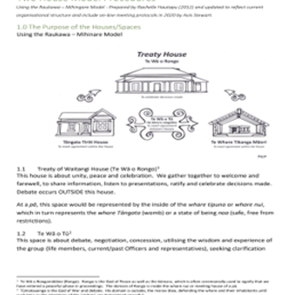
Two House Model
Our current Two-House model at Playcentre Aotearoa whereby the values of both houses guide consensus decision making.
We can further enhance this partnership by each Centre having a Bicultural Officer as one of the key 5 roles of the Centre leadership Team.

Slide 11
Celebrating our dual heritage
Our current Two-House Model at Playcentre Aotearoa whereby the values of both houses guide consensus decision making.
The values of both houses are expressed here.

Slide 12
Mahi a whakaihuwaka?
To actively promote Te Ao Māori and Te Tiriti O Waitangi within their Centre.

Slide 13
Wairua - Spirit of the role
To ensure the Centre Curriculum as a whole is welcoming and culturally appropriate.
Champion for Te Ao Māori and te Tiriti o Waitangi commitment within your Centre.
•Lead your Centre's Bicultural Curriculum
•Share what you know about Te Ao Māori and Te Reo Māori
•Encourage others to share what they know/ get involved
•Support and encourage whānau voice (passionate and enthusiastic about supporting Tangata Whenua).

Slide 14
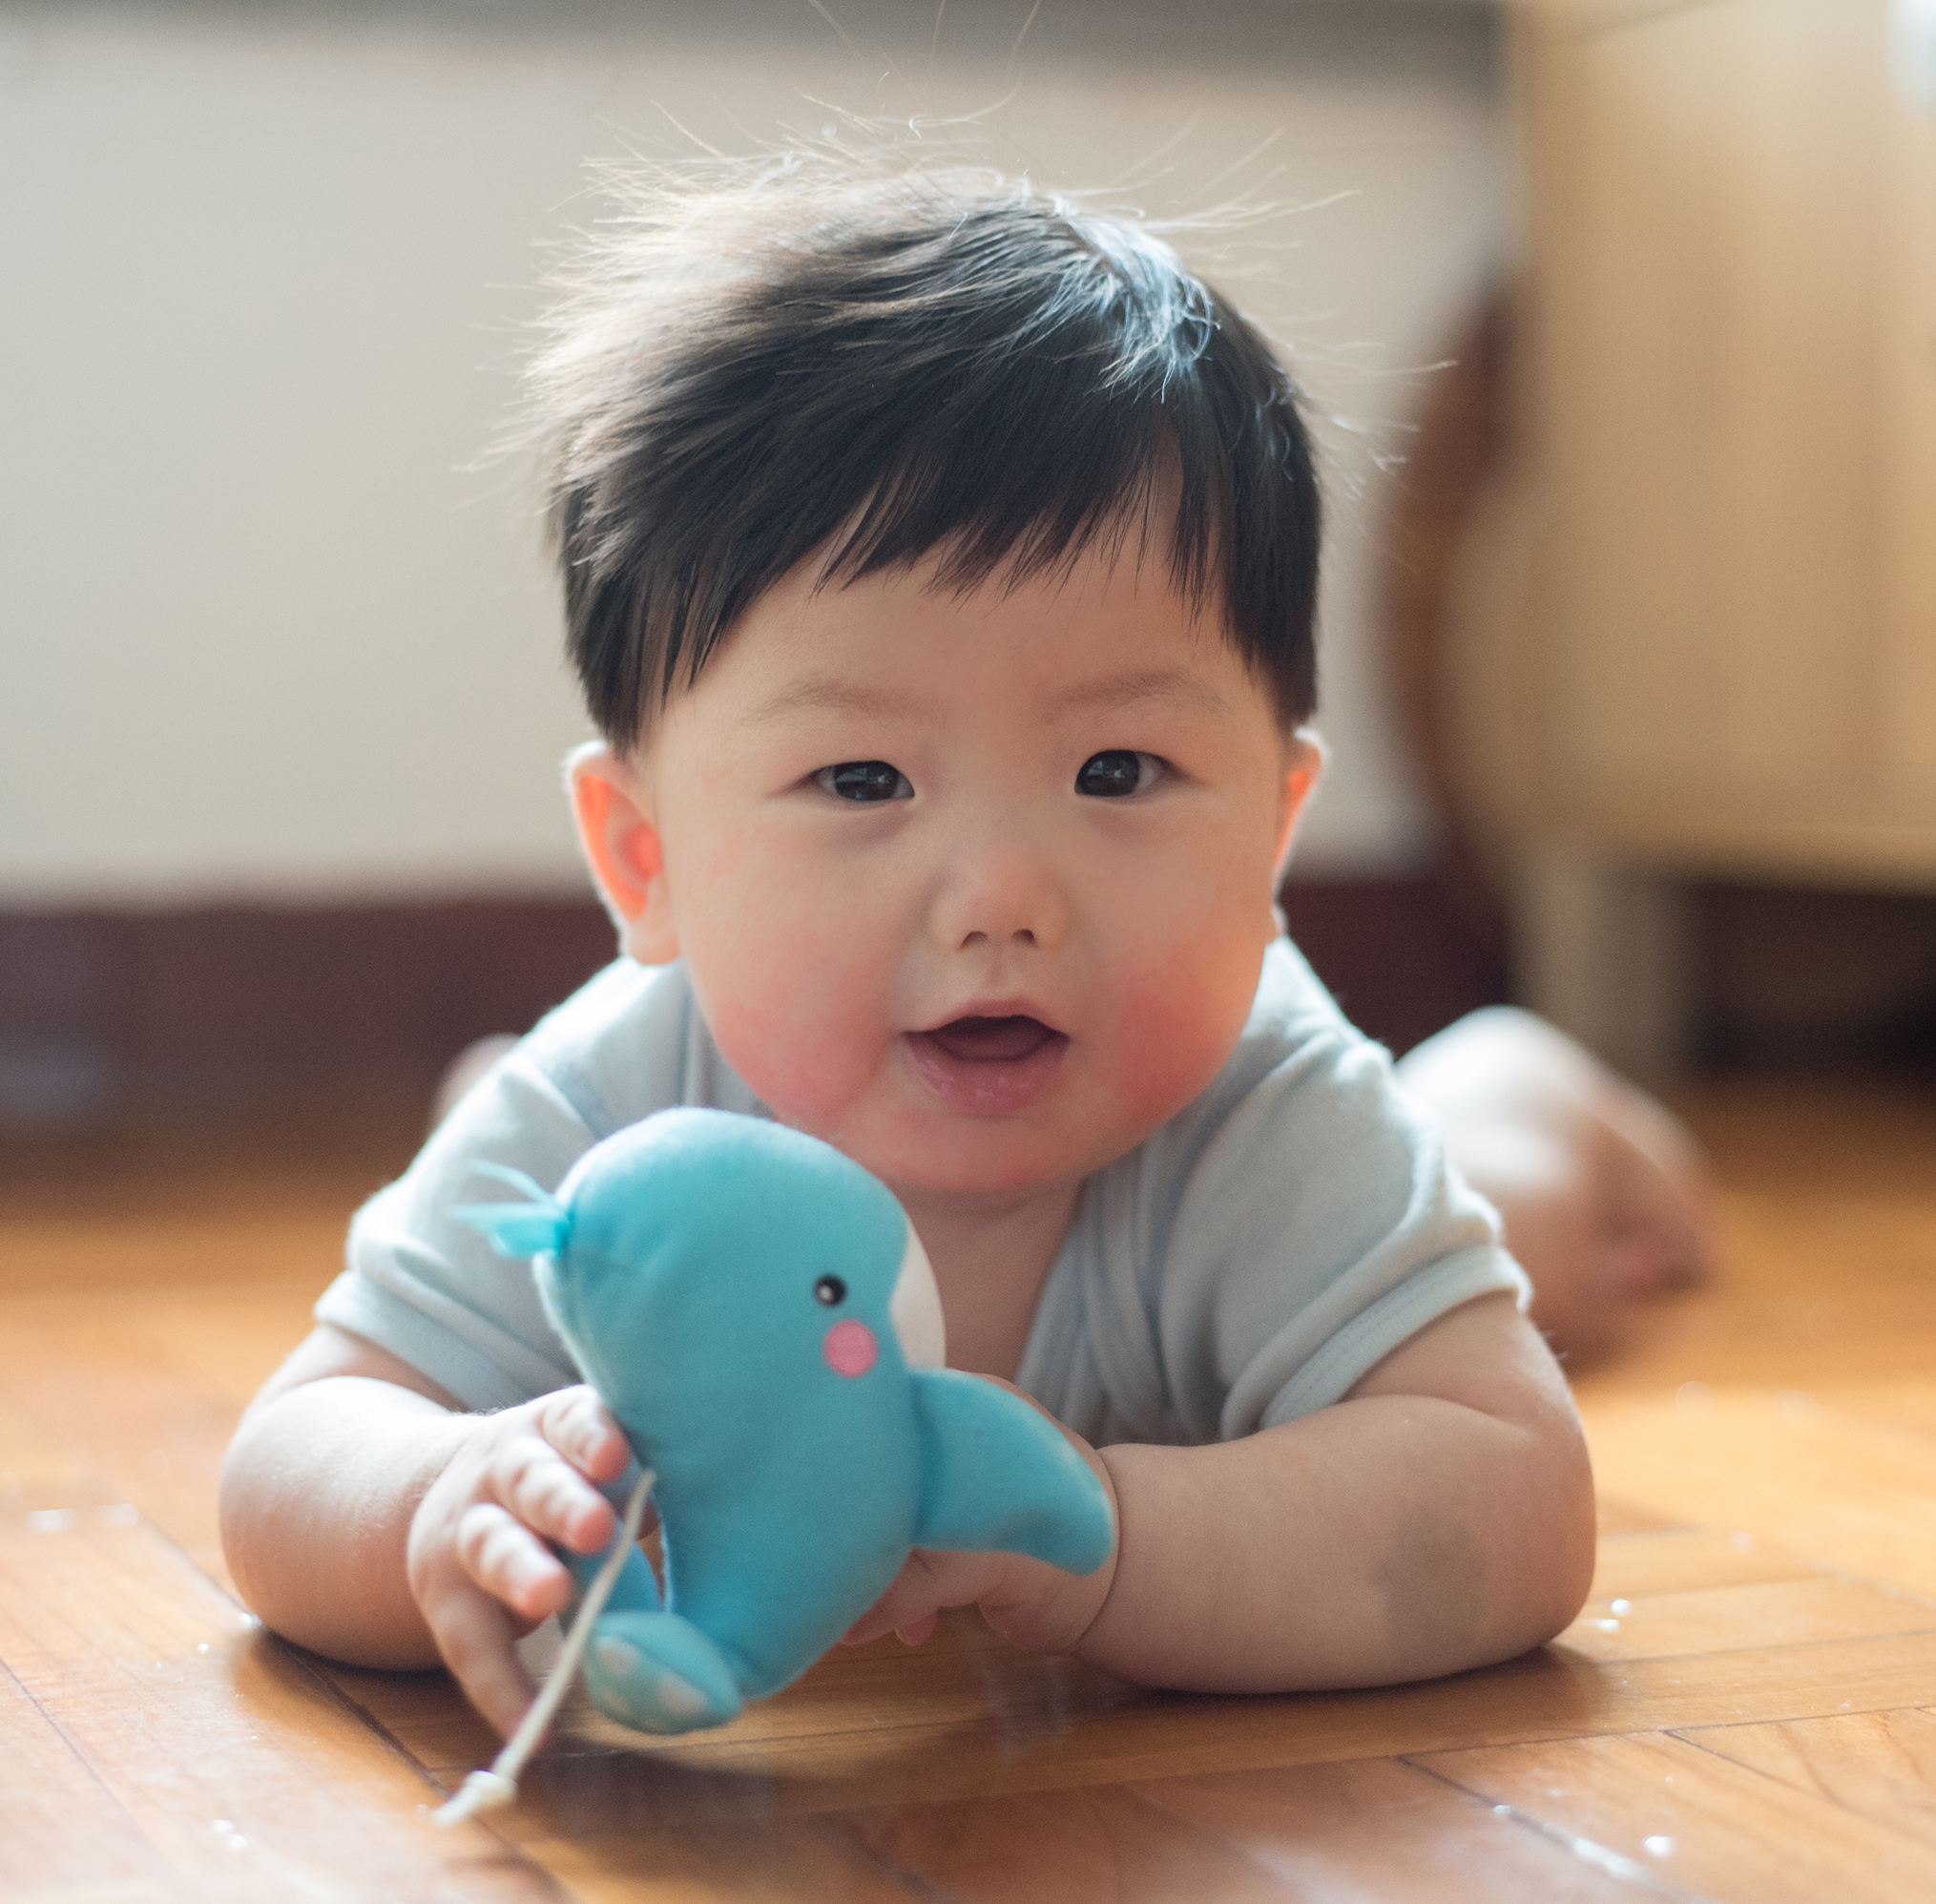
Tautoko - Support
Before we move onto different ideas for your Centre, you must know you will be well supported as part of a community promoting
Te Ao Māori and Te Reo Māori in Playcentre through;
Online wānanga once a term
Online question panel once a term
Bicultural Officer Facebook group to support each other
CAs/ Session Facilitators/ Other Centre members/ Kaihononga Māori
He waka eke noa! We are all in this (canoe) together!

Slide 15
Action Points for your Centre
Ka rawe!!! These next few slides will give you clear actions for you and your Centre to activate.
Make sure to jot down your questions at the end of the presentation we will move into regional breakout rooms and you can hui wānanga with your Kaihononga Māori from your region.

Slide 16
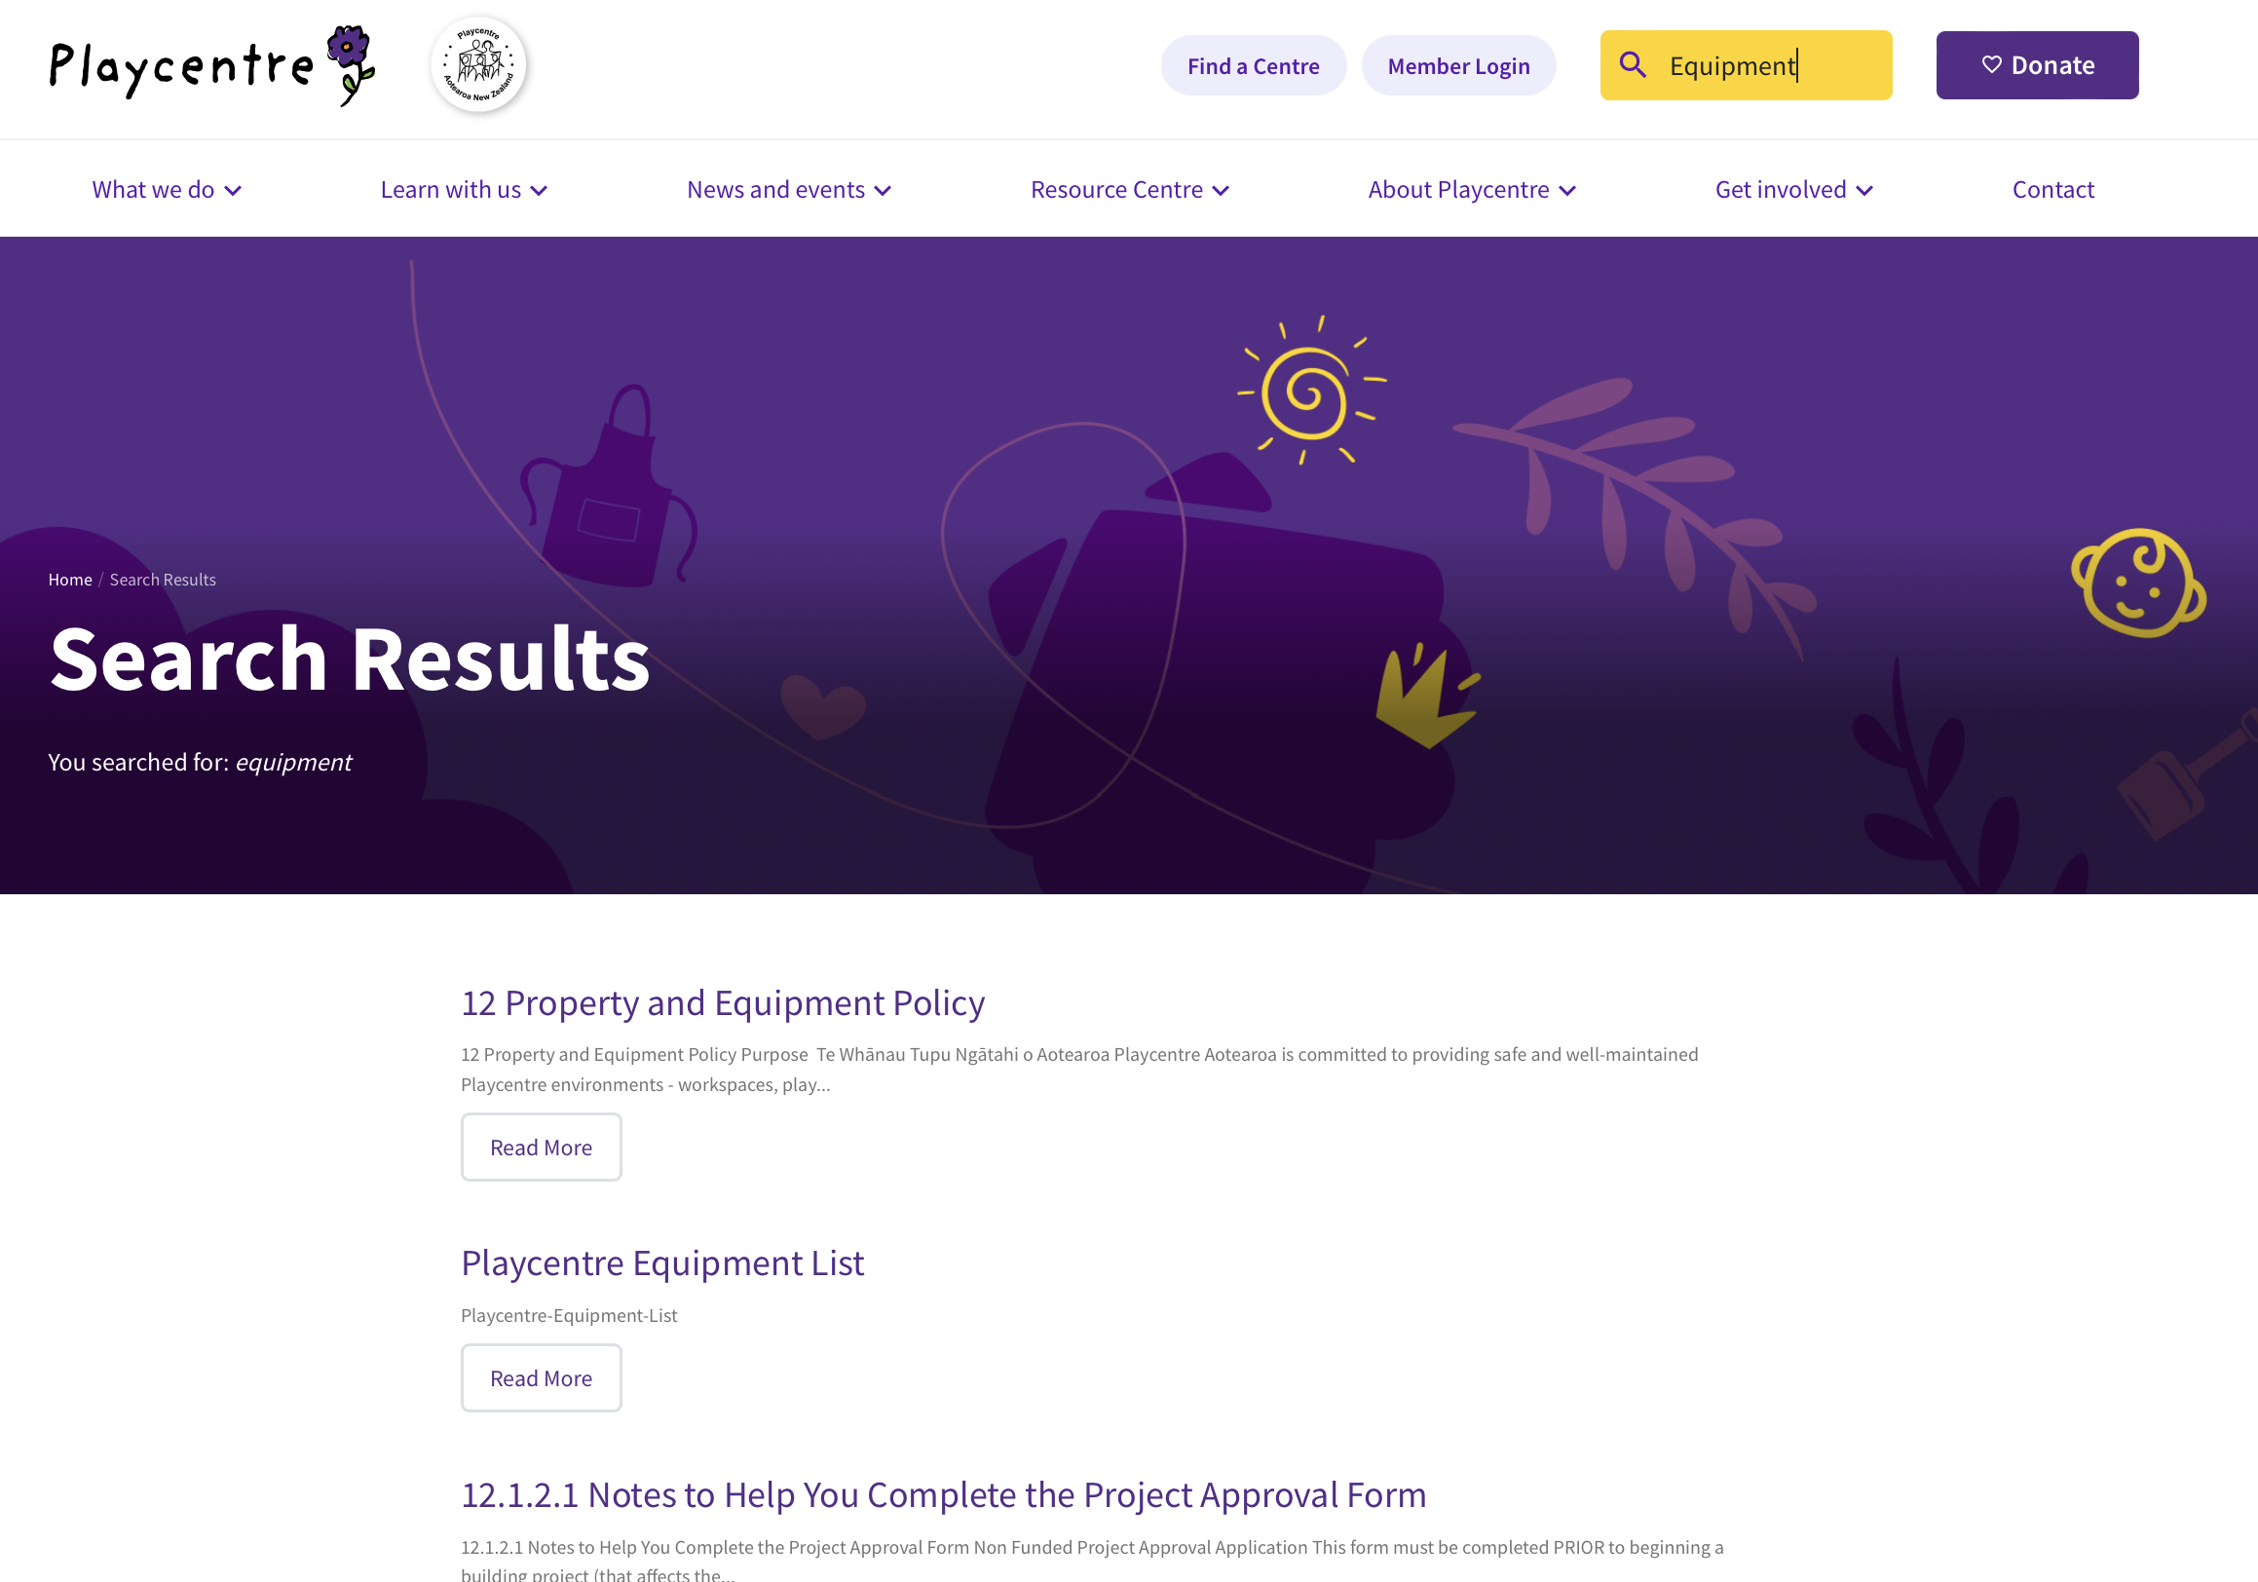
Do a stocktake!
Keyword search Equipment

Slide 17
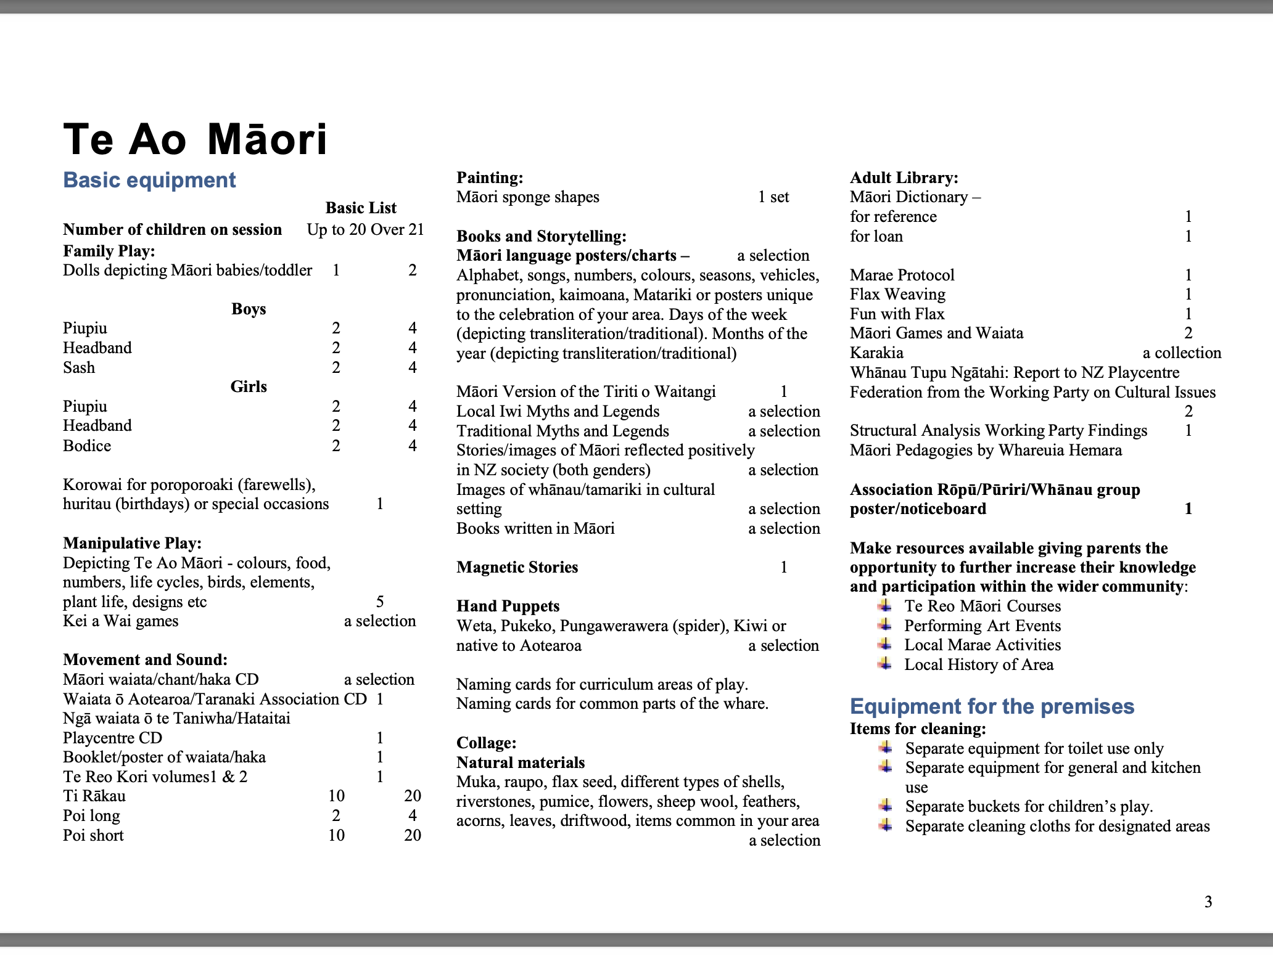
Scroll down to page 3 to find the
minimum requirement of bicultural resources for your Centre(s).

Slide 18
Read this book!
Find this book! Affectionately known as the Little Red Pukapuka.
WHĀNAU TUPU NGĀTAHI
FAMILIES GROWING TOGETHER 1990
This book contains useful examples of Tikanga and offers a pathway for best bicultural practice in your Centre.

Slide 19
Create a language strategy
Read Tau Mai Te Reo I The Māori Language in Education Strategy
Tau Mai Te Reo sets out the goals we seek to achieve and provides a framework for your Centre to use as a guide to develop their Te Reo strategy. It builds on the previous Tau Mai Te Reo Strategy published in 2013.

Slide 20
Check out this book...
KEI TUA O TE PAE ASSESSMENT FOR LEARNING: EARLY CHILDHOOD EXEMPLARS BOOK 3 2006
This book from Ministry of Education has examples of exemplar bicultural practice that you can implement in your Centre.

Slide 21
Study Te Whāriki
TE WHĀRIKI 2017 – Is full of te reo me ona tikanga Māori
Unique in its bicultural framing, Te Whāriki is the national curriculum document for early childhood education (ECE) and offers a pathway for 'local' curriculum.

Slide 22
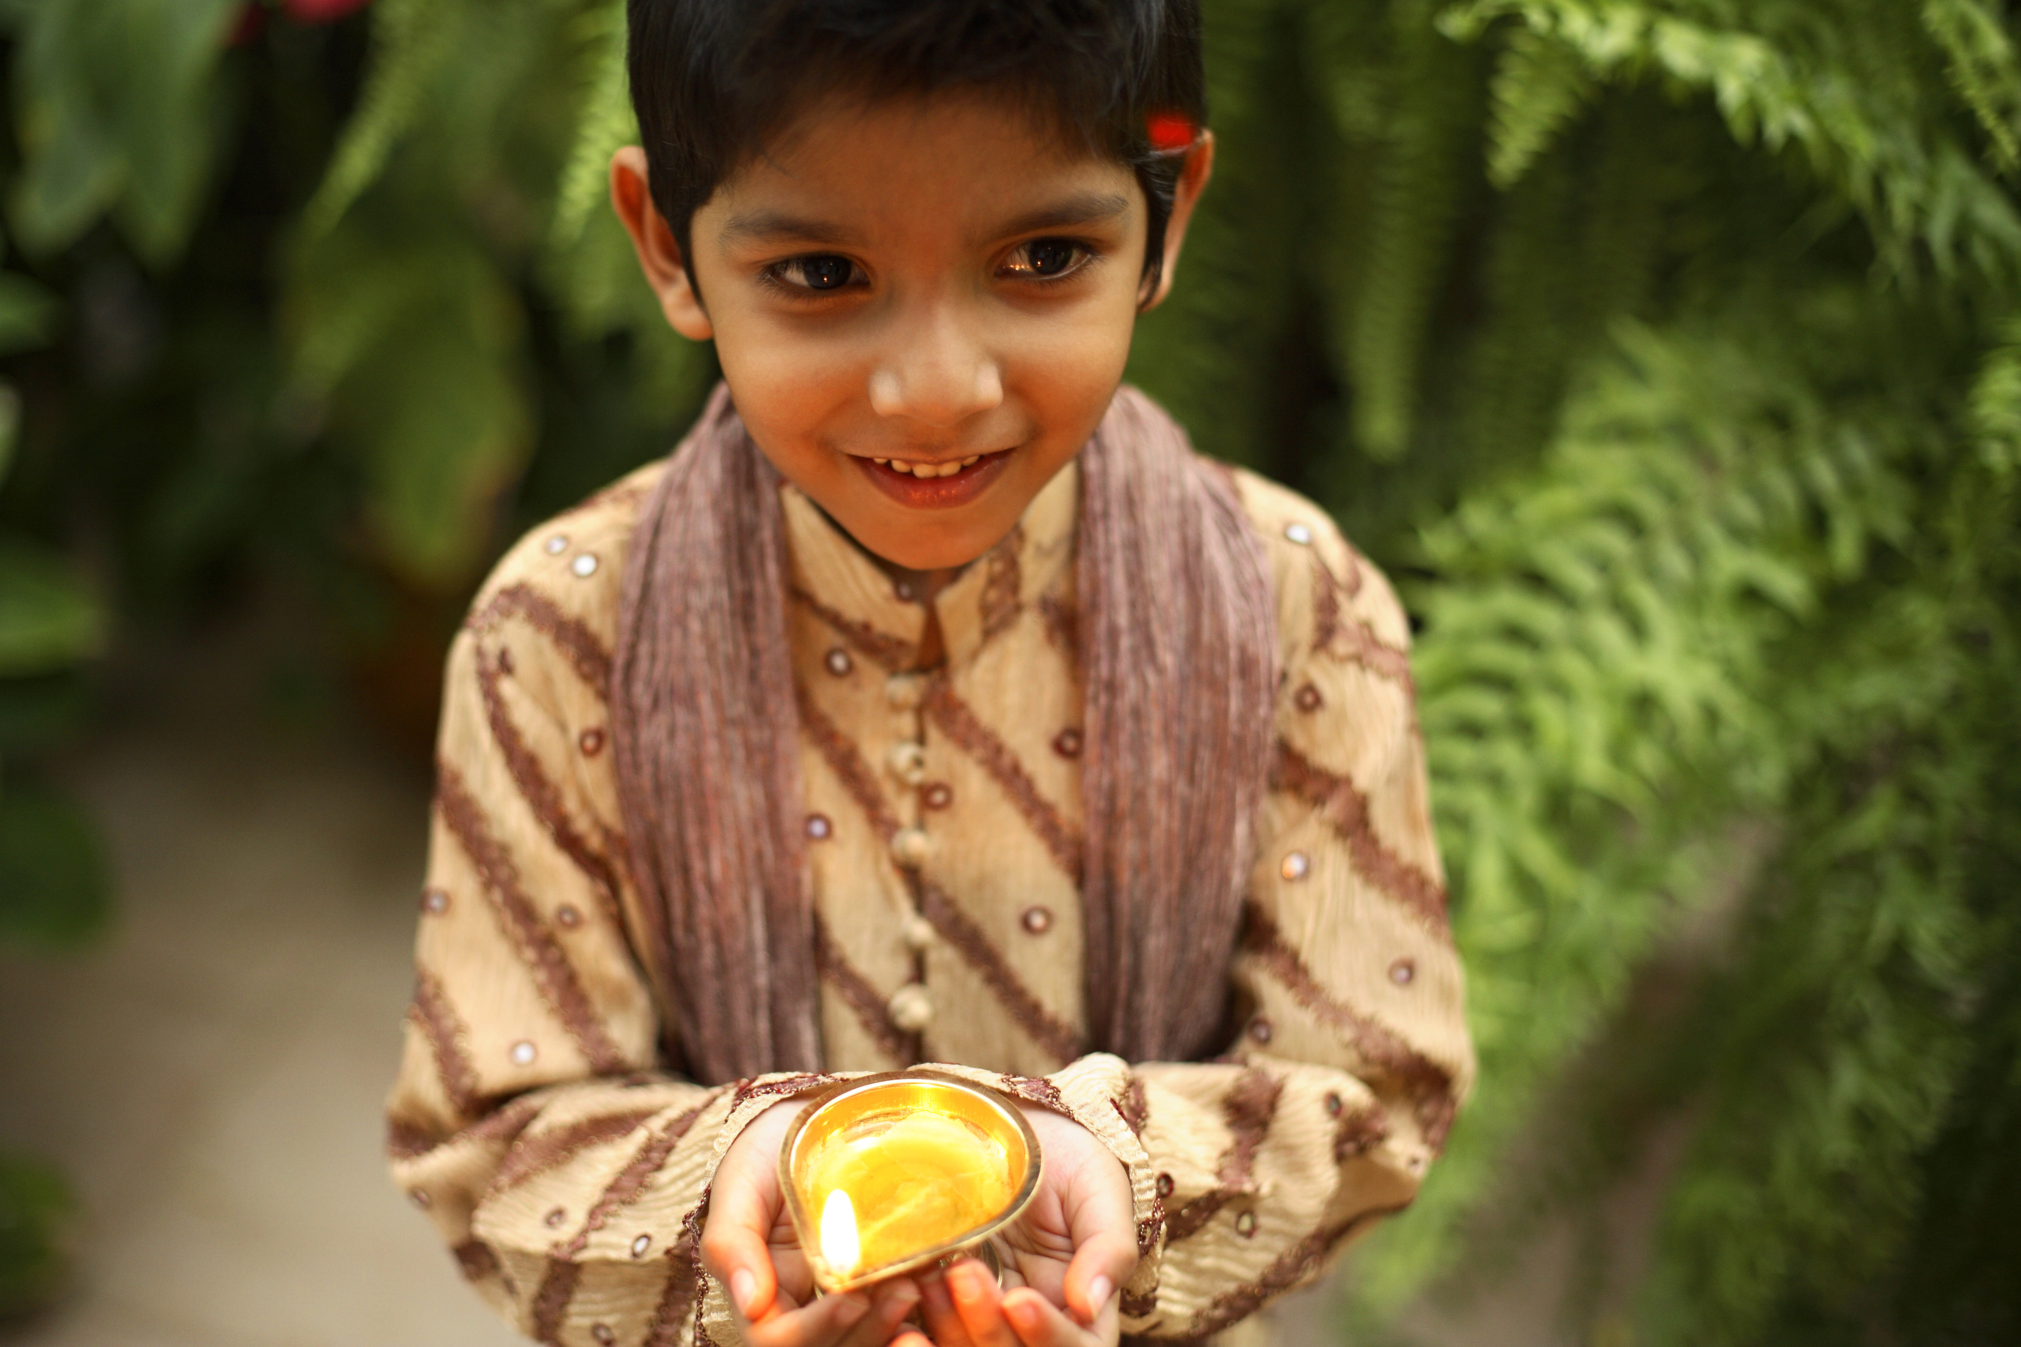
Get outdoors!
Nature excursions to the awa, ngāhere, beach, or bush are all great ways to connect with the whenua.
Collect natural resources to take back to Centre, learn the local Māori history and be refreshed by the winds of Tawhirimātea.

Slide 23
BREAKOUT ROOMS

