Slide 1
Purpose
To provide leadership for the centre & support Centre members, encouraging involvement of all and positive relationships.

Slide 2
Common tasks: 1) Maintain an overview of the centre’s functioning. 2) Facilitate and chair centre meetings 3) Offer support and guidance to Centre Office Holders 4) Be aware of policies, procedures and finances to ensure centre is meeting requirements 5) Ensure a good relationship is maintained with other Centres and Regional Hub 6) Represent the views and opinions of your Centre at Cluster Meetings 7) Encourage emergent leadership within your centre.

Slide 3
Maintain an overview of the centre’s functioning.
Be aware of the common documents that are required for the functioning of the centre:
ERO report
ECE regulations – 29th September 2018
Licensing criteria for ECE - June 2018
Centre Licence – keeping it up to date.
The Playcentre website
The monthly Playcentre Bulletin .
CSW reports.
Know the roles of the other office holders.
Join the national Aotearoa Presidents FB page. (Playcentre Aotearoa Presidents)

Slide 4
Regulations and Criteria

Slide 5
Facilitate and chair centre meetings
Best practice to hold 2 centre meetings a term.
Make sure the secretary has displayed/circulated an agenda at least a week before the meeting.
Make sure office holders have their reports ready for the meeting, ie treasurers report.’
Chairing meetings is a facilitation role and making sure everyone has a voice. You are not expected to know everything.
Use consensus decision-making as a balanced method of decision making (Making Consensus Work by Robbie Burke)
Follow the Agenda staring with Karakia, waiata, ice breaker etc.
Other meetings are AGM, planning/evaluation, internal evaluation.

Slide 6
Making Consensus work

Slide 7
Offer support and guidance to Centre Office Holders
If you have good office holders in the other key positions this will make your role a lot easier.
Your role is to make sure they are coping with their responsibilities but not to do it for them!
Your CSW/CA will be able to provide support to your office holders if they need it

Slide 8
Be aware of policies, procedures and finances to ensure centre is meeting requirements
The Playcentre website is the main resource for your policies and procedures, the ones in your policy folder will not necessarily be up to date as they were sent out as a one off, if you want to keep the folder updated you will need to print off the new policies when changes are made.
The Playcentre bulletin will inform you of any changes made to policies.
Your CSW and CA can support your with policies and procedures.

Slide 9
Ensure a good relationship is maintained with other Centres and Regional Hub
You will be the first contact for your Regional Hub.
They are there to help and support you.
You will be the main contact for the CSW and CA.
The National Service Delivery Centre (Mana st wellington) is also there to help, but try your regional office for advice first.

Slide 10
Represent the views and opinions of your Centre at Cluster Meetings
Ensure that your centre is represented at the termly cluster meeting, either by yourself or another delegated member.
Cluster meetings is a great way to network with other centres in your area, plan events together ie Open Week in March 2020
From the cluster meetings a reprehensive is chosen to attend the national meetings and they will take your centres/clusters voice to decision making meetings.

Slide 11
Internal Evaluation
This is something that is a requirement for each centre to do, and will need to be provided for ERO
Your CSW can support you with this.
Indepth evaluation at least one a year.
Good practice to use one of your Annual Plan items as an internal evaluation.
Spontaneous evaluation – shorter and quicker, good to have a number of these each year between your indepth evaluation.

Slide 12
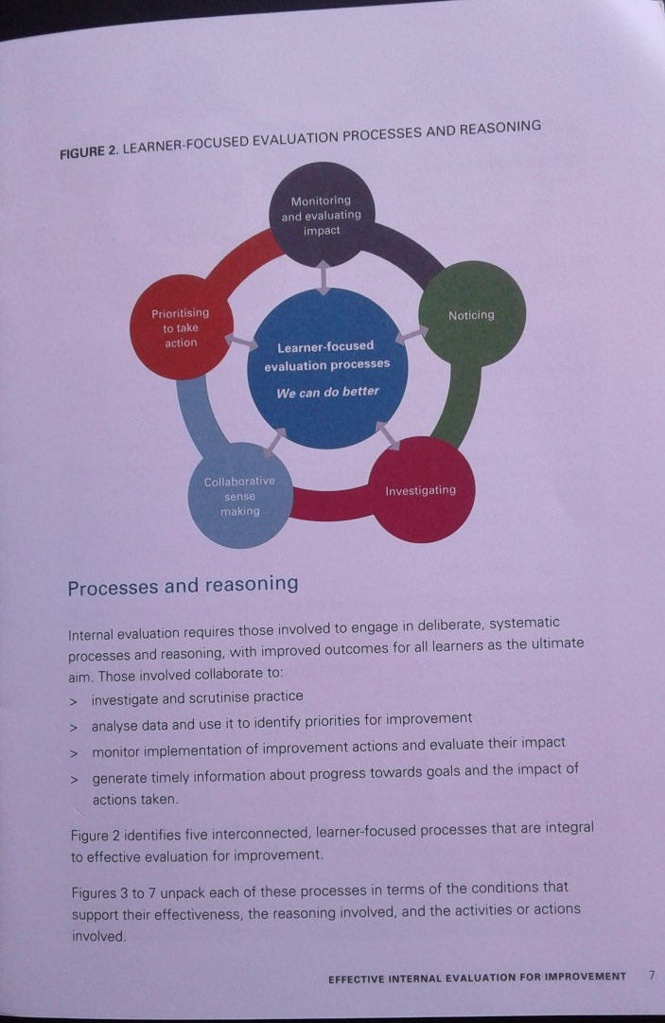

Slide 13
ERO (Education Review Office)
Check your last ERO report, what were the recommendations, are you working on these?
When was your last visit from ERO – they usually visit approx. every 3 years.
Working with your CSW to fill in the paper work.

Slide 14
Annual and Strategic Plans
Your responsibility for overseeing these each year, usually before the AGM so they can be presented at the AGM
Strategic Plan is the bigger picture of what needs to be done in the next 3-4yrs
Annual plan is taking 4-5 items from the Strategic plan and looking at them more indepth over the next year, need to have Who, what and when, budget.
Reviewing your annual plan at each monthly meeting to keep you on track.
It is good practice to have one of the items from your Annual Plan as your in-depth internal evaluation topic.

Slide 15
Employment:
If you have Session support workers/facilitators then their main contact with the centre will be the president. Make sure you keep good communication with them, your CSW will support you.
Playcentre Aotearoa is the employer.
Cleaners, grounds people etc are strongly enouraged to be contracted companies. If you want to employ a centre person you will apply for a contract of services contract to be drawn up through your CSC.
You may be required to run appraisals for cleaners and ground people that are not company based.

