Slide 1
President and Coordinator Training
Meetings

Slide 2
Facilitate and chair centre meetings
Best practice to hold 2 centre meetings a term (or one a month)
Make sure the secretary has displayed/circulated an agenda at least a week before the meeting.
Make sure office holders have their reports ready for the meeting, ie treasurers report.
Chairing meetings is a facilitation role and making sure everyone has a voice. You are not expected to know everything.
Use consensus decision-making as a balanced method of decision making (Making Consensus Work by Robbie Burke)
Follow the Agenda staring with Karakia, waiata, ice breaker etc.
Make sure minutes are circulated after the meeting.
Other meetings are AGM, planning/evaluation, internal evaluation.
Text normal

Slide 3
General Business Meeting Date/Time: Present: Apologies: Opening Karakia: Ice Breaker: Approval of previous minutes – approved by: Second By: Matters arising from previous meeting: Reports: (not all roles will have a monthly report) President: Treasure: (must provide a monthly report) Moved by: Second By Secretary: (incoming/outgoing correspondence) Enrolments: Health and Safety: Property: Equipment: Fundraising: (Any other role reports) Internal Evaluation Topic (What are we working on, what stage are we up to, who needs to do what?) New General Business: Set date for next meeting Closing Karakia Meeting closed: (Time) :
Text normal

Slide 4
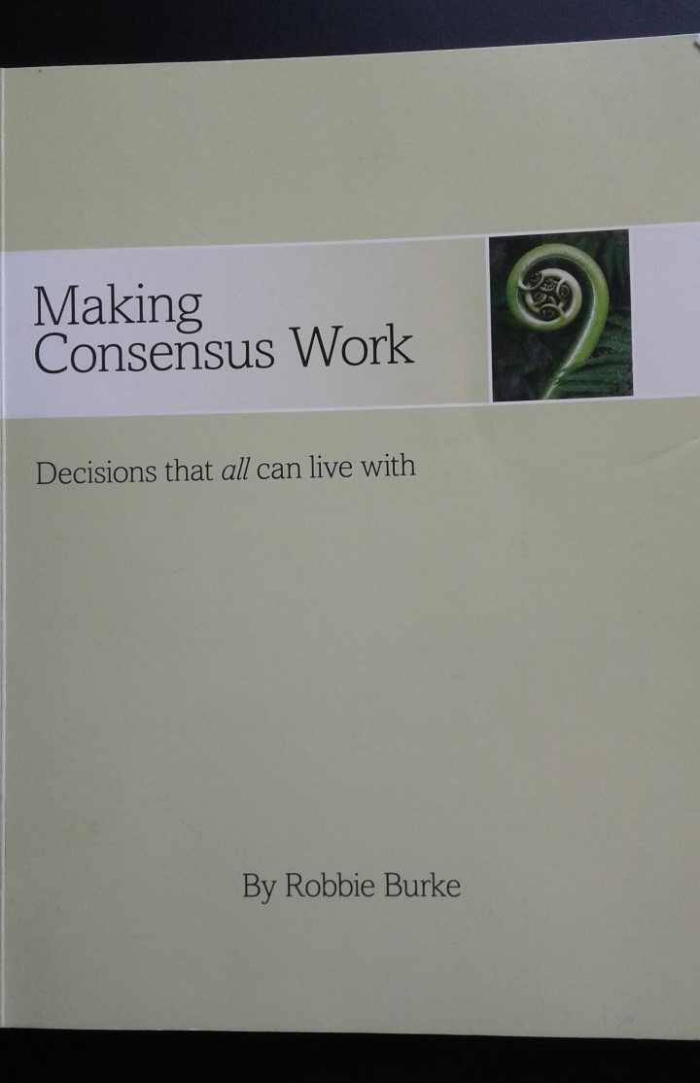
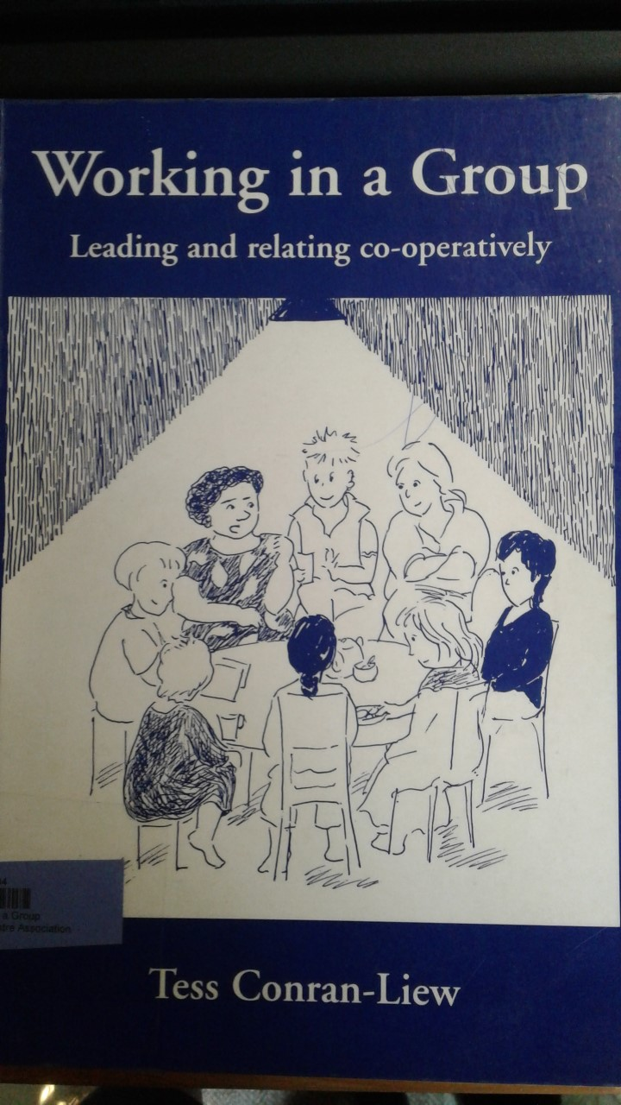
Resources:
Text normal

Slide 5
Links to Website Waitata and karakia https://www.playcentre.org.nz/current-members/rauemi-resources/

