Slide 1
Centre President, Coordinator and Secretary
Kat Lester and Stephanie Jackson
November 2023

Slide 2
Karakia Timatanga
Tūtawa mai i runga
Tūtawa mai i raro
Tūtawa mai i roto
Tūtawa mai i waho
Kia tau ai
Te mauri tū
Te mauri ora
Ki te katoa
Haumi ē, hui ē, tāiki ē!
Come forth from above, below, within and from
The environment
Vitality and wellbeing for all
Strengthened in unity!

Slide 3
President/Coordinator role
To provide leadership for the centre & support centre members, encouraging involvement of all and positive relationships.
Key tasks include:
Maintain an overview of the centre’s functioning.
Offer support and guidance to centre office holders.
Be aware of policies, procedures and finances to ensure centre is meeting requirements.
Maintain a good relationship with other centres.
Represent the views and opinions of your centre at cluster meetings.
Encourage emergent leadership within your centre.
Facilitate and chair centre meetings.
Whiria te tāngata - weave people together

Slide 4
Maintain an overview of the centre’s functioning
Key people and documents:
The Playcentre website – the first place to look for information. You will need to register (open to everyone) and log-in. (Hint: if you can’t find what you are looking for on the website try Googling “Playcentre” and your search term.)
The Playcentre Bulletin – updates and other useful information. At least one centre member should read the bulletin in depth and ensure office holders have seen any relevant information.
Centre Advisor – your first point of contact for questions or issues.
Regional Funding Admin – your contact for enrolments, funding and Discover.
Regional Support Lead – if your Centre Advisor is unavailable or you need additional assistance.
Your centre’s office holders – know who holds each role and what their main responsibilities are.
Centre employees – you are their key contact at the centre.
The national Aotearoa Presidents Facebook page (Playcentre Aotearoa Presidents).

Slide 5
Supporting office holders
Be aware of the main responsibilities of each office holder’s role, who holds each role at your centre and ensure their key tasks are being completed.
Your role is to support them but not to do the role for them! Encourage them to attend the training workshop relevant to their role. Your Centre Advisor can offer support or training to any office holder.
Encourage emergent leadership as you get closer to the AGM.
Office holder responsibilities: https://www.playcentre.org.nz/learnwithus/role-descriptions/

Slide 6
Strategic and annual planning and evaluation
Ensure your centre has an annual and strategic plan and is engaging in internal evaluation.
Strategic plan: an overarching long-term plan defining a centre’s vision and goals for improvement for the upcoming years.
Annual plan: a plan identifying 'who', 'what', and 'when' in relation to key tasks undertaken each year (a licensing requirement).
Internal evaluation: Intentionally reviewing an area of our Playcentre practice to improve for our tamariki. Can be emergent (spontaneous self review, 2-3 per term) or strategic (in depth review over several terms, 1-2 per year).
Centre ERO report: read as part of developing your strategic plan and strategic evaluation topic, what recommendations were made?
Strategic planning: https://www.playcentre.org.nz/resource-centre/strategic-planning/
Annual planning: https://www.playcentre.org.nz/resource/playcentre-annual-plan-overview-2022/
Internal evaluation: https://www.playcentre.org.nz/learnwithus/internal-evaluation/
ERO reports: https://ero.govt.nz/review-reports
Your Centre Advisor can help with strategic and annual planning and internal evaluation.

Slide 7
Playcentre Governance
Have an understanding of the two house model of Playcentre and how centres and whānau contribute to the leadership of Playcentre nationally by feeding back through their regional representatives or rōpū Māori.
Engage in Playcentre governance on your centre’s behalf and represent your centre at cluster meetings.
Maintain relationships with neighbouring centres and share ideas and resources.
Your Centre Advisor can connect you with your regional representatives for more information.
National Playcentre governance: https://www.playcentre.org.nz/member/governance/regional-national-governance/

Slide 8
Secretary role
To organise and promote centre meetings.
Key tasks include:
Alongside the president/co-ordinator, ensure centre meetings happen on a regular basis (ideally once a month, minimum 1 per term).
Prepare the centre meeting agenda and ensure that it is distributed at least one week in advance.
Distribute the minutes in a timely fashion.
Maintain an overview of centre communications (at some centres this may be managed by the president or a separate communications role).

Slide 9
Centre meetings
Ensure centre meetings happen on a regular basis (ideally once a month, minimum 1 per term), that the agenda is distributed at least one week in advance, the minutes are shared in a timely fashion and quorum is met.
Alongside general business each meeting should include: a financial report (profit/loss for each month); reviewing centre’s strategic and annual plans; reviewing the centre hazard register; reviewing the centre accident register.
Chairing centre meetings:
Chairing meetings is a facilitation role, ensure everyone has a voice. You are not expected to know everything.
Start with a karakia, waiata and ice breaker.
Use consensus decision-making as a balanced method of decision making (see Making Consensus Work by Robbie Burke).
Make sure minutes are circulated after the meeting.
Other meetings your centre might have include the AGM, planning and evaluation meetings, internal evaluation meetings.
Your Centre Advisor can help with facilitating centre meetings and centre meeting best practice.

Slide 10
Playcentre communications
May be managed by the secretary, a communications/email role, or the president/coordinator depending on the centre.
Centre should be using centre@playcentre.org.nz as their main e-mail address.
Check the centre e-mail on a regular basis.
Liaise with other office holders to ensure e-mails are seen by the relevant office holder.
Read the Playcentre Bulletin and translate any key information to members (centre newsletter, Facebook or messenger post etc).
Ensure all members are included in centre communications (Facebook pages, e-mail etc).
Read the Communications and Media and Privacy and Information Management policies:
https://www.playcentre.org.nz/policiesandprocedures/categories/operating-successfully/
Centre communication channels should be used for centre business only (not personal communications).
Personal information should be stored confidentially and used for centre business only.
Manage storage of centre’s digital files (should all be stored on centre’s OneDrive, attached to their centre e-mail account).

Slide 11
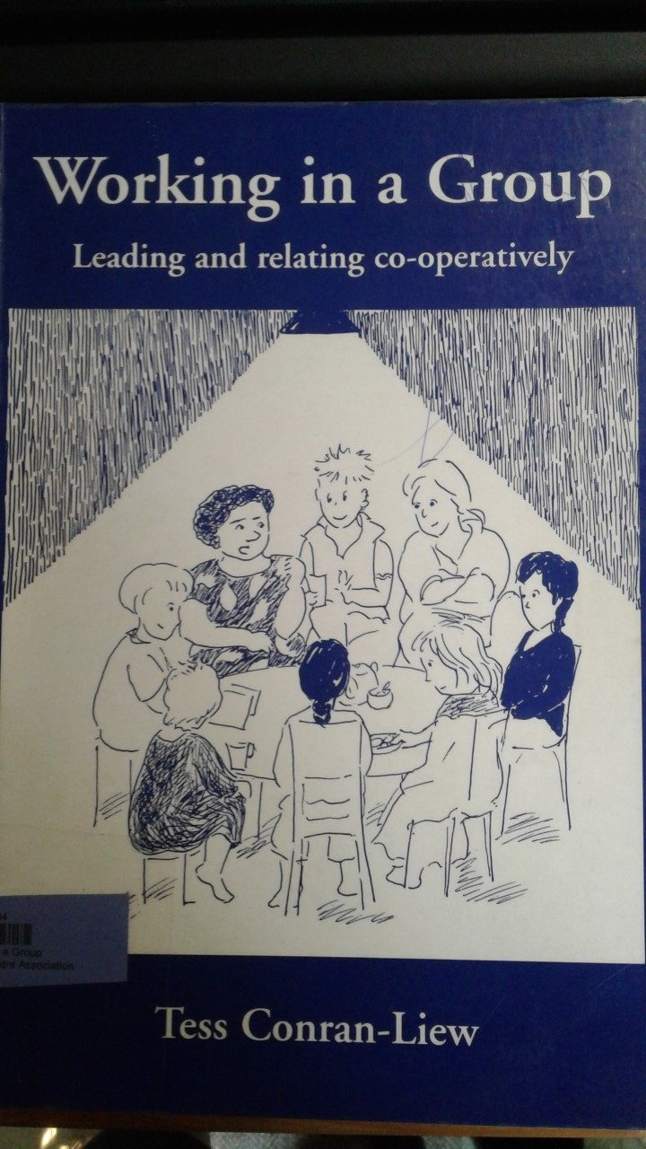
Useful links and resources
Playcentre website registration: https://www.playcentre.org.nz/member/
Playcentre Bulletin sign up: https://www.playcentre.org.nz/news-and-events/playcentre-bulletin-newsletters/
Office holder role descriptions: https://www.playcentre.org.nz/learnwithus/role-descriptions/
Regional team contact details: https://www.playcentre.org.nz/about/about-playcentre/regional-team/
Playcentre Aotearoa Presidents Facebook page: https://www.facebook.com/groups/306844539699486 Centre meeting resources: https://www.playcentre.org.nz/centre-business-meetings/
Karakia and waiata: https://www.playcentre.org.nz/current-members/te-ao-maori-resources-and-events/
Playcentre polices and procedures: https://www.playcentre.org.nz/policiesandprocedures/
Books:
Making Consensus Work, Robbie Burke
Working in a Group, Tess Conran-Liew.
These are both Playcentre publications. Your centre should have a copy in its adult library,
or ask your Centre Advisor.

Slide 12
Closing Karakia
Koia kei runga
Koia kei raro
Koia kei waho
Koia kei roto
Ko te mauri ako
Ko te mauri ora
Kua tau, kua tau, kua tau e!
That which exists above
That which exists below
That which exists externally
That which exists internally
It is the essence of our learning
And teaching
It is the essence of our physical existence
Let it be at rest for now, let it be, let it be!

