Slide 1


Kaiwhakaihuwaka
Health and Safety Induction Training

Slide 2


Kaiwhakaihuwaka Role:
Purpose:
To support the Centre to maintain a safe and healthy environment for all members, tamariki, whānau and visitors.

Slide 3

Common Tasks:
Be the point of contact for any Health and Safety issues raised. These can then be escalated to the Centre Advisor for support/advice.
Ensure the Centre follows Playcentre Aotearoa’s Health and Safety policies and procedures.
Encourage and promote a positive safety culture at the centre.
Report any Incidents or hazards in the Register .
All high risk incidents to be reported to the Centre Advisor (this includes both Adult & Child incidents).
Review Hazard & Risk Register regularly and discuss with members actions to minimise risk of harm.
Ensure emergency procedures are followed and documented (e.g. fire and earthquake drills).
Maintain Civil Defence and First Aid Kits (incl. Quick Get Away kit).

Slide 4
Managing Hazards & Risks
Display the Hazard & Risk Register in a prominent position near the sign-in tablet
Review the Hazard & Risk Register at least once per term
  add any new hazards
  remove all hazards that have been resolved
  follow-up on temporary hazards that haven’t been resolved
  Have all members sight and sign the updated Hazard and Risk Register each term
Ensure each session is completing the Sessional Health & Safety Check
Notes:
All visitors to your Centre should have the Hazard Register pointed out to them, in particular any major hazards should be explained. Therefore, it would be best if this is on the wall next to your sign-in area. Visitors do not need to sign the register unless they are a contractor on site regularly or for an extended period.
Hazard register does not need to include temporary hazards (e.g. broken tree branch) as these should be resolved as soon as possible – if unable to resolve then these hazards quickly then they should then be included in the Register and removed once resolved.
You do not need to wait for the end of term to update the register. Once a hazard has been resolved, remove it from the register, then print a new updated register with that thing removed for the next term.
Keep copies or photos or summaries of all hazards identified by the Daily Hazard Checklist for at least once term. Make sure hazards identified go into the H&S GBM report, and onto the Hazard Register as necessary. If a hazard was identified in the Daily Hazard Checklist walk around, and immediately eliminated, then it does not need to go on the register.
Put this task on the Centre’s Annual Management Plan as a reminder.
Hopefully, this will eventually be on Discover.

Slide 5
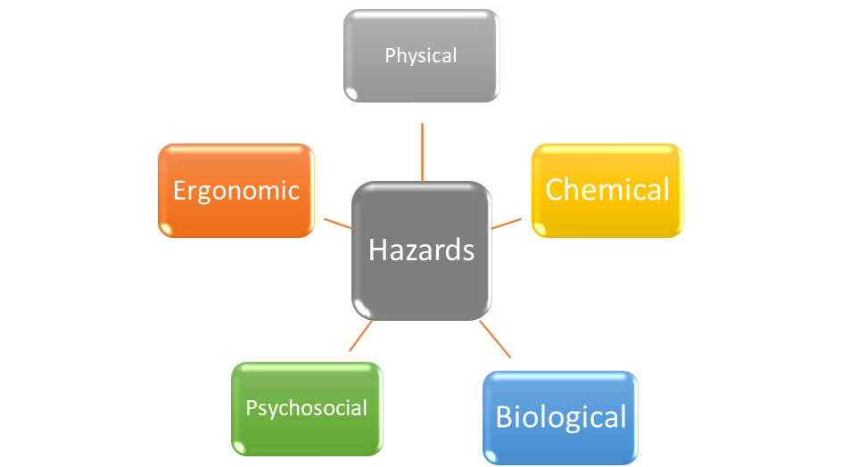
What is a Hazard?
S
A hazard can be defined as; a situation or thing that has the potential to cause harm and can include the following broad categories:
Notes:
Hazard Categories: Some examples –
Physical – includes environmental factors (e.g. uneven or slippery surfaces, vehicles), Violence and Aggression
Psychosocial – workplace stressors (workload, Fatigue, Alleged harassment/bullying, Aggression, Mental Wellbeing)
Chemical – hazardous substances
Ergonomic – Manual handling (children or equipment, workstation set up)
Biological – Communicable diseases, pathogens (Blood borne or Respiratory)

Slide 6
What is a Health & Safety Risk?
It is the likelihood and extent of harmful consequences arising from a Hazard
Likelihood:
‘How likely that an injury or illness will occur’
Consider the task/activity and by whom, how often and how long exposure to the hazard
Current risk controls in place
Previous events that happened at Playcentre or elsewhere
Consequence:
‘What harm the hazard could cause’
Injuries or ill health
Who might be exposed to the hazard (centre members, children, multiple people)
Notes:
’

Slide 7
‘Likelihood’ Table:
‘Consequence’ Table:
Descriptor | Detail
Almost Certain | The event is expected to occur in most circumstances. Circumstances are in train that will almost certainly cause it to happen. The event is expected to occur within the next 6 months. Probability >85%
Likely | The event will probably occur in most circumstances Circumstances are such that its likely to happen within 6-12 months Probability > 56%-85%
Possible | The event could occur in some circumstances Is considered to have a reasonable likelihood of occurring within the next 1-3 years. Probability 25% -55%
Unlikely | The event is not expected to occur Is considered to have limited likelihood of occurring within the next 3-5 years. Probability 5%-25%
Rare | The event is only expected to occur in exceptional circumstances Not expected to occur within 5 years. Probability <5%
Descriptor | Detail
Severe | 1 or more fatalities (deaths)
Significant | Severe injuries/illness resulting in permanent disability Hospitalisation for more than 48 hours Significant duration lost time injury ( > 3 months) (Notifiable injury/illness/event under HSW Act 2015)
Moderate | Lost time injury/illness Impacts of injury lasting < 3 months including restricted duties or time off work Hospitalisation for < 48 hours (Not a notifiable injury/illness under HSW Act 2015)
Minor | Medical treatment injury only Minor injuries with no lasting effects
Minimal | Discomfort or First aid treatment only
Notes:
The Consequence and Likelihood tables are found in the ‘Risk Management Framework’ and ‘Risk Register Template add links

Slide 8
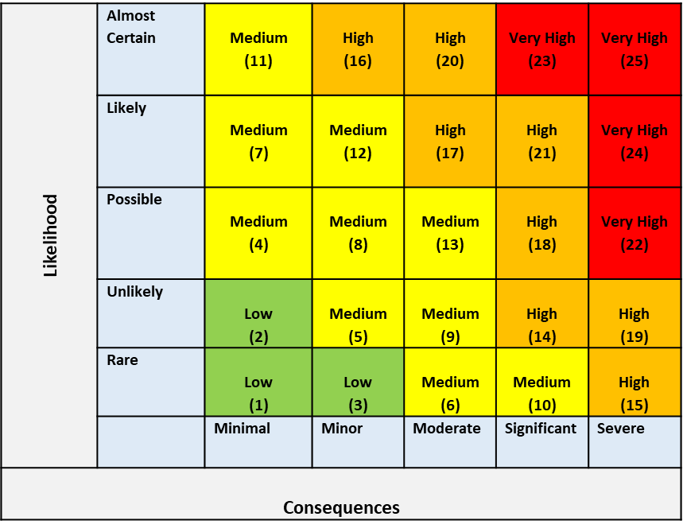
Risk Matrix
A Risk Matrix is used to determine the severity of the risk, to prioritise its management
Notes:
To determine the level of risk – plot the ‘consequence’ and ‘likelihood’ on the risk matrix table. Use the previous slide for consequence and likelihood descriptions.
By allocating a risk rating, we can assess what risks need to be managed first and prioritise resources to ensure effective controls are put in place to eliminate or minimise the risk of harm
High risk Hazards should always be escalated and prioritised first – These should be reported to the Centre Advisor as soon as possible.

Slide 9
Risk Controls
ACTION |  | WHAT IS THIS? | EXAMPLE
Eliminating |  | Removing the sources of harm (eg equipment, substances or work processes). | Removing a trip risk or getting faulty equipment repaired. Removing and repairing faulty equipment
Minimising | Substituting | Substituting (wholly or partly) the hazard giving rise to the risk with something that gives rise to a lesser risk (eg using a less hazardous thing, substance or work practice). | Using hypoallergenic and/or alternative PPE (gloves) Using non-toxic cleaning agent instead of a toxic one.
 | Isolating/ preventing contact | Isolating the hazard giving rise to the risk to prevent any person coming into contact with it (eg by separating people from the hazard/preventing people being exposed to it). Isolation focuses on boxing in the hazard or boxing in people to keep them away from the hazard. | putting up safety barriers/gates Storing cleaning chemicals in locked cupboards
 | Using engineering control measures | Using physical control measures including mechanical devices or processes. | Use of trolleys for carrying/transferring heavy/awkward items. Ventilation to assist in removing airborne contaminants Ergonomic equipment (workstation) Gate locking devices
Minimising | Using administrative control measures | Using safe methods of work, processes or procedures designed to minimise risk. It does not include an engineering control measure, or the wearing or use of personal protective equipment. | Employment Inductions Education & Training Taking adequate rests and breaks Safety Checklists
 | Using personal protective equipment (PPE) | Using safety equipment to protect against harm. PPE acts by reducing exposure to, or contact with, the hazard. | Using safety glasses/face shields and gloves. PPE is the least effective type of control and should not be the first or only control measure considered.
Notes:
To determine the level of risk – plot the ‘consequence’ and ‘likelihood’ on the risk matrix table. Use the previous slide for consequence and likelihood descriptions.
By allocating a risk rating, we can assess what risks need to be managed first and prioritise resources to ensure effective controls are put in place to eliminate or minimise the risk of harm
High risk Hazards should always be escalated and prioritised first – These should be reported to the Centre Advisor as soon as possible.

Slide 10
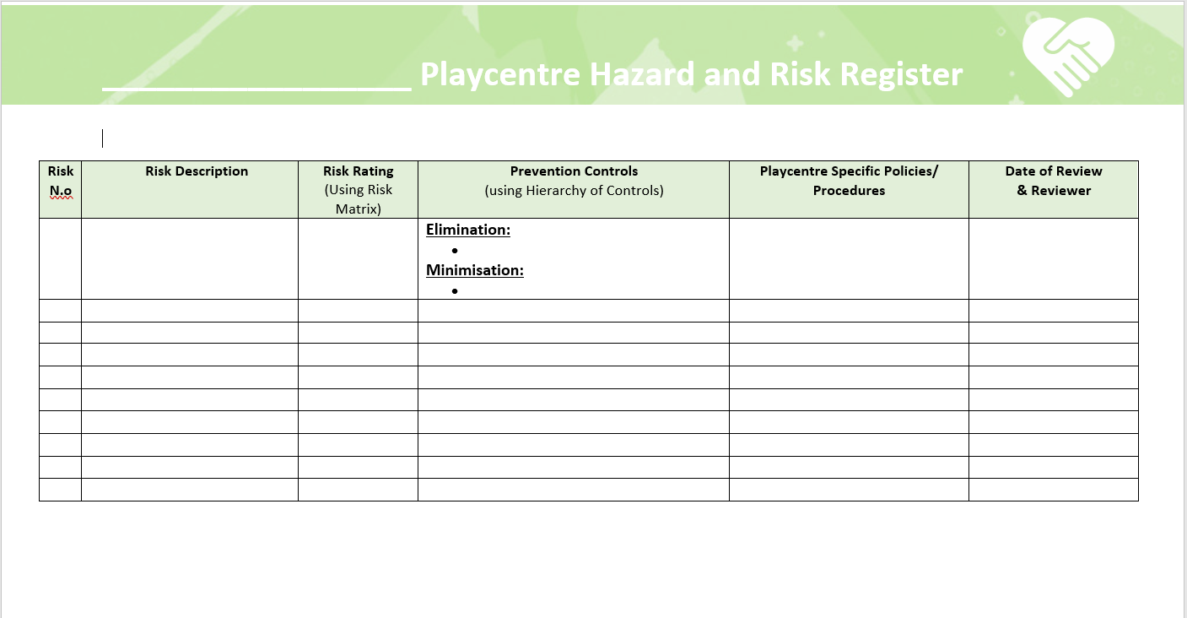

Slide 11
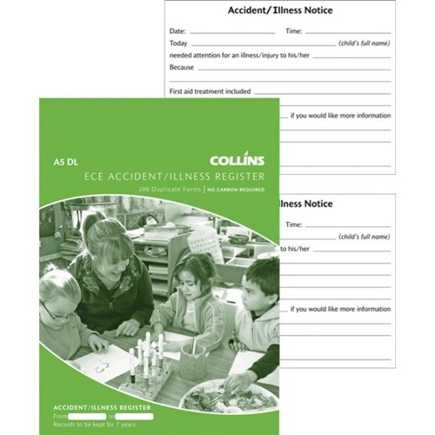
Illnesses, Incidents, and Injuries
Ensure all members know where the First Aid kit is located.
Ensure the Child Incident, Illness and Injury Flowchart is displayed for members information.
Ensure all members are easily able to identify the First Aiders present on each session.
Ensure all members know how to complete an incident report for an Incident.
Ensure report documentation is kept for two years.
Notes:
Every accident, injury or illness occurring on session must be recorded. Even if the accident only required a hug, it should be recorded as then you can see whether any trends are occurring, e.g. a tripping hazard is actually present. There is an A4 sized record sheet in the P&P folder, however to save the trees, and make it easier to store, and review, these records, your Centre could choose to purchase one of these A5 sized record books (available easily online from stationery and ECE websites). This book allows for two records per page, and are carbon copied, so a copy can be removed and given to the parent of any children who are independently attending session. Records of minor illnesses, incidents, and injuries must be retained for two years.
Records of notifiable events must be keep for five years.

Slide 12


Civil Defence and First Aid Kits
This includes the Quick Get Away Kit, which is really an easily portable subset of the Civil Defence Kit.
Check the contents each term, in alternate terms would be a good idea (add this to your Centre’s Annual Management Plan).
Suggested contents can be found in the P&P folder section 9.9.9.
Notes:
The suggested contents for your Civil Defence Kit can be found in the P&P folder, and a termly content checklist pages (I suggest you print this each year and store with your CD kit to make checking each term easy). The contents needs to account for your role numbers, so don’t forget to top up the amounts if your role increases. The contents should be checked each term, put this task on the Centre’s Annual Management Plan as a reminder.
The minimum contents for your first aid kit can be found in Appendix 1 of the Licensing Criteria. The P&P folder also has suggested FA kit contents, and checklist pages (I suggest you print this each year and store with your FA kit to make checking each term easy). The contents should be checked each term, put this task on the Centre’s Annual Management Plan as a reminder. Do the Civil Defence kit one month, and the FA kit another month.
There are lots of pre-made FA kit options these days, some of which are very easy to mount to the wall, but then click off and take where needed. They normally come with enough space to add any extra items you may require.
The MoH infectious disease posters should be on the wall next to your first aid kit.

Slide 13
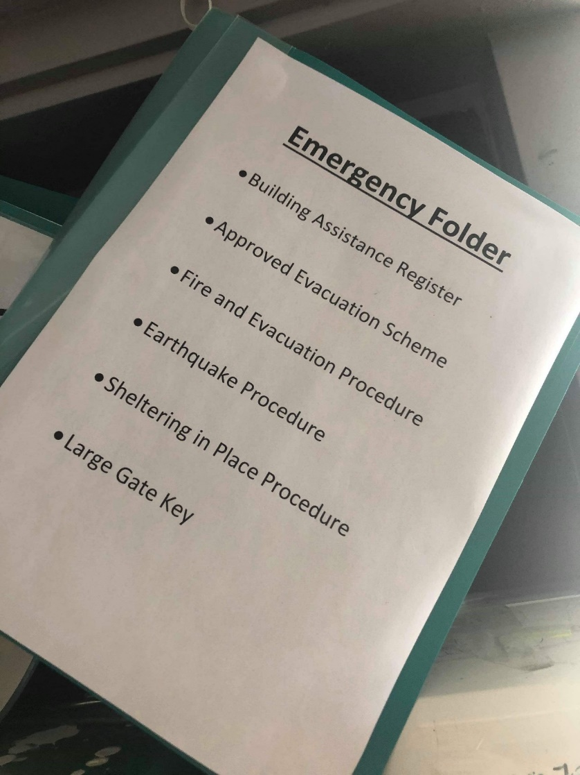
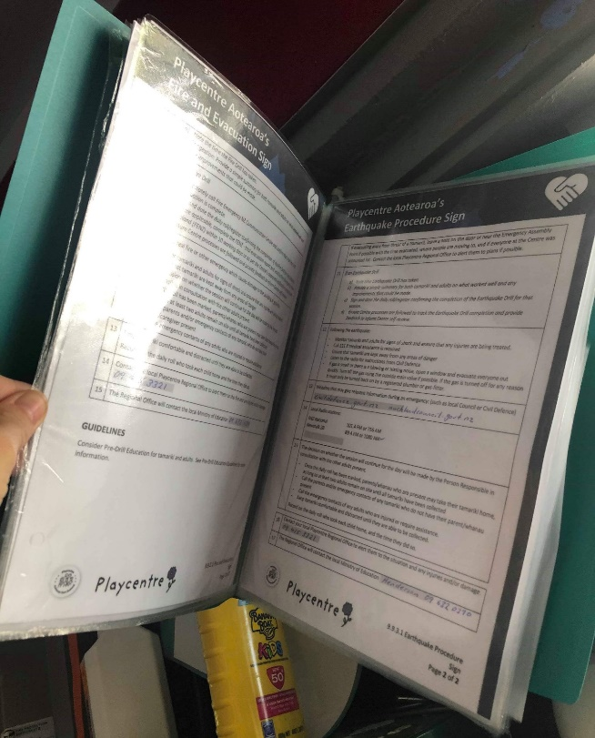
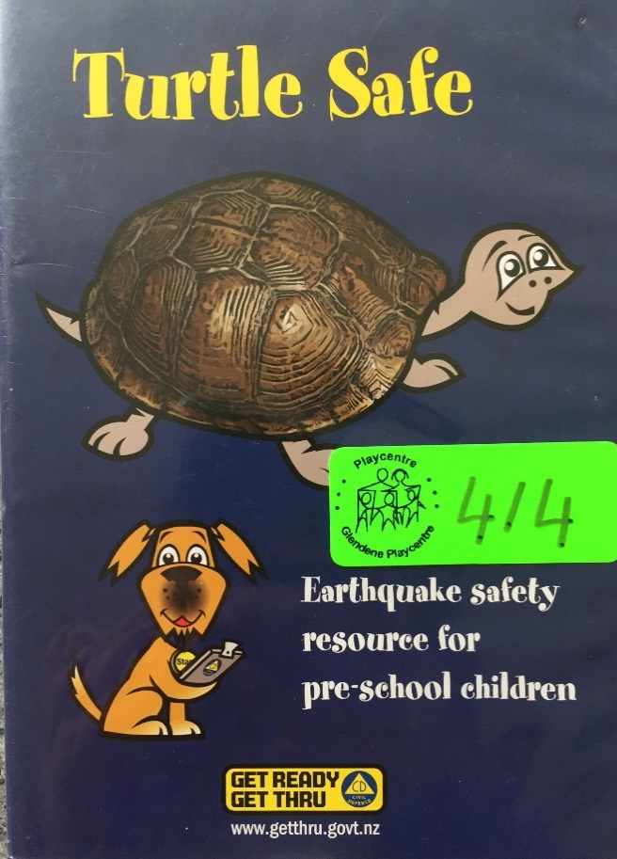
Emergency Procedures
Ensure all Emergency Procedure Signs are printed, and can be easily picked up and taken with the sign-in tablet, during drills, and in the event of an emergency.
Ensure all Emergency Drills occur – fire/earthquake/sheltering in place one of each type per term – notified fire drills on one session in terms two and four.
Assistance Register – review, and update if necessary, at least once per term.
Notes:
All Emergency Procedure Signs should be printed and available to grab easily when conducting any drills, or in the event of an emergency. Ideally these should be stored/hanging next to the sign-in area, with the Building Assistance Register. Laminating them, or placing them in a clearfile, to protect them would be advisable. It would also be a very good idea to store your Centre’s FENZ approved evacuation scheme information with them, and have your Quick Getaway Kit nearby.
All three types of emergency drills need to take place on every session once per term. You are not responsible for completing all of these drills, but you do need to ensure that each session is completing them. It is advisable to have different Centre members conduct the drills each term, to ensure more people are familiar with what to do in the event of an emergency. It is wise that each session has a brief discussion, at the completion of each drill, on how it went, and whether anything needs improvement.
Ideally you should call 111 when doing the fire drills to become familiar with doing this in event of an actual emergency, or at least do this on each session once per year. If you are told not to do this by FENZ, then mock the call. It would be a very good idea to write down the answers to the questions they are likely to ask you, and include this with your procedures. Ideally when doing your fire drill you should set off your building alarm, so that all members and children can become familiar with this sound, and are then less likely to panic in the event of a real emergency. If your alarm is connected to a call centre, and will cost your Centre money to have it reset, you could simulate this (e.g. ring a bell loudly, blow a whistle, yell ‘fire’), or you might need to find out whether there is a ‘test alarm’ function you could use. Make sure you take your Centre’s tablet with you to complete the Roll Call. Turn off the Wifi to make this easier.
Notified fire drills should be done twice per year ideally in terms one and four, or as often as is specified in your approved evacuation plan. The new process for this is simply to submit a report after the drill. If you can’t find your Centre’s approved evacuation plan, or don’t have one, you need to contact your Regional Property Coordinator to find/acquire it.
You need to track when all emergency drills have occurred, and whether there are any improvements that need the be made to your processes. There is a tracking template in the P&P folder if you wish to use it, but you may design your own. The member who lead the drill should fill out the drill paperwork. Drills should be reviewed as part of the H&S section of your GBM, and any potential issues identified, and improvements of the drills to be made, noted in your meeting minutes, and then communicated to all members. Hopefully, this will eventually be on Discover.
Review, and update if necessary, the Building Assistance Register at least once per term – put this on the Centre’s Annual Management Plan as a reminder. Ideally this should be on the wall near the sign-in area, next to the Emergency Procedure signs.
Review Quick Getaway Kit contents at least once per term - put this on the Centre’s Annual Management Plan as a reminder. Ideally this should be on the wall near the sign-in area, next to the Emergency Procedure signs.

Slide 14
Other Tasks
Excursions Paperwork
Complete Monthly Building WOF check
Ensure H&S Signs are displayed in the correct places in your Centre
Ensure all Medicine Administration documentation is kept up-to-date
Ensure that each session is completing the Food Record
Ensure all members know where the Isolation Area is, and where the Spill Kit is located
Liaise with members and regional office in the event of an infectious disease outbreak
Notes:
Signs: child protection flowchart, laundry, toileting and nappy changing, notifiable events, ‘injury, illness and incident’, MoH infectious diseases posters (these can be ordered online from healthed.govt.nz), sick and soiled, washdown, sleeping children (paperwork to be kept for two years)
The isolation are needs to be away from play and sleep areas. The mattress or stretcher to be used should be easily accessible, and cleanable, and unlikely to be used for a sleeping child. The spill kit should include: a bucket with lid containing wipes, towel (for sick child), gloves, cover for mattress (maybe).
The infectious disease chart covers what to do in the event of an outbreak of a moderate to serious infectious disease occurring at your Centre (e.g. hand, foot and mouth or measles). If you need to notify your regional public health service in the event of the occurrence of a notifiable infectious disease (e.g. measles) your CA will be able to access your children’s immunisation records. The only thing you need to have to do with this is maybe ensure that updated immunisation records are sighted, copied, and the information passed on to your CA. You may in no circumstance share information about anyone’s immunisation status (adult or child) with anyone else within or outside the Centre, with the exception of the Regional Public Health Service in the event of an outbreak. You are bound by the ‘Code of Conduct’ and ‘Privacy and Information Management’ policies, I suggest you familiarise yourselves with them.
It is up to your Centre to determine how to deal with all other more mild infectious illnesses. I recommend using the MoH publication ‘Ngā Kupu Oranga Healthy Messages’ to help guide you in deciding what to do. You may choose to put guidelines of when members and their children should stay away from Centre into a Centre Practice. This document can also help guide you in setting up or reviewing your Centre’s cleaning practices. I will read out a small section from this document:
“When should they stay away? In general children should stay away from an early childhood service when they are ill and causing concern or: • have no interest in activities or play • have little energy, want or need to sleep or rest for long periods • cry easily, are irritable or in pain • constantly want to be held and comforted • have a fever • any child with diarrhoea or vomiting should stay away until symptoms cease and they are well. “Should” is used where regulations require you to exclude a child or staff member for the stated time. “Advised” is used where medical experts recommend that you exclude a child or staff member for the stated time.”
With vomiting and diarrhoea a good rule of thumb is stay away for at least 48 hours after the last episode in the case of multiple instances of vomiting or diarrhoea, or stay away for 24 hours if there was only one vomit or diarrhoea, as these could be due to food or anxiety.
There will be a P&P section in the Playcentre Bulletin each month. Ensure that you read this, as any P&P updates or revisions will be notified here. The P&P Review Schedule on the website will also list the last time each P or P was updated, so you can ensure that you are always following the latest version.
Feedback on any P&Ps can be sent through at any time, but may only be actioned when the review cycle for that P or P comes due.

Slide 15
Excursions
Ensure that all relevant paperwork is completed before each excursion
Ensure the excursions bag is maintained and ready-to-go
Editable excursion forms are available
Regular spontaneous excursion forms can be kept permanently written up, and new members can sight and sign these on enrolment
Notes:
The Risk Assessment and Management forms in the P&P folder are only for Excursions. All external contractors will have their own. All Centre events on site do not require them. All documents relating to Centre hire are separate, and do not needs RAMs.
Editable Excursion forms are coming.

Slide 16
H&S Reports to Centre Business Meetings (CBM)
Your CBMs should always have a H&S section
In this section you will present your report, it should contain:
  A summary of any minor illnesses, incidents or injuries that have occurred since the last meeting
  Any new hazards that have been identified from either the Sessional Health & Safety Checks or Illness, Incident and Injury records, or Notifiable Events – including any trends or near misses that may indicate a larger issue to be addressed
  Review of the hazard Register, and whether any temporary hazards that are unresolved need to be added
  A summary of all emergency drills that have occurred and any recommendations for process changes needed
Following your report presentation the meeting can discuss which actions are to be taken, by whom, and by when, to address the hazards identified – the hazard and risk register should be updated if required
Notes:
Hazard register does not need to include everyday common sense hazards e.g. hot stove, knives. Will have reoccurring hazards e.g. fungus, puddles, and new temporary hazards to be dealt with e.g. broken tree branch.
You do not need to wait for the end of term to update the register, reoccurring or new temporary hazards identified can be added at any time. Once you have dealt with a temporary hazard, cross it off the register, then print a new updated register with that thing removed for the next term.

Slide 17

Important Relationships
Centre Advisor – To communicate and escalate Health and Safety issues or risks.
Property Team
Centre President/Coordinator
Session Leaders/Coordinators/Duty Team
Session Support Worker/facilitator
Property Officer
Notes:
CA completed termly Centre Assurance Check lists. These will cover H&S things. Make sure you see them to follow up on any actions identified.

Slide 18

Useful Resources
Policy and Procedures (P&P) Folder, and P&P section on the website (PA) – particularly the Health & Safety Section.
Licensing Criteria for centre-based ECE services 2008 – amended Sept 2022 (MoE)
Ngā Kupu Oranga Healthy Messages – A health and safety resource for early childhood services (MoH)
Your Centre’s Annual Management Plan

Slide 19
Thanks for all your hard mahi to keep yourselves, members, tamariki and visitors safe!
If you have any questions, or for further support,
please speak to your Centre Advisor in the first instance.

