Slide 1

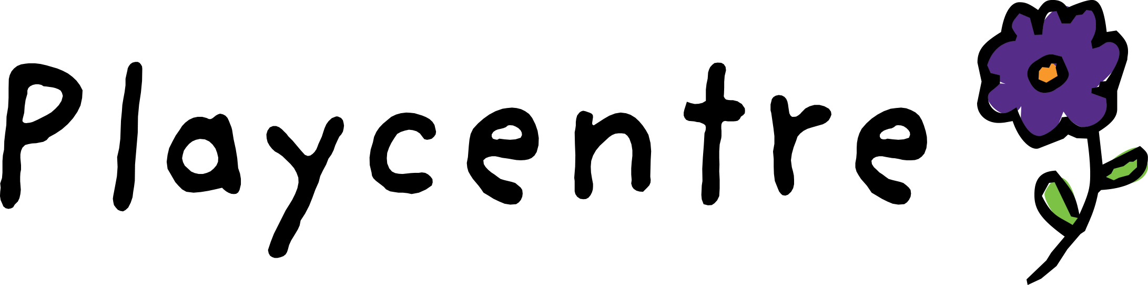
Curriculum, planning & evaluation
Supporting curriculum in Playcentre

Slide 2
Karakia Tīmitanga
Whakataka te hau ki te Uru
Whakataka te hau ki te Tonga
Kia mākinakina ki Uta
Kia mātaratara ki Tai
E hī ake ana te Ata kura
He Tio
He Huka
He Hau Hū
Tihei Mauri Ora!
Cease the winds from the west Cease the winds from the south
Let the breeze blow over the land Let the breeze blow over the ocean Let the red-tipped dawn come with a sharpened air.
A touch of frost
A promise of a glorious day
Notes:
Cease the winds from the west Cease the winds from the south Let the breeze blow over the land Let the breeze blow over the ocean Let the red-tipped dawn come with a sharpened air. A touch of frost A promise of a glorious day

Slide 3
Mihi whakatau
Mihi
Health & Safety
Tikanga
Notes:
Tēnā koutou katoa
Tihei mauri ora!
E te whare, e te papa, tēnā korua.
E nga mate, haere atu rā.
Rātou ki a rātou.
Tātou ki a tātou.
Karanga mai e te kaupapa ō te rā.
He mihi nui, he mihi mahana kia a koutou katoa.
Ask for participants to thumbs up if lots of experience, heart if about middle of the road, applause if quite new.
Invite participants to introduce themselves and describe what they hope to get out of the session.

Slide 4
Workshop outline
Curriculum leadership
Curriculum in Playcentre
Planning, assessment and evaluation
Curriculum design cycle
Putting it in to action
Curriculum and Internal Evaluation
More information

Slide 5
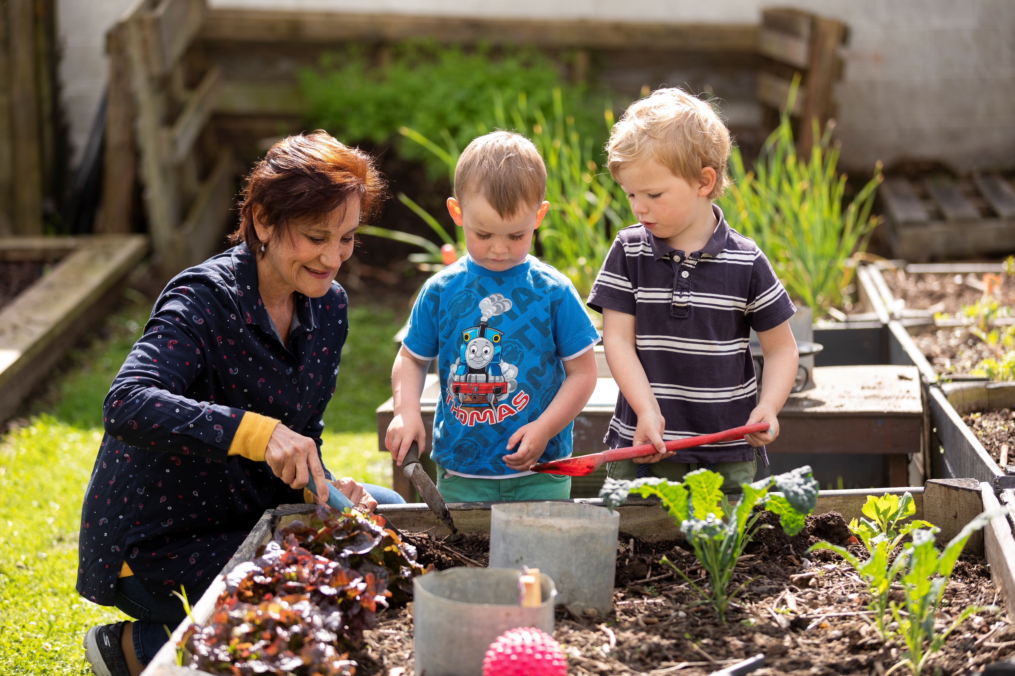
Curriculum leadership
Playcentre is a whānau-led early learning service
We work together to support the well-being and learning of all tamariki
A curriculum lead is called many different things and is often supported by a curriculum team
Curriculum leadership ensures processes are in place to support every child’s learning and to support Playcentre whānau as kaiako
Notes:
This is a workshop for Playcentre people who lead the planning and evaluation curriculum processes for children's learning in Playcentre.
Curriculum leaders can be a parent, extended whānau member or an employed facilitator and goes by many names like LEAP Officer, Planning and Evaluation Officer, Session Facilitator, Te Whāriki Champion and Curriculum lead.
It's really important that we remember that Playcentre is a whānau led early learning service, all parents, whānau and employed facilitators are the kaiako and we work collectively to support the wellbeing and learning of the tamariki.
This role is not about one person supporting all of the learning in a Playcentre – it's about empowering and inspiring others to be kaiako as well.
It is useful for every centre to have a person or team of people with a focus on curriculum leadership, hopefully this presentation will help you gain a few ideas...let's get started.

Slide 6
Role of the curriculum lead
Support the centre to implement a curriculum for tamariki on session
Role model play and quality interactions with tamariki on session
Share and build knowledge among Playcentre whānau
Initiate and facilitate discussions about children’s learning (on session and at hui)
Make Te Whāriki and local curriculum visible in day-to-day Playcentre life
Create an inclusive learning environment
Support centre whānau to identify and document children’s learning
Support centre whānau to implement Te Whāriki
Support curriculum-focused internal evaluation
Notes:
There are two key parts, the first is about supporting children's learning on session, the other is about building knowledge and ability within the adults.
Supporting children's learning on session is about role modelling play and quality interactions with tamariki, leading by example. It's about making Te Whāriki and local curriculum visible in day-to-day life and creating an inclusive learning environment, including all ages, cultures, genders and abilities – making sure it is an equitable place for all of our tamariki and whānau.
Building knowledge and ability within the adults includes initiating and facilitating discussions about children's learning, on session and at planning hui. Even those informal conversations by the side of the sandpit form part of this too. It's about supporting centre whānau to identify and document children's learning, to implement Te Whāriki and support curriculum focused internal evaluation. We'll look at that in more detail near the end of this session.

Slide 7
Skills and competencies
Understand and role model Playcentre philosophy​
Teaching and learning theory knowledge​
Working knowledge of Te Whāriki and Effective Internal Evaluation
Explore and experiment​
Problem solving skills​
Relationship building skills​
Coaching and mentoring​
Clear communication​
Document learning​
Ability to learn, apply and adjust your learning to new situations
Notes:
We've talked about the role of the Curriculum lead, but what are the skills and competencies that are needed to fulfill that role?
Take a look at this list, the skills and competencies are largely focused on Playcentre philosophy, Te Whāriki, teaching and learning and relationship-based skills.

Slide 8

Curriculum in Playcentre
Te Whāriki is the national early learning curriculum in Aotearoa
All licensed Early Childhood Education (ECE) services follow Te Whāriki
Te Whāriki provides the framework on which each ECE implements their own local curriculum
Notes:
When we talk about curriculum in Playcentre we’re talking about both Te Whāriki and the local curriculum.
Hopefully, you are familiar with Te Whāriki already if you have taken on this role, it’s the national early learning curriculum in New Zealand.
The most recent version is the 2017 version with the green cover.
There a lots of PLD opportunities, including Playcentre Education and Playcentre PLD if you want to learn more about Te Whāriki.

Slide 9
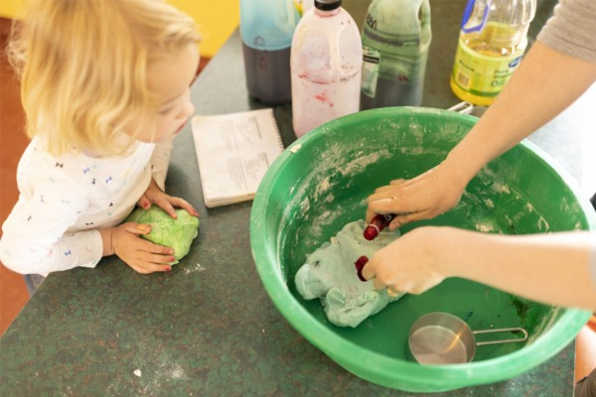
Curriculum in Playcentre
Local curriculum is "What matters here"
Local curriculum includes learning about your families, people and places in your area, modern and future perspectives, pūrākau, whenua, moana, iwi, marae and local cultures
Notes:
Each ECE has their own local curriculum, it is specific to their area, people and places around them.
It includes stories of the people, the iwi, local pūrākau, the geography, animals, community groups and businesses.
It is all about, what matters here.

Slide 10

Curriculum – children’s learning
Assessment - What learning did we observe?
Evaluation - How effective are our practices?
Planning - What next?
Notes:
A big part of this role is supporting the assessment, planning and evaluation processes that happen in your centre.
Assessment is the measure of learning, what learning did we observe?
Assessment makes valued learning visible; it shows us how we can support learning and it shows us progress over time
Formal e.g. written observations and photographs
Informal e.g. listening, observing, participating and responding to children
Kaupapa Māori assessment places the child and the whanau in the centre, capturing strengths, abilities and competencies
Learning stories, narratives and learner maps are some of the tools
There are many opportunities for children to be involved in their own assessment
Te Whāriki’s learning outcomes and kaiako goals can support assessment and planning
Evaluation asks the question, how well or how effective? How effective are our strategies, interactions, physical environment or centre culture? Evaluation is happening all the time in your centre.
Planning asks the question, what next based on what we’ve discussed in our evaluation of our practices.
These processes are all linked, they form the assessment, planning and evaluation cycle. The information we pick up in the assessment, helps us evaluate our practice and both of those inform our next steps, our planning.

Slide 11
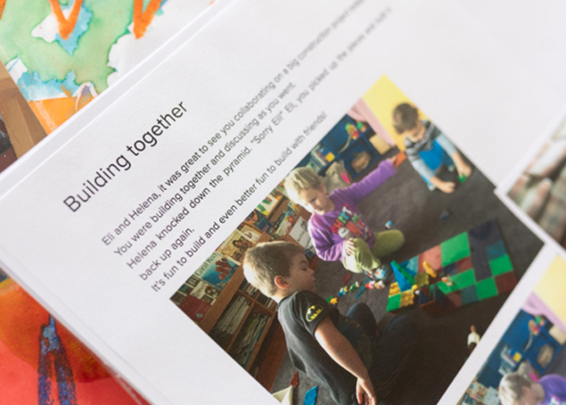
Curriculum – children’s learning
Notice
Recognise
Respond
Notes:
Assessment, planning and evaluation happen all the time at Playcentre.
Every session, we notice many things happening and some of it we’ll recognise as learning. Some of what we recognise as learning, we’ll respond to. Some of the learning we responded to, we will revisit and some of the learning we responded to, we will document.
Some of the ways we document are photos, learning stories, videos, learner maps, profile books, transcripts and artefacts like artwork.
In comparison to the learning that is happening, the documentation we do is only a very small sample of the learning happening for our tamariki.

Slide 12
Assessment, planning and evaluation- curriculum design cycle
1. Notice
2. Recognise
3. Respond
4. Record
5. Revisit
Notes:
Invite participants to share what their curriculum cycle looks like.
When we are assessing and planning for children’s learning at Playcentre, this is the cycle that we follow – the curriculum design cycle.
It is important to know that we do this for both individual children’s learning and for groups of children where we see a shared interest or learning
We’ll go through each one, but just to run through them – the first step is notice, then recognise, respond, record, and finally revisit.
Notice: what have we noticed about the child and their play. This includes their interests and passions, observations about their relationships, knowledge and skills they already have or are developing, their learning dispositions and their working theories along with any schemas. It includes whanau culture and aspirations and any identifiable learning needs or goals that the child has for themselves. Use tools like learner maps, profiles, pepeha, a collection of observations (formal and informal).
Recognise: make sense of their learning. what do the things we’ve noticed, tell us about this child? This happens during formal and informal learning conversations – on session, during hui, Facebook groups or other online forums your centre might use. It’s useful to have multiple perspectives, the child’s own perspective (child’s voice), their parents and other kaiako on session. It could include links with Te Whāriki in particular the learning outcomes the child appears to be working towards. We can also include what we think the purpose of play is, why is the child playing – what are they trying to do?
Respond: supporting children’s play and learning. This is how we support and enrich children’s play. Sometimes our response is immediate, the things we do in the moment of play. Sometimes we think about our response and bring it in something a few minutes later, later in the session or on another day. These are some things to think about when we respond. This is emergent curriculum – the curriculum we’re building on as things happen for the children. It could include invitations to play and creating a rich learning environment for the tamariki. It could build on islands of interest and learning enquiries. An island of interest is where a child has a fascination or a passion about a particular area – dinosaurs is a good example. It involves quality interactions with our tamariki and encouraging children’s agency, empowering them to make decisions and have control over their own learning. It includes kaiako teaching strategies as well. This involves, intentionally making decisions about what we’re doing and how we’re interacting with children. It can include if, how and when to step in and the language or techniques we use to support children to grow their skills.
Record: make children’s learning visible. Some of the ways we record are learner maps, learning stories, magic moments, daily session evaluations, termly reflections, photos and videos. These capture a small snippet of the learning that is happening for our tamariki.

Slide 13
Assessment and documentation
Assessment is the process of seeing and gathering a variety of evidence in everday practice and anaysing and using the evidence to increase learning opportunities for children (noticing, recognising, responding).
Documentation is simply a record of some of that assessment activity, used to inform kaiako understanding and action.
Notes:
We’ve touched on it before, but want to make it clear that assessment and documentation are not the same thing.
Assessment is the process of seeing and gathering a variety of evidence in everyday practice and some of that we do record. The recorded assessment is documentation, but actually we’re assessing children’s learning all the time.
Every time you’re are watching your child and responding to them you have made some kind of assessment about what they are learning and how you can best support their next step.

Slide 14
Every session
Talk to each other about individual and shared learning
Discuss how kaiako can support and enrich children’s learning
Once per term
Once per year (July/Aug/Sept)
Involve children in conversations about their learning
Revisit highlights and challenges
Update learner maps
Plan for next term based on assessment and evaluation
Consider a possible internal evaluation for the next term
Discuss significant purchases related to learning in time for the next years’ budget
Document some of the learning
Notes:
So that’s all a bit theoretical so far, as a curriculum lead you are probably keen to get to the basics of what needs to happen and when it needs to happen.
Putting this into practice, on every session you can involve children in conversations about their learning and talk to one another about children’s learning and shared learning.
You can discuss how you can support and enrich children’s learning and build on what has been recognised can take place on a daily basis too.
Some of these discussions will be recorded and shared in a way that other kaiako can use. A common way to do this is using a session evaluation which can occur at the end of session, at a natural break time in the session or contributed to throughout the session. There is no one way to do this, it’s about having a process that works well for your centre.
Once a term, it is helpful to revisit the previous term’s highlights and challenges – this might be something you do as the curriculum lead. You can look at back over the learning documentation including session evaluations picking out some of the trends and highlights to consider for the new term.
Ideally families would update learner maps once a term to help inform planning for the coming term. Once families have updated learner maps it’s great to have a group discussion about possibilities and opportunities for the term. You can look at individual children and groups of children and consider what you could to to support them. You don’t have to plan to a detailed level, it is about brainstorming opportunities and possibilities. In the term following, this planning supports your sessions depending on the type of session, how energetic you are, other factors like the weather and specific requests from tamariki. Some things you might want to schedule, include anything you need extra resources for, excursions or visitors. A lot of ideas that we plan for in our emergent curriculum, grow and change over the term.
Also once a term, you may have a curriculum focus that you’d like to review as an internal evaluation. A lot of centres have a term theme based on children’s learning, something like science, a learning outcome from Te Whāriki or a Te Ao Māori value – how do we encourage our children to be kaitiaki at Playcentre? If you do have a term focus it is a great chance to incorporate internal evaluation into what you are doing on session with your children already – we’ll talk more about that again soon.
Finally, once a year before AGM think about those big picture, learning focused purchases that you want to budget for. If you’ve had lots of physical play and you are talking about buying a new piece of equipment for your playground. That’s the time to add it to your budget for the year.

Slide 15
Promoting curriculum
Think out loud
Have prompts and templates available
Use Te Whāriki in Hui
Use a private social media group
Have child focus hui
Play Te Whāriki bingo or other “games”
Buddy up
Encourage participation in the Playcentre Education programme
Notes:
So again part of your role as curriculum lead is not just about curriculum for children but inspiring other whānau in your centre to be excited about children’s learning. Here are a few ideas about how you can promote curriculum in your centres, think about what you are doing already and whether any of these might be useful to bring in throughout the year.
The first one is the most basics and can seem a bit silly, but it really is just about thinking out loud. If you’ve been in Playcentre for a while, responding and supporting the play might come quite naturally to you, but it may not come naturally to other parents starting at Playcentre. So think out loud, explain what you notice and why you do what you do when supporting children’s learning – other people can learn from you by hearing you break it down.
Prompts and templates available for new parents is another way to support, examples include the Te Whāriki Learning Outcomes that can be stuck to learning stories or learner maps, having learning kupu like dispositions and schemas up on the walls to prompt discussions. Some centres like to have learning story resource folders that include learning story, narrative and magic moment templates along with scissors, glue sticks, stickers, learning outcomes or anything else that makes it easy to record some of the learning.
Play and learning books and journal articles on display at your centre is another great resource to share with your whānau, pull them out, make them visible and display them in the related area of play.
Another thing you can do is integrate Te Whāriki into your hui, use it for energisers or icebreakers, a topic for an internal evaluation or even reserve a section of each hui for PLD. It is easy to get caught up in the day-to-day business, integrating Te Whāriki into every hui can help draw us back to focus on learning for children.
Online forums like closed Facebook groups can help keep learning conversation going even if whānau have to leave early or haven’t had the opportunity to contribute on session. Posting a simple question that prompts reflection allows families to contribute when they have time and gives visibility across multiple sessions.
Te Whāriki bingo helps build parents familiarity with the strands and learning outcomes of Te Whāriki. Displaying the learning outcomes board, encourage centre members or sessions to match a document like a learning story, magic moment or a photo with a learning outcome.
Other good options include running a portfolio session in the evening or holidays – providing dessert or other tasty treats brings everyone together. More experienced families can buddy up with new members, helping them do their learner maps, starting out with magic moments or introducing learning stories.
And of course, encourage participation in the Playcentre Education – PIA in particular is designed to help adults learn to support and understand the value of children’s play.

Slide 16
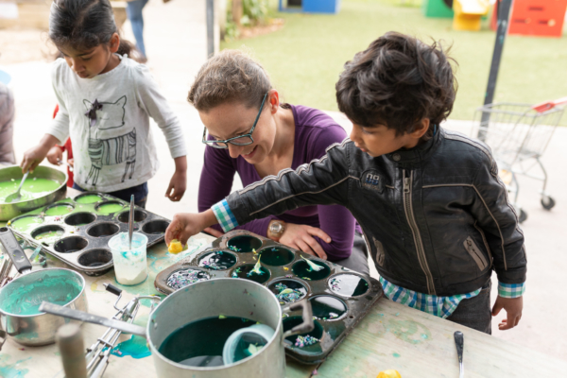
Curriculum and Internal Evaluation
We reflect on how we support learning in our Playcentres - internal evaluation is how we make this happen
All internal evaluation is focused on children's learning
Evaluation is part of the assessment and planning process
Use evaluative questions
Notes:
We won’t go into Internal evaluation in too much detail, but we do want to encourage you to use that process for any curriculum themes or big picture planning you are doing for a term. Rather than doing two separate things, you can make less work for yourself by making your internal evaluation support your day-to-day practice.
When working on internal evaluation, ensure the focus remains on outcomes for children and children’s learning – focus on people and learning rather than things and processes.
Use evaluative questions like “How well do we as kaiako respond to and plan for children’s learning between sessions?”
Sometimes it’s just flipping the lens, for example – Sustainable practices becomes “How do we encourage our tamariki and whānau to be kaitiaki of our Playcentre and community?”

Slide 17
Internal Evaluation Cycle
1. Noticing
2. Investigating
3. Making sense
4. Taking action
5. Monitoring and evaluating
Notes:
The Internal Evaluation cycle consists of 5 steps or stages.
Notice – choose a learner focused topic that is relevant to your tamariki – it could be a goal from your strategic plan, a key next step from ERO, a current tamariki interest/passion or an aspect of Te Whāriki you’d like to grow. For anyone that has heard of NELPs, the NELPs can be used to help form and evaluative questions.
Investigating – is the opportunity to gather information and possibilities. You can look at: What is the centre doing already? How effective is it? What do other Playcentre’s do? What do other ECEs do? What do the experts like Te Whāriki say?
Making sense – this is working out what will work for you as a centre?
Taking action – the next step taking action is about deciding exactly what will change, when and where it will change, who will make the change happen and how you can record the change.
Monitoring and evaluation – is when you look at how well the change worked, what you would want to continue and what else you could try. Again for anyone that has hear of NELPs they can be used to reflect on your internal evaluation and you can identify key changes.
Thoughout this process make use of documentation you are already doing, photocopy and reuse photos, learning stories, magic moments, session evaluations, termly reflections and meeting minutes.
Let’s use carpentry as an example. Let’s say that over the last term you’ve noticed quite a few children enjoying carpentry. When you think about what is happening there, for some children it might be able building and construction for others it might be about taking things apart, deconstructing. Your focus question might be “What opportunities do tamariki have to construct and deconstruct using real tools and equipment?”
When you move to the investigating stage, have a bit of a stocktake – what are we doing already, how effective is it, do parents feel confident supporting children? You could visit another Playcentre or ask on the Playcentre Facebook group. Take a look at Te Whāriki – where does constructing and deconstructing fit in terms of Te Whāriki? What ideas does Te Whāriki have for extending? Investigating is about coming up with lots of ideas.
The next step is about deciding which of the ideas will work for your centre and prioritising them so you can make it happen. You might have a few ideas that are managable and that would work for your centre. One parent might arrange the purchase of replacement tools, another might source new resources to work with like soft wood, egg cartons or cardboard. You might think of some other ideas outside of the traditional carpentry area, like taking apart old equipment.
Then thoughout the term you’ll monitor and evaluate the changes you make, using and reusing documentation you are already doing as much as possible like learning stories showing the equipment being used, quotes from tamariki or end of session evaluations. Finally at the end of the process you can briefly summarise what you have observed and evaluated throughout and decide what you’d like to continue, how effective the changes were and anything else you’d like to try. The final step is to ensure it is all collated in your internal evaluation folder for future reference.

Slide 18
Examples of Internal Evaluation Topics
How well do we support our tamariki to make connections with local places?
How well do we support whānau to become confident kaiako at Playcentre?​
How well do we respond to ākonga aspirations?​
How well do we gather multiple perspectives on children’s learning?​
Notes:
This slide has a few other internal evaluation topics. Te Whāriki and other ministry of education resources are great sources for internal evaluation topics, for example, you can turn a learning goal into a question – “How well do we as adults support our tamariki to make connections between people, places and things in their world?”
Support children’s learning through/as [a strand or learning outcome of Te Whāriki, a Te Māori value, a learning disposition, a learning domain?​
Make learning visible at Playcentre?​
Capture learning growth over time?​
Grow children’s strengths and interests?​
Revisit play and learning with tamariki?​
Ensure we include every child?

Slide 19
More information
Te Whāriki online​
​Internal Evaluation information on the Playcentre website​
​Playcentre Planning Ideas Facebook Group​
​Te Whatu Pōkeka | Kaupapa Māori Assessment for Learning​
​Licensing Criteria for Centre-based Services – C1 – C13
Playcentre Education – B401/PE1 Kia Tākaro, C406/PL3 Enriching children’s learning
Kaihononga Māori, Centre Advisors, PLD Team
Notes:
Well done for making to the end, I hope you have found some useful snippets in this, just some more useful places to get resources. Te Whāriki online has many different resources and evaluative questions. The internal evaluation section of the Playcentre website has further detail on internal evaluation. The Playcentre Planning ideas group on Facebook is a source of inspiration for resources. Te Whatu Pōkeka | Kaupapa Māori Assessment for learning provides a Māori world view to consider in your evaluation. The Licensing Criteria C1 – C13 are related specifically to curriculum and can be useful to support your investigation and decision making. The Playcentre Education programme provides a number of resources and perspectives helpful for internal evaluation. Finally the Playcentre Education programme and your Kaihonona Māori team, Centre Advisors and PLD Team are also good sources of support and information.

Slide 20

Questions?
Notes:
Q&A

Slide 21
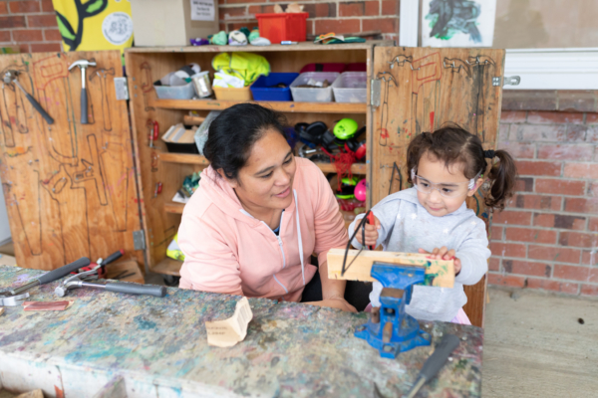

He kai kei āku ringa
There is food at the end of my hands
Thank you for taking the time to participate in this workshop.
Good luck in your role supporting curriculum.

Slide 22
Karakia Whakamutunga
Kua mutu ā mātou mahi
Mō tēnei wā
Manaakitia mai mā katoa
O mātou hoa
O mātou whānau
Aio ki te Aorangi
Our work is finished
For the moment
Blessing upon us all
Our friends
Our families
Peace to the Universe

