Slide 1


Public Relations
Office Holder Training November 2023
Jo Leahy, Communications Manager

Slide 2

Karakia Timatanga
Tūtawa mai i runga Tūtawa mai i raro Tūtawa mai i roto Tūtawa mai i waho Kia tau ai Te mauri tū, te mauri ora Ki te katoa Haumai ē, hūi ē, tāiki ē. | Come forth from above, below, within and from the environment Vitality and wellbeing for all Stengthened in unity. Nā Scotty Morrison

Slide 3

Role Description
Purpose
To promote Playcentre externally (to attract new whānau) and internally (to retain current whānau) for your Centre.
Common Tasks
Promote your Centre in your local community to attract new whānau.
Coordinate social events for centre whānau and celebrate achievements.
Assist with fundraising projects at Centre.

Slide 4
Public Relations Seminar Outline
In this workshop we are going to create a fictional persona and follow this single imaginary person on their Playcentre journey. Let’s call them Sam. I am going to take you through the different public relations work we can carry out at the different stages of Sam’s journey.
Making sure Sam knows Playcentre exists
(this is the public awareness aspect of the role);
Making sure Sam chooses Playcentre
(this is the public awareness of the benefits of
Playcentre over other ECE options and also the
benefits of your specific centre);
Sam’s first visit to their local Playcentre
(now this may seem minor, but the first visit is crucial);
Sam’s time as a Playcentre member
(ensuring someone has a positive experience as a Playcentre member comes down to a lot more than
just PR, but PR can be significant).

Slide 5
Making sure Sam knows Playcentre exists (public awareness)
1
How people hear about Playcentre
Word of Mouth
Have attended Space or Babies Can Play
Were Playcentre tamariki themselves
Advertising
Social Media
Plunket referral
Website
Posters
Mail drops
Baby expos
Local community events
Open Days
Visiting a Playcentre for a birthday party or other event
What else?
There is a marketing adage called ‘the rule of seven’: a person needs to see or hear your marketing message at least seven times before they take action.

Slide 6

National Events/Campaigns
As per the Public Relations Strategy we are implementing a range of events, campaigns and initiatives at a national level.
The aim of these is to increase the awareness of Playcentre and support centres to thrive.
Events planned for 2024 are:
Waitangi Day (6 February)
Playcentre Open Week (4-8 March)
National Children’s Day (3 March)
National Volunteer Week (16-22 June)
Matariki (28 June)
Playcentre Messy Play Week (19-23 August)
Te Wiki o te Reo Māori (9-15 September)
Grandparents Day (6 October 2023)
We encourage you to make the most of these events and use the promotional materials
created at a national level to promote your centre in your local community!

Slide 7
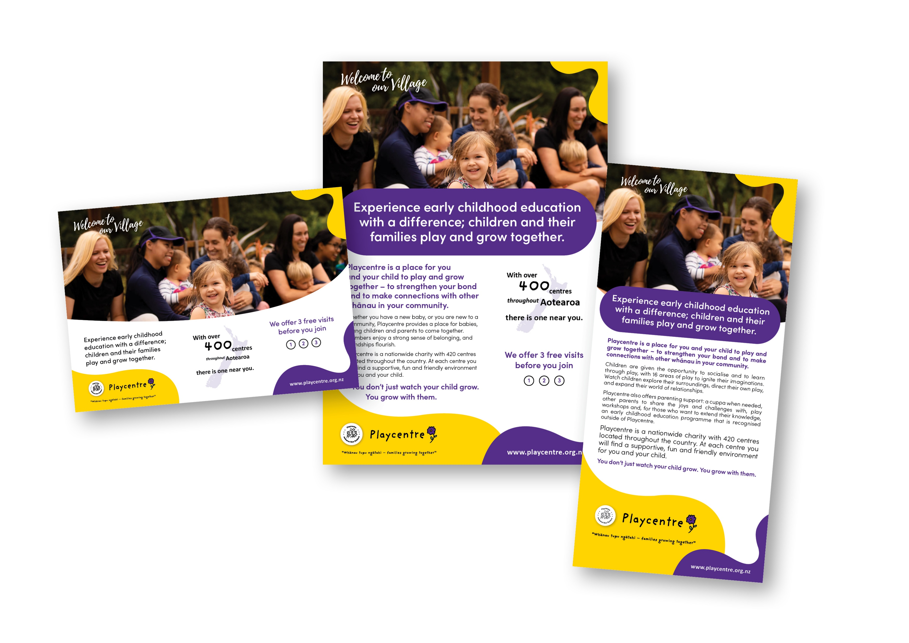
Playcentre brand
If you are using the Playcentre brand, please ensure you follow our Playcentre Brand Procedures.
Playcentre branding/logos are available to download on our website.
Appropriately applied, our brand identity will enable us to communicate clearly the values and status of Playcentre to our wider communities, both locally and nationally.
To support you and to maintain a consistent brand image we have created several documents and templates, plus promotional materials that you are welcome to use. These include editable templates so you can just add in your specific centre details.
All these resources can be found in the PR/Communications section of our website. You will need a member login to access these. For support, please contact askpr@playcentre.org.nz

Slide 8

Making sure Sam chooses the Playcentre option
(public awareness of the benefits of your centre)
2
Key messages are the core messages we want our target audience to hear and remember. They can be used in all of our communication such as newsletters, social media, your website profile and promotional materials.
A large part of public relations is repetition. The more times our target audience hears, reads or learns our key messages, the better recall they will have.

Slide 9
For example, at a national level our slogan is “Welcome to our Village” which conveys positive imagery of a supportive community, for both tamariki and adults. This is one of Playcentre’s unique attributes and a significant point of difference to other early childhood education providers.
The aim is also for the slogan to resonate with current members because it is meaningful to them and each specific centre as a community. Playcentre is their village and they should be proud to welcome others into it.

Slide 10
Playcentre key messages
Experience early childhood education with a difference; tamariki and their whānau play, learn and grow together.
Playcentre is a place for you and your tamariki to play, learn and grow together – to strengthen your bond and to make connections with other whānau in your community.
Tamariki are given the opportunity to socialise and to learn through play, with 16 areas of play to ignite their imaginations. Watch tamariki explore their surroundings, direct their own play, and expand their world of relationships.
Playcentre provides a free adult education programme to develop parenting skills and understand how tamariki learn and develop. This leads to an early childhood education qualification for adults (NZQA approved) that is recognised outside of Playcentre.
Whether you have a new baby, or you are new to a community, Playcentre provides a place for babies, tamariki and parents to come together. Members enjoy a strong sense of belonging, and friendships flourish.
At each centre you will find a supportive, fun and friendly environment for you and your tamariki.

Slide 11
Who are you targeting?
Who is Sam in your community?
Are they a…
Stay at home mum
Part-time working mum
A grandparent
A nanny
Stay at home dad
Part-time working dad
An aunty
Everyone is welcome at Playcentre. Every community is unique and so is every Playcentre, based on the needs of that community.

Slide 12
Getting noticed
Once you have established your target audience, you can share your story in the following ways:
Social Media Promotional Material Community events
Imagery Branded signage Hosting events
Website presence Branded merchandise Partnerships with organisations
Local Google listing Media coverage Feeder programmes
Online
Online
Print
Face-to-Face

Slide 13

Social Media
We recommend keeping your centre Facebook page and Instagram account up to date and using this as a
promotional tool (for both current whānau and attracting new whānau).
Playcentre Aotearoa will continue to create high quality posts for centres and members to share from our main public pages.
We encourage you to share posts from our public Playcentre Aotearoa Facebook page and our public Playcentre Aotearoa Instagram page. Posts on here are designed for you so that you have material without having to reinvent the wheel.
We also encourage centres and individual centre members to join our private Playcentre Facebook Group (for current and past members). Playcentre Aotearoa regularly posts resources for centres to use on session which are available on our website. It’s also a great place to discuss play ideas or find out how other centres do things.

Slide 14

Facebook
What type of content should you post?
Illustrate the variety of activities that you do on your sessions, the sense of belonging and community, excursions, our key messages and need to know information (like closing and opening dates for term time).
Branding your post
Adding the Playcentre logo to images is an easy way to ensure our Playcentre branding remains consistent when images are shared via social media. Playcentre branding/logos are available to download on our website.
Social media templates, including Facebook guidelines, cover images and profile pictures are also available on our website.
Ideal number of words
Short and sweet between 80-100 characters.
    Get members to share, react to and comment on your page.
Community Facebook pages: Use community pages on Facebook to promote your centre and post regularly. It is the perfect place to promote open days and whānau events. When people move areas, they often join these groups to get to know their new community.

Slide 15
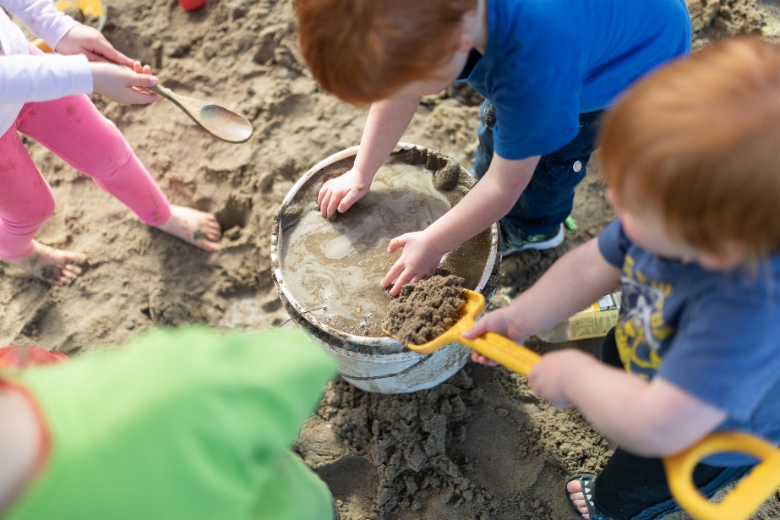
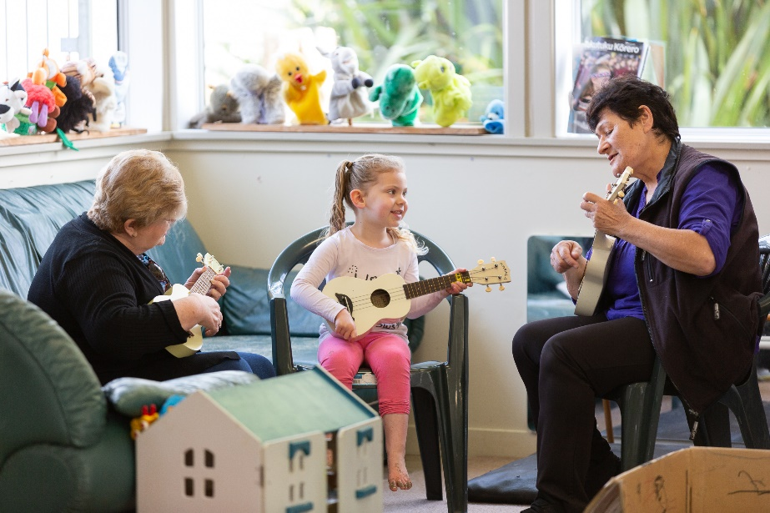
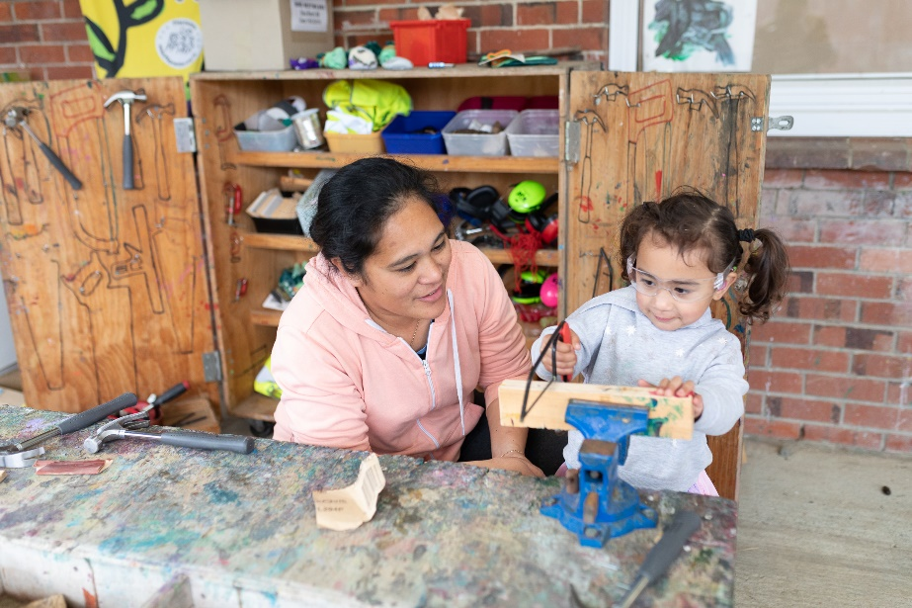
Imagery
An image can be more effective at conveying a moment, resources and a feeling.
If you do use images of your members, please ensure that the people in the image are aware of the purpose of the image and consent to it being used.
There is a photo release permission form available on our website.
The Playcentre Aotearoa enrolment form contains options for whānau to give permission for images of their tamariki to be used. This means centres should know who has consented and don’t need to get signed approval for images used each time. It is recommended that the photo release permission form is used to obtain signed approval if you would like to use an image for a specific purpose. i.e. In a promotional flyer about the centre.
Playcentre Aotearoa have undertaken professional photoshoots in Auckland and Christchurch so that we have a larger library of imagery that represents the essence of Playcentre. This imagery is being used in all of our PR campaigns. If you do require imagery, please let us know.

Slide 16

Website presence
Every centre has a website profile on the main Playcentre Aotearoa website (www.playcentre.org.nz).
At a national level Playcentre Aotearoa campaigns are directing people back to the Playcentre website and in particular for individuals who are interested in Playcentre to ‘find a centre’ in their local area. Biggest age group of visitors is 25-34.
Please ensure your website profile and open days are times are up to date. Email any updates you would like through to askpr@playcentre.org.nz
What would Sam like to learn about your centre and encourage her to visit?

Slide 17
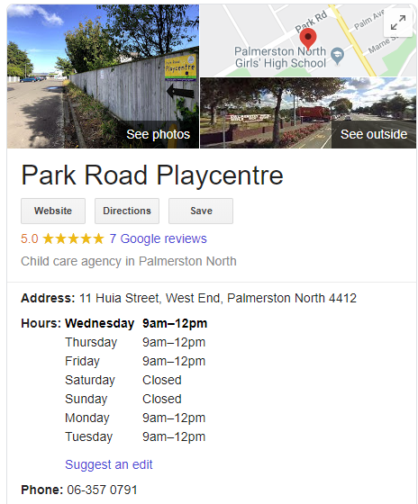
Google listing
Check your centre’s Google Business Listing is up to date and includes the correct address, phone number and open days and times.
If time permits, ask members to review the Playcentre and add in photos of tamariki playing, rather than just the street view image that Google automatically provides.
If you are unable to edit your Google Business Listing, please email communications@playcentre.org.nz and we can do this for you.

Slide 18

Promotional Material
We have created high-quality promotional material for Centres to use. There are generic Playcentre branded resources and resources which are editable for your Centre.
Promotional Material
Flyers (DL, Trifold, A4, A5 Letterbox, postcard) with editable sections in Word
Posters (promoting your centre, open days, garage sale, fundraising) with editable sections in Word
A2 Posters for events and expos
A3 Posters for events
Posters promoting a centre (ideal for your key messages)
with editable sections in Word
Social Media posts
Event posters, flyers and invitations
Cluster DL flyer with editable sections in PDF
*These templates are available on the website in the log-in area under PR and Communications. These have been designed so that you don’t have to reinvent the wheel. They are editable in either Word or Adobe PDF. We are continually designing more and welcome feedback to communications@playcentre.org.nz

Slide 19
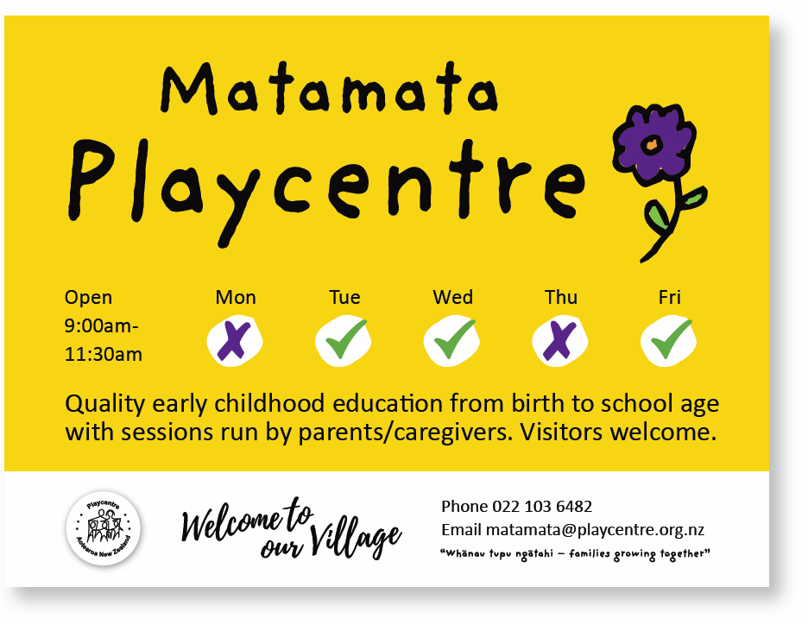

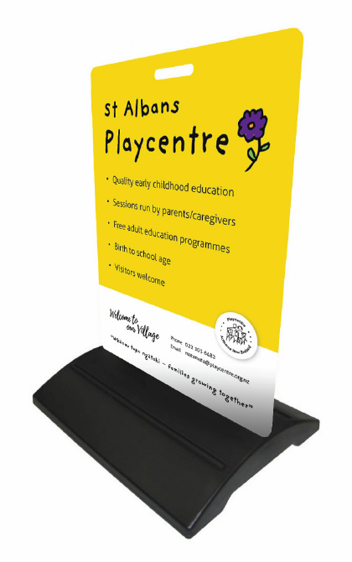
Branded signage
Ensure that you have up-to-date signage that shows where your centre is so that potential members can easily find it or be directed to it. Also, include your contact details and open days and times.
A lot of centres have requested teardrop or feather flags to be able to put outside when they are open or at events to increase exposure.
There are several templates available in our signage procedures.
It is recommended that you purchase your signage through one of our preferred suppliers. They will organise design, print and installation of any Playcentre signage you may require. They have the correct branding files and are briefed on what is required. Also, the more that centres use them, the lower the price will be. ignage must be approved by
If you don’t have a yellow road sign at the beginning of your street saying ‘Playcentre’ please contact your Regional Property Coordinator.

Slide 20
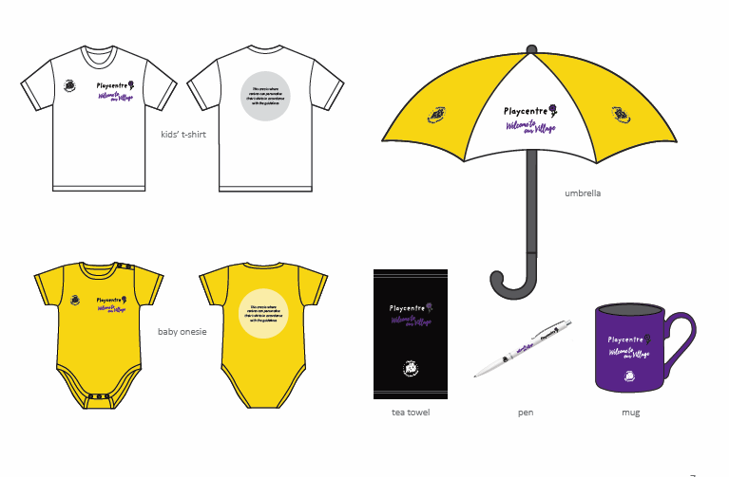

Branded merchandise
Branded merchandise can create unity, heighten awareness in communities and increase brand recognition for your centre. They are also often used as fundraisers.
Our branded merchandise procedures are available on the website and provide ideas, templates and designs as well as a merchandise checklist and preferred suppliers.

Slide 21
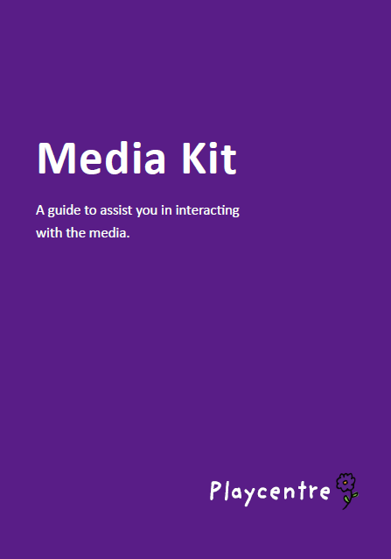
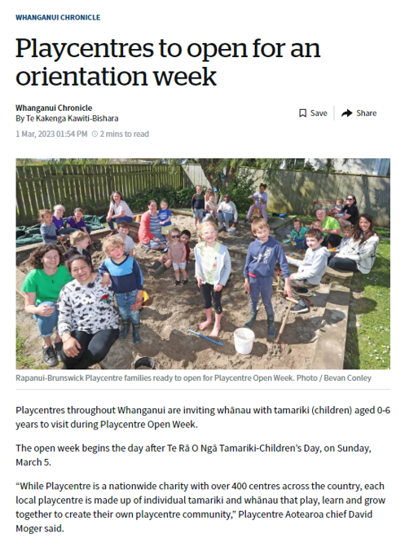
Media Coverage
Write positive and inspiring stories about Playcentre for your local paper. Invite them to Playcentre events and open days.
    Community newspapers often publish ‘personalised stories’ for their readers. For an event, phone or email your local paper
    and briefly outline the event and invite them to attend.
We have a media kit available on our website with templates on how to create a press release and tips and tricks with the media.
For advice or support, please contact the National Communications Manager on communications@playcentre.org.nz

Slide 22
Attending community events
It is important that Playcentres are visible and seen as a hub for whānau and are involved in your local community.
We would recommend that you participate in:
Local events in your community ie. School fairs, community market days
BBQ’s at events
Fundraisers (ie. Movie nights, bake fairs)
Add flyers to ‘Welcome to the neighbourhood’ packs
Christmas parades
Put up a flag and banner promoting your centre and have promotional
material to give out.
Share positive stories at local events, simply tell people what you love about Playcentre.
Which events would Sam attend?

Slide 23
Hosting events at your centre
Promote national Playcentre events in your local community (e.g. Playcentre Open Week, Messy Play Week)
Open days
Whānau days
Play workshops (open to the local community)
Coffee mornings with your local community
Host morning teas supporting a cause
Hāngī, umu or other cultural feasts (these can also make for a great fundraiser)
Matariki or Puaka nights
Offer ‘Welcome to the neighbourhood’ events
Join with other centres in your cluster to host a joint event
Publicise the events if appropriate. List the events on Facebook, Instagram, community pages, put up posters, listings / adverts in community newspapers, Eventfinda and through Neighbourly.
    Every day is technically an open day. However, this offers the opportunity or prompt for those to come along who perhaps haven’t seriously considered joining yet and offers current members an opening to invite people along.

Slide 24
Partnerships with local organisations
At a national level, Playcentre Aotearoa are building and strengthening partnerships.
We do encourage centres to strengthen these same partnerships at a local level. We recommend contacting the following to raise the profile of Playcentre in your local community and provide them with associated promotional material.
Local Plunket nurse
Local midwives
Doctors surgeries
Mainly Music groups
Libraries / related shops
Local school
Community radio and newspapers
We encourage you to invite your local Plunket nurse, midwives and any other community groups to a morning at Playcentre. This way they know what they are recommending and can see first-hand what Playcentre does and what is so special about it. It gives you a chance to firm up the local relationship and they are more likely to refer people to you.

Slide 25
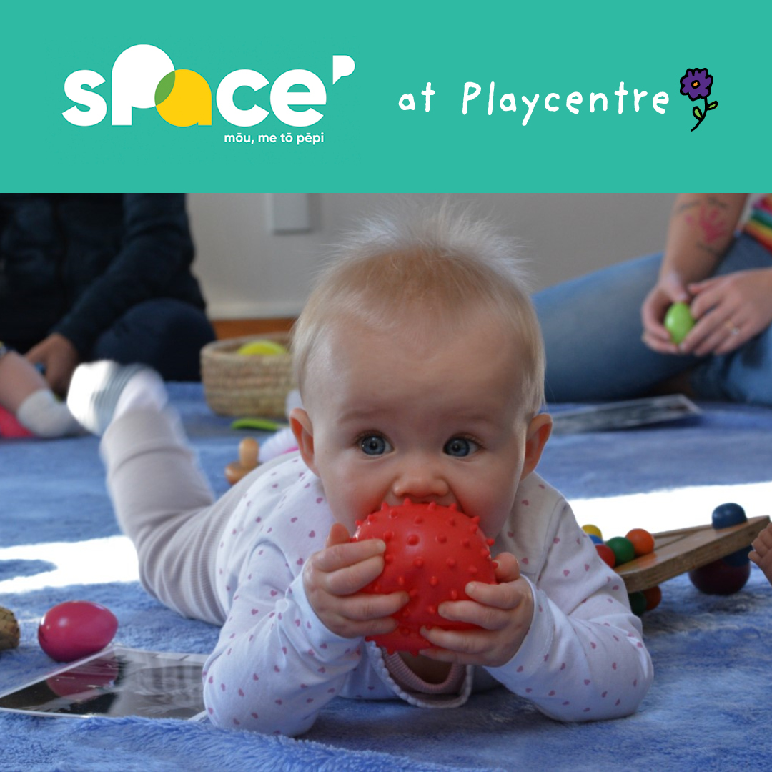

Infant programmes
Space and Babies Can Play infant programmes are hosted at many Playcentres, providing an opportunity for whānau and groups to continue their connection by joining Playcentre.
To encourage this, we would suggest having a Playcentre member visit a Space or Babies Can Play session to explain what Playcentre is all about, invite whānau to mixed-age sessions and to centre functions. They already live locally, know where you are located and feel at home in your centre. This would help to maximise the number of whānau that join Playcentre after completing their Space or Babies Can Play journey.
Anecdotal research suggests that even if they don’t join your centre initially, they often join a couple of years later (perhaps once they have had a second child or circumstances change).
If you would like more information on how to facilitate this, please feel free to contact your region’s Whānau Programme Lead.

Slide 26
Sam’s first visit to her local Playcentre (the first visit)
3
What can we do to make sure that Sam’s first visit to Playcentre makes them want to come back?
The goal is for visitors to your centre to join up as members.
Firstly, ensure that your centre email and voicemail is checked regularly to see if people are wanting to book in for a visit. Reply to them in a timely and friendly manner, inviting them to come along.
Do you have a process to manage phone and email enquiries from new whānau wanting to arrange a visit during school holidays?
If someone does turn up unannounced (and your centre practice is to pre-book a visit) always greet the visitor positively. Even if you can only invite them in for a short time. Take their contact details and arrange for them to have a visit another day. At every session, there should be someone that can welcome a visitor appropriately.

Slide 27
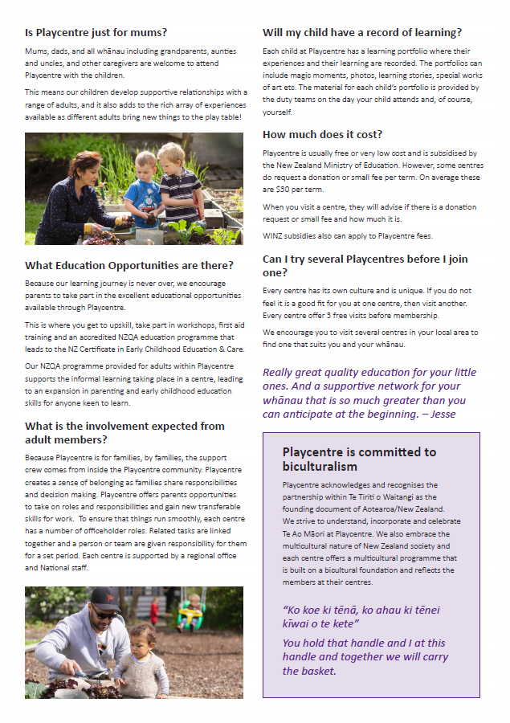
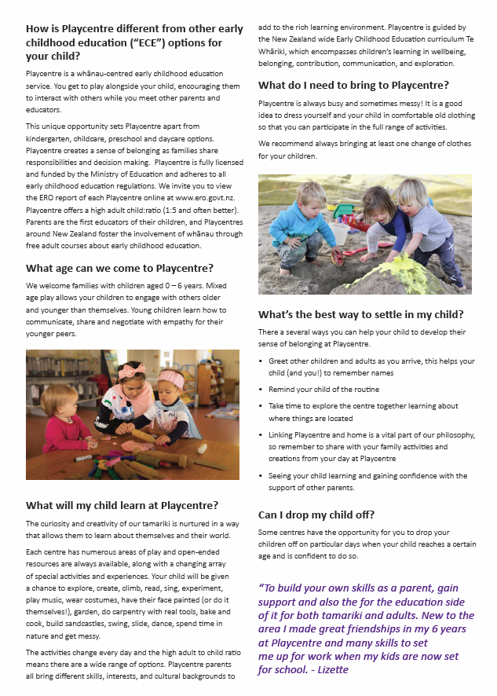
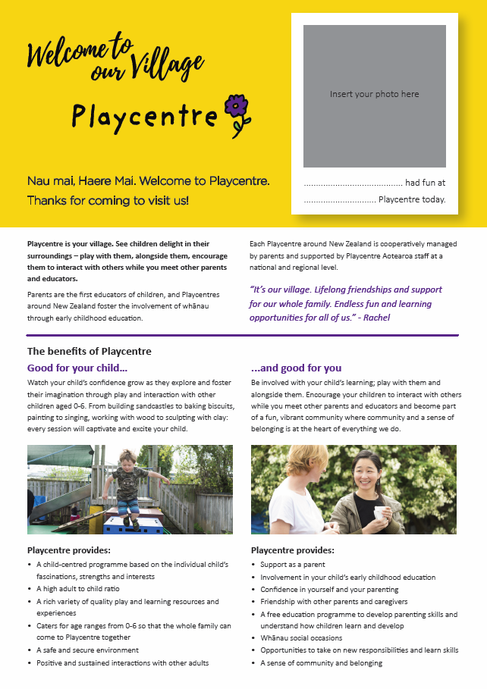
So Sam and their whānau is at the gate entering your Playcentre for the first time...now what?
If you see them approaching, help them with the gate and introduce yourself.
Ask their names, the names of their tamariki, their ages and interests.
If you are free show them around. If you aren’t free, be friendly and introduce them to someone else who can show them around.
Tell them a bit about Playcentre
Show them where the toilets are, changing table (if needed) and fire exit.
Provide them with a visitor sheet that they can read at home (there are templates available in the Resource Centre on our website).
Illustrate the supportive whānau environment and that tamariki build relationships with other adults and tamariki of all ages (this is unique to Playcentre).
Answer any questions they might have.

Slide 28
Helpful hints
Some centres find name badges (for both adults and tamariki helpful).
Decide prior as a centre how much information you want to give the visitor. Some prefer to give very little at the beginning and others like to state what is expected but emphasise that the time invested is very worthwhile.
Invite them to like your public social media pages.
If time allows, write a short learning story for them.
Take their contact details and keep a record of visitors (you can do this in the Discover app on your centre tablet) so that if they don’t initially join, over the next 12 months you can communicate with them and invite them to open days, events and community whānau activities.
Buddies – once a visitor enrols (or even before) buddy them up with a more experienced member that can help with any questions, orientation, working through the Welcome to Playcentre booklet etc.

Slide 29
After they visit
If you have the opportunity, after their visit send them a friendly email or text saying how nice it was to meet them and their tamariki and that you look forward to seeing them again. Letting them know, if they have any questions, feel free to ask. Keep it light-hearted.
Even if Playcentre isn’t for them, they can still be a source of word of mouth and may join in the future or recommend to a friend or someone in their network that they join.
Once someone does enrol, keep supporting them as they find their feet at Playcentre.
Get to know them, make them a part of your village and support them.
The ‘Welcome to Playcentre’ booklet which can be downloaded from our website
is a useful tool.
What would support Sam at this stage?

Slide 30
Sam’s time as a Playcentre member (internal PR)
4
Depending on the size of your centre, some of these ideas listed could be taken up by another role.
Coordinate social events for centre whānau and celebrate achievements.
Welcoming new visitors.
Following up with visitors who don’t return.
Arranging buddies for new whānau.
Give out certificates when appropriate. Templates for tamariki and adults are available on our website.
Arranging baking/meals/gifts for members going through difficulties or have new babies.
Birthday cards for members.
Publicise events occurring at the centre.
Taking photographs (ensuring that no imagery is to be used without signed consent from
the parents).
Internal newsletters and Facebook groups.
A ‘warm fuzzy’ board to share thanks to other members.
Assist with fundraising projects.
Manākitanga - enhance other peoples mana and your own so that it is a place where members are valued, accepted, encouraged and needed.
Promote a centre culture
where members are proud
of what they do and
support each other.
Celebrate each other and say positive things about other members out loud
to others.

Slide 31
More Information
This PR Toolkit and the PR resources outlined in this presentation are all available on the Playcentre website under PR/Communications (in the member only section).
We are here to support you and help your centre thrive. Please feel free to contact me on communications@playcentre.org.nz with any questions, ideas and feedback.

Slide 32
Thank you for choosing to be a part of the Playcentre Village and for volunteering to take up the Public Relations and Communications Officer role for your centre.

Slide 33
Karakia Whakamutunga
Koia kei runga Koia kei raro Koia kei waho Koia kei roto Ko te mauri ako Ko te mauri ora Kua tau, kua tau, kua tau e. | That which exists below That which exists externally That which exists internally It is the essence of our learning and teaching It is the essence of our physical existence Let it be at rest for now, let it be, let it be!

Slide 34


