Slide 1



Te Wāhanga Mātauranga Playcentre Education
Education Champions Info 2023-4

Slide 2

Karakia Tīmatanga
Kia hora te marino
Kia whakapapa pounamu te moana
Hei huarahi mā tātou i te rangi nei
Aroha atu, aroha mai
Tātou i ā tātou katoa
Hui ē! Tāiki ē!
May peace be widespread
May the seas be like greenstone
A pathway for us all this day
Let us show respect for each other
For one another Bind us all together!

Slide 3
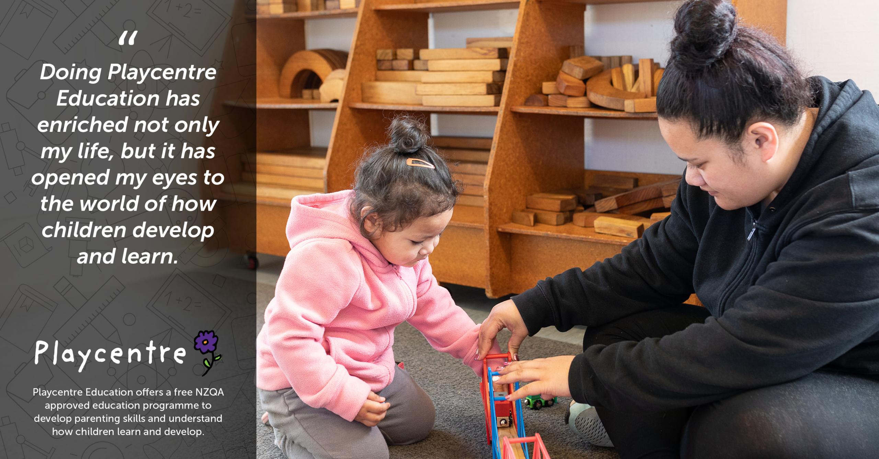

Slide 4

Kaiwhakaihuwaka – Champions of Education
Advocate for mātauranga – adult education
Promote and celebrate adult education
Support centre members to enrol and progress through the Playcentre Education programme
In some centres, organise first aid courses and request professional learning and development (PLD)

Slide 5
What is the education programme?
One qualification –
the NZ Certificate in Early Childhood Education and Care (Level 4)
  The Playcentre Introductory Award (PIA) and Playcentre Educator Award (PEA) are stepping stones on the way to the Level 4 certificate
  Primary Teacher Bridging Award for NZ primary teachers (3 modules of the certificate)
Nationally-recognised certificate
Designed for educators in Playcentre, home-based care and playgroups
Transferrable skills to the wider parenting, education and community sectors

Slide 6
The Programme
Ten modules
  Four Playcentre Educator modules
  PIA awarded after 1st two modules completed and PEA after all four PE modules
  Six Playcentre Leader modules
  Level 4 certificate awarded at the end of all ten modules
Blended delivery
  Face-to-face workshops available for some modules
  Online delivery for all modules
    Self-paced, self-study iQualify
    Live, interactive small group webinars

Slide 7
How is Playcentre Education unique?
Other providers also offer the Level 4 ECE certificate
Playcentre’s delivery designed to:
  Empower whānau to study while bringing their tamariki along to Playcentre
  Be hands-on and practical; involved in running Playcentre sessions and supporting tamariki learning
  Small modules – easy to start/stop with other life commitments
  Rolling enrolments throughout the year – start anytime

Slide 8
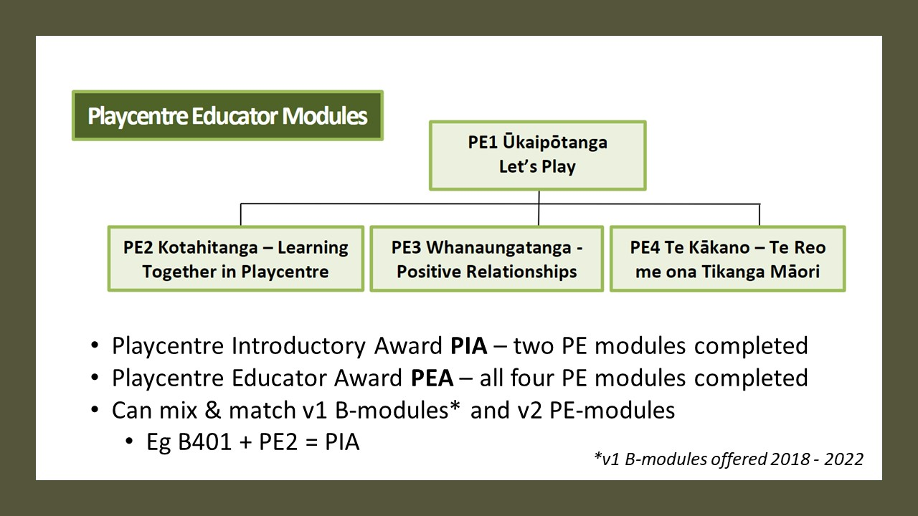

Slide 9
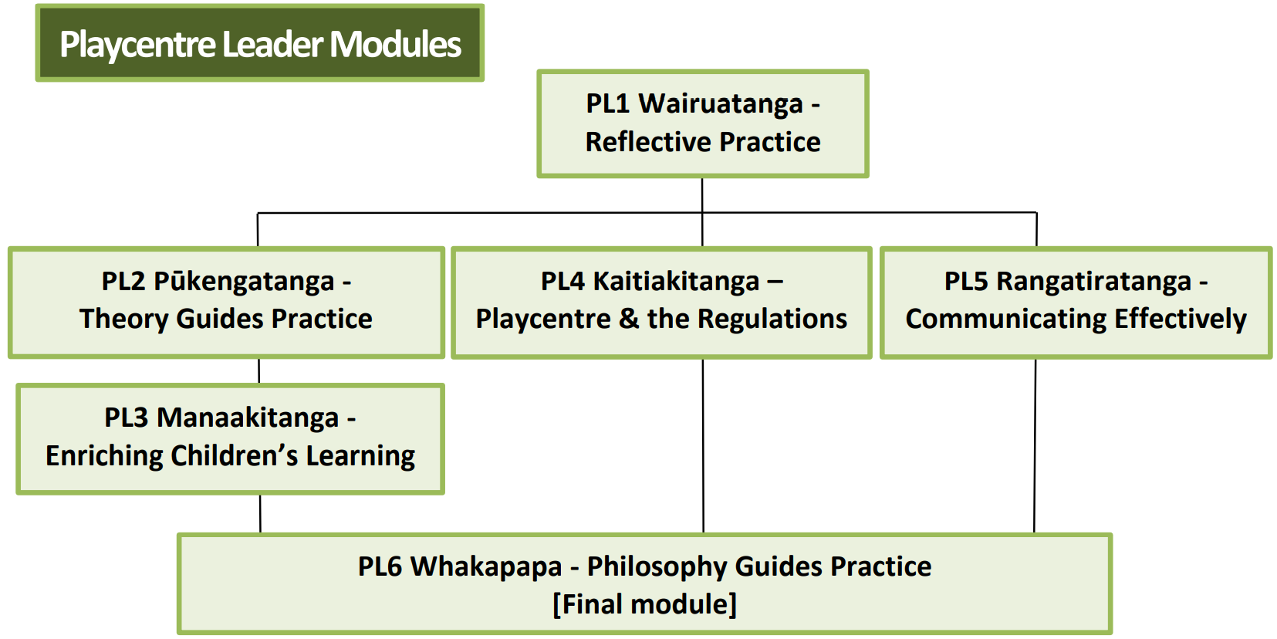

Slide 10
Education Timeline
Most ākonga are multi-tasking parents who are raising tamariki, doing Playcentre and may be working or with other volunteer commitments
Programme designed to be part-time but speed can be increased for those who want to move quicker
Average completion times for part-time study, attending Playcentre 1-2 times per week
  PIA – 1 to 2 terms
  PEA – 1 to 2 terms
  Playcentre Leader modules – 2 to 3 terms

Slide 11
Education Timeline
Ākonga can enrol in two modules at a time
Practicum includes 40 Playcentre sessions ie once per week for a year
Can stop/start at any point, however we encourage ākonga to finish all modules they start
Low completion rates may impact opportunities for future ākonga
Fastest graduate to date – 6 months from start to finish

Slide 12
New Enrolments
All new participants start with PE1 Ūkaipōtanga - Let’s Play
  Face-to-face, webinar or iQualify online options
  When they sign up for the first module via the Playcentre website, participants receive a auto confirmation email with a link to download an enrolment pack
  Remind people to check junk folder
All upcoming module options are listed on the website under
Learn with Us → Playcentre Education → Upcoming Workshops and Online Modules https://www.playcentre.org.nz/learnwithus/upcoming-workshops-and-online-modules/

Slide 13

New Enrolments
Enrolment pack includes:
  Student handbook
  Enrolment form
  Recognition of Prior Learning (RPL) form (to apply for
  credit for previous study or work experience)
  Police vetting form
  Safety check form
  As part of the police vet/safety checking process, two forms of ID must also be verified by a Playcentre Aotearoa staff member, proof of NZ/Aus citizenship or residency

Slide 14
Verifying ID
Any Playcentre staff member or Person Responsible
can verify ID
  Sight the original
  Sign and date a copy with “I verify this is a true and
  correct copy.”
  Full info here 7.2.3c – How to verify identity documents for police vets | Playcentre
Things to remember
  Front and back of licenses must be copied (expiry date is on the back)
  ID must be current (new in 2023)
  NZ birth certificates issued after 1998 (earlier certificates can be re-issued)

Slide 15
Continuing Students
All upcoming module options are listed on the website under Learn with Us → Playcentre Education → Upcoming Workshops and Online Modules https://www.playcentre.org.nz/learnwithus/upcoming-workshops-and-online-modules/
The website groups options into:
  Online – iQualify and webinar – these are offered nationally
  Regional face-to-face workshops
If a learner has been inactive for more than two years, they will be asked to complete a re-enrolment form

Slide 16
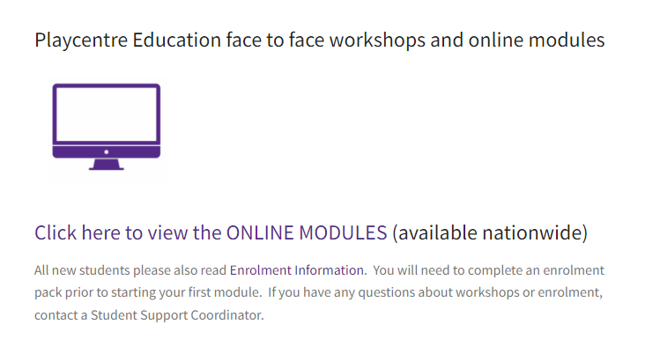
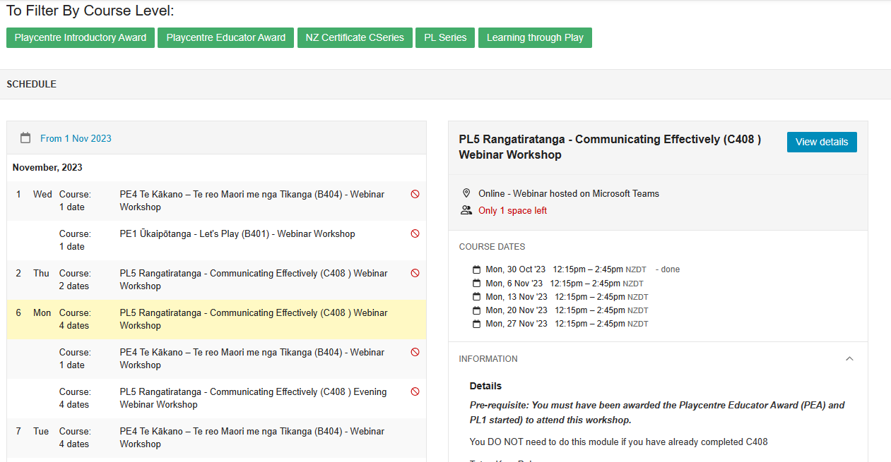
Booking for Online Modules

Slide 17
Booking for Online Modules
All online modules are run nationally
Webinars or self-directed iQualify
Webinars added at the end of a term for following term
  Additional webinars added to meet demand
iQualify groups
  PE1, PE2, PE3 – 1st and 15th intakes (no 15th if in the school holidays)
  PL1, PL2, PL3, PL4 – intakes 1st of each month Feb – Dec
  PL6 – intake 15th of each month Feb – Nov, will do a late Jan 2024 intake date TBC
  PL6 by invitation when all other modules finished or nearly finished. Contact Haley haley.education@playcentre.org.nz if you think this is you and haven’t heard ☺

Slide 18

Booking & Requesting Face-to-Face Workshops
Modules available face-to-face
  Learning through Play workshops (standalone or
  as part of PE1, PE2, PL1, PL3)
  PE1 Ūkaipōtanga – Let’s Play
  PE2 Kotahitanga – Learning Together in Playcentre
  PE3 Whanaungatanga – Positive Relationships
  PE4 Te Kākano – Te Reo me ona Tikanga Māori
  PL5 Rangatiratanga – Communicating Effectively
Centres can request to host
  Provide possible dates/times/potential numbers
  Centres in UNI & CNI (all centres north of Taupō) – Barbara.education@playcentre.org.nz
  Centres in LNI and South Island – Chrissie.education@playcentre.org.nz

Slide 19
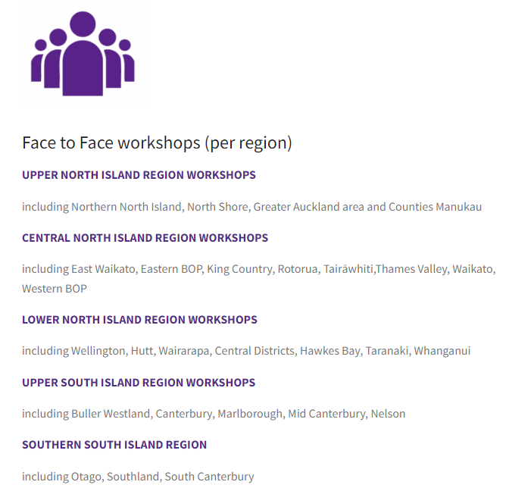
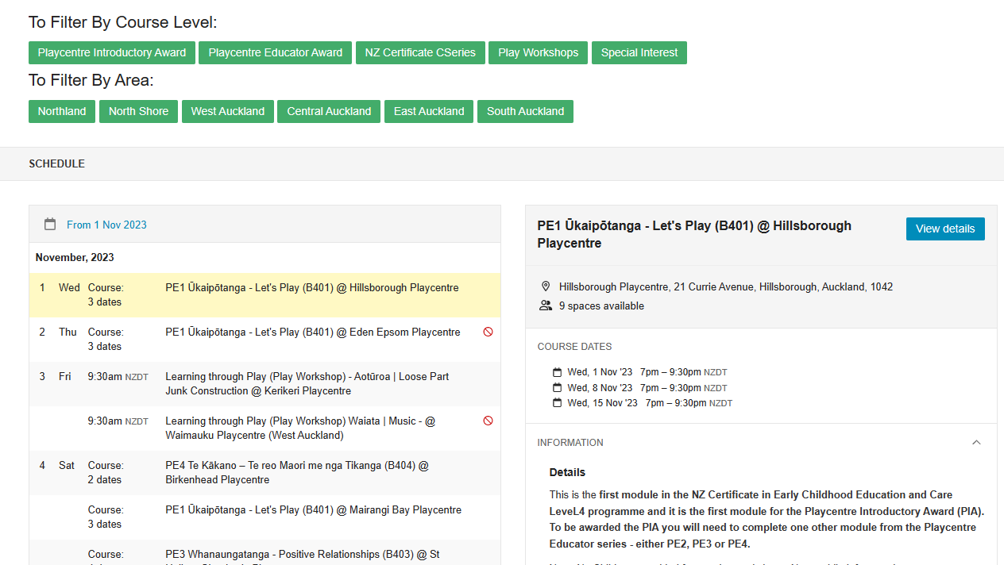
Booking for Face-to-Face Workshops

Slide 20
Hosting Workshops
Make your centre accessible at the day/time pre-arranged with the Education team. If held outside a session time, your centre needs to designate someone to open up/lock and relay any info.
Provide the necessary equipment for the workshop tables, chairs. The facilitator may also require access to relevant books which should be available from your centre’s library (i.e. Te Whāriki, Equipment for Playcentres).
Have tea and coffee available.
If on session, provide adults to supervise any tamariki who are present to ensure their safety during the event. (Discuss capacity to do this in advance with Ed team)

Slide 21
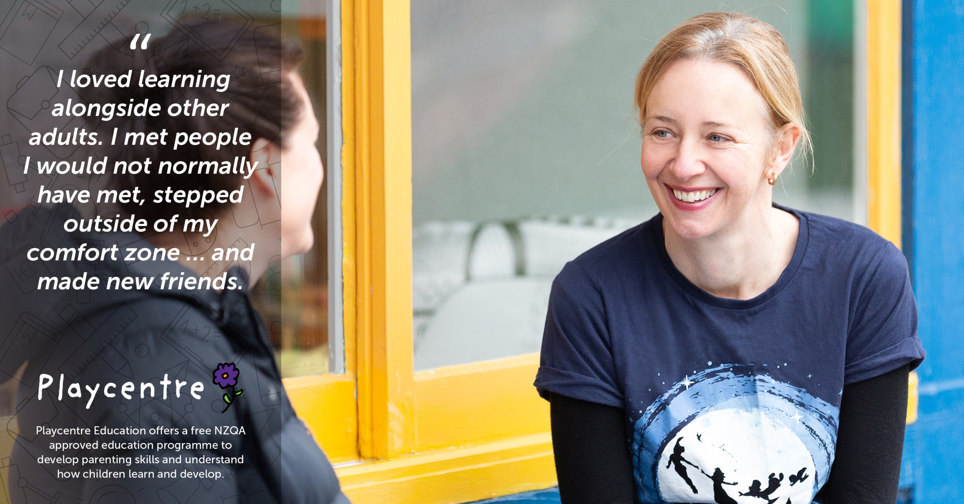

Slide 22
Creating a Place for Ūkaipōtanga
PE1 Ūkaipōtanga – Let’s Play
Ūkaipōtanga is feeling a sense of belonging and grounding to where you are
PE1 helps whānau better understand how Playcentre works to create belonging; at the same time whānau need to feel that they belong to take the first step to sign up
How do you create a senses of ūkaipōtanga for new whānau and introduce Playcentre Education?

Slide 23
Promoting the Benefits for Whānau & Centres
Understand how tamariki learn and develop
Build strong relationships as skilled parents and kaiako educators
Place for participants to learn and share ideas & strategies
Develop skills and confidence to contribute to quality sessions
Support centre licensing (funding)
Strengthen inclusive practice and diversity
FREE qualification (worth $1500-2000) recognised nationally

Slide 24

Promoting Education
Share your passion for education – share light bulb moments
Connect with other centres in your cluster to organise workshops
Communicate education benefits for caregivers, tamariki and the centre

Slide 25

Supporting Education
Encourage members to enrol in the programme and check in regularly about their progress
Support members to complete assessments e.g cover office holder roles or give them time on session to do observations
Organise write up sessions with food,
time for discussion and to write up assessments

Slide 26
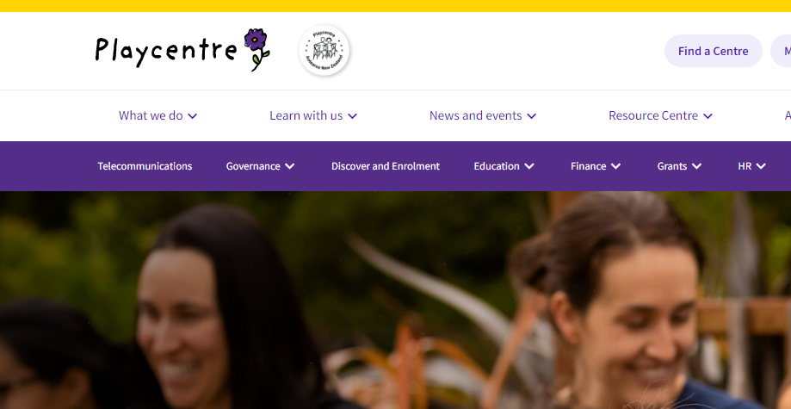
Website – Public Area and Members Area

Slide 27

Receiving and Celebrating Awards
Centres are notified by email when members are
awarded PIA, PEA, PPTBA and L4 certificates
PIA, PEA, PPTBA certificates are sent to centres via post or
via Centre Advisors
Level 4 certificates posted directly to ākonga
Celebrate awards at centre hui or a special event
Offer small perks for achieving awards eg a book, play resource, kai
Some centres have a wall to celebrate award and certificate graduates

Slide 28
RPL and Other ECE Qualifications
To learn more about recognition of prior learning (RPL), contact an Education Student Support Coordinator prior or at enrolment
People holding an ECE qualification Level 4 or above cannot enrol in the certificate, however can be utilized as Person Responsible (PR) for licensing Playcentre sessions.
  Check the 2022-go4611.pdf (gazette.govt.nz) for accepted qualifications to be PR
International ECE qualifications that have been assessed through NZQA, as being equivalent to NZ ECE qualifications listed on the gazetted list of qualifications, are considered for person responsible.

Slide 29

Primary Teaching Qualifications
Primary teachers can RPL into the L4 certificate
On completion of the Playcentre Primary Teacher Bridging Award, they are recognised as Person Responsible
Bridging award includes:
  PE1 Ūkaipōtanga – Let’s Play
  PL2 Pūkengatanga – Theory Guides Practice
  PL4 Kaitiakitanga – Playcentre and the Regulations
More information on website https://www.playcentre.org.nz/learnwithus/playcentre-education/primary-teachers-in-playcentre/

Slide 30
Transitioning between programme
Prior to 2018, Playcentre offered the Playcentre Diploma in Adult and Early Childhood Education (Level 6)
  Courses 1 – 6
  Courses 2 & 3 can still transition into the new programme
  Course 4, 5, 6 – at level 5-6 and considered a higher level study already – cannot enrol
In 2023, Playcentre Education transitions from v1 to v2 of the NZ Certificate in Early Childhood Education and Care (Level 4)
  All ākonga should now be in v2. Contact the Education Team if you started pre-2023 and are unsure of your next steps.

Slide 31
Privacy and Copyright
Education will contact centres 2x per year with a list of enrolled ākonga. Please return this form to indicate who is no longer at centre. Education will follow up with individuals to confirm.
Education is unable to share ākonga progress information with Education Officers or Centre Advisors due to student privacy obligations. The best way to find out someone’s progress is to ask them in a supportive way.
Education pays a Copyright licensing fee for resources provided to students. Materials are provided for student use only.
We discourage centres from keeping copies of old resources at centre due to Copyright obligations and because they change from time-to-time.

Slide 32

Useful Info for Education Champions to Know
Website for booking into modules
Student handbook
Playcentre Education fact sheet
How to support ākonga through PIA and PEA guidelines
All of these are available on the Playcentre website – remember there is the public area and the members’ area
Playcentre Education Champions Facebook group (moderated by Playcentre Education)

Slide 33

Adult Library Resources
Required and recommended readings lists updated for 2023
List available on the website Playcentre-Education-Required-Readings-v2.pdf

Slide 34
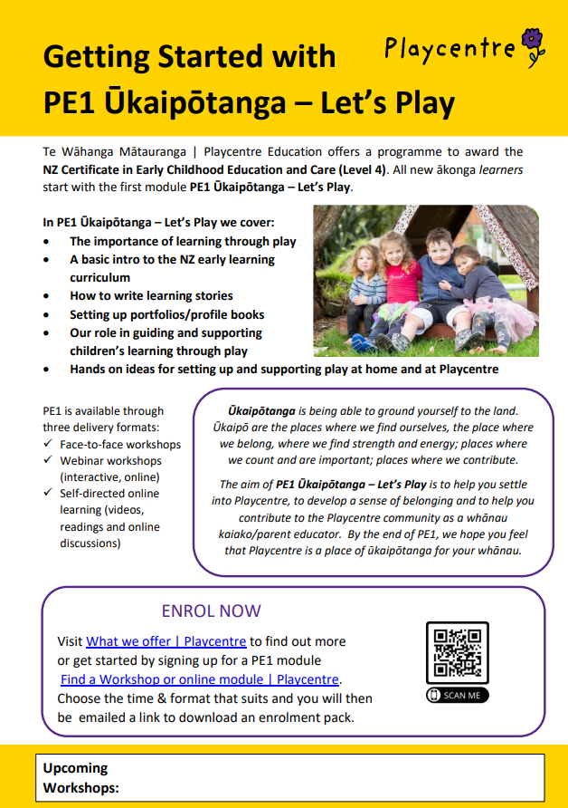
Playcentre Education Posters
A3 and A4 size available on the Playcentre website in the members area
  A3 good for walls
  A4 great for new family intro packs
Also Learning through Play Workshops poster
Posters for face-to-face modules
Images/text for social media coming soon

Slide 35


Any other pātai?

Slide 36
Karakia Whakamutanga
Kua mutu ā mātou mahi
Mō tēnei wā
Manaakitia mai mā katoa
O mātou hoa
O mātou whānau
Aio ki te Aorangi
Our work is finished
For the moment
Blessing upon us all
Our friends
Our families
Peace to the Universe

Slide 37


