Slide 1



Playcentre Education
Education Officer Training 2022

Slide 2

Nāu te rourou, nāku te rourou, ka ora ai te iwi
With your food basket (contribution) and my food basket,
the people will prosper

Slide 3
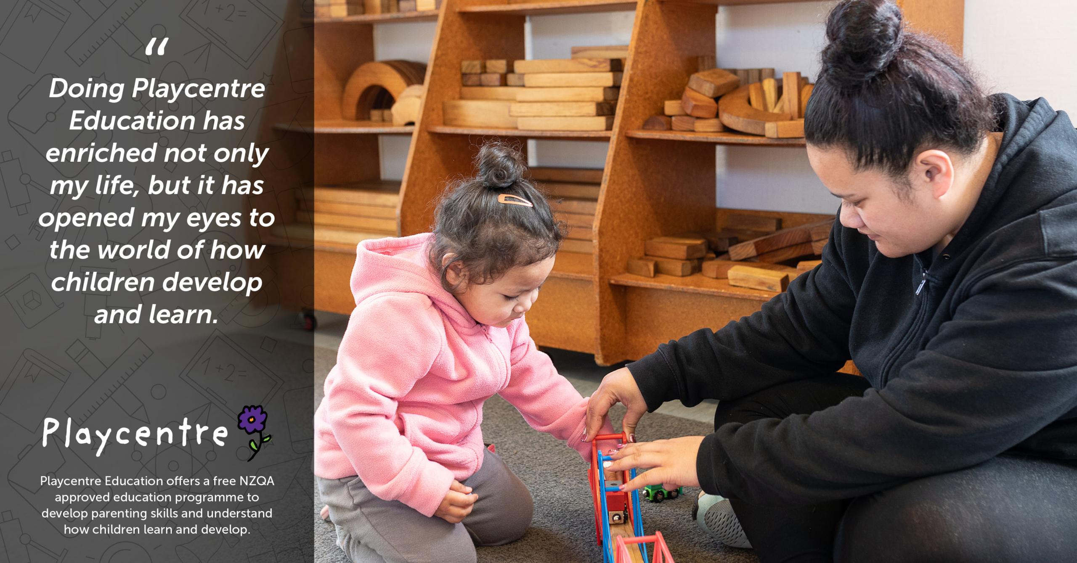

Slide 4

Centre Education Officer Role
Advocate for mātauranga – adult education
Promote and celebrate adult education
Support centre members to progress through the Playcentre Education programme
In some centres, organise first aid courses and request professional learning and development (PLD)

Slide 5

Promoting Education
Share your passion for education – share light bulb moments
Connect with other centres in your cluster to organise workshops
Communicate education benefits for caregivers, tamariki and the centre

Slide 6

Supporting Education
Encourage members to enrol in the programme and check in regularly about their progress
Support members to complete assessments e.g cover office holder roles or give them time on session to do observations
Organise write up sessions with food,
time for discussion and to write up assessments

Slide 7
What is the education programme?
One qualification – the NZ Certificate in Early Childhood Education and Care (Level 4)
  The Playcentre Introductory Award (PIA) and Playcentre Educator Award (PEA) are stepping stones on the way to the Level 4 cert
Nationally recognised certificate
Designed for educators in Playcentre, home-based care and playgroups
Transferrable skills to the wider parenting, educator and community sectors

Slide 8
How is Playcentre Education unique?
Other providers also offer the Level 4 ECE certificate
Playcentre’s delivery designed to:
  Empower whānau to study while bringing their tamariki along to Playcentre
  Be hands-on and practical; involved in running Playcentre sessions and supporting tamariki learning
  Small modules – easy to start/stop with other life commitments
  Rolling enrolments throughout the year – start anytime

Slide 9
The Programme
Ten modules
  Four Playcentre Educator modules
  PIA awarded after 1st two modules completed and PEA after 1st four
  Six Playcentre Leader modules
  Level 4 certificate awarded at the end of all ten modules
Blended delivery
  Face-to-face workshops available for some modules
  Online delivery for all modules
    Self-paced, self-study iQualify
    Live, interactive small group webinars

Slide 10
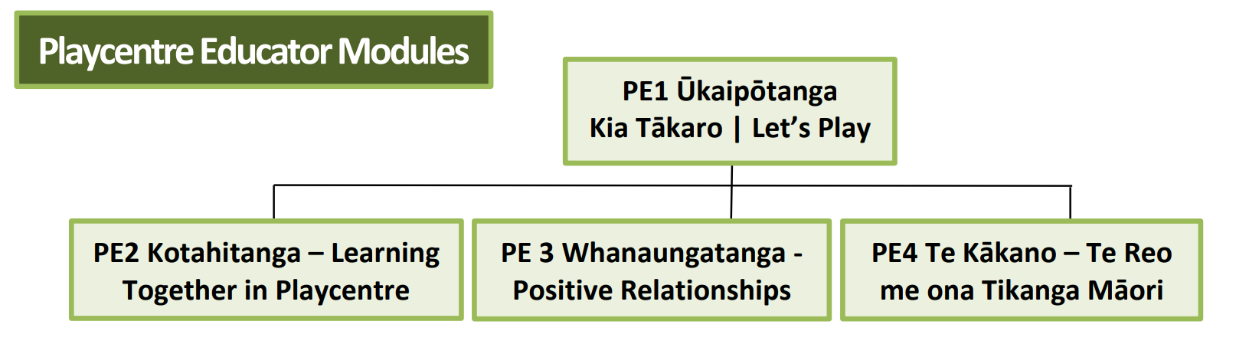

Slide 11
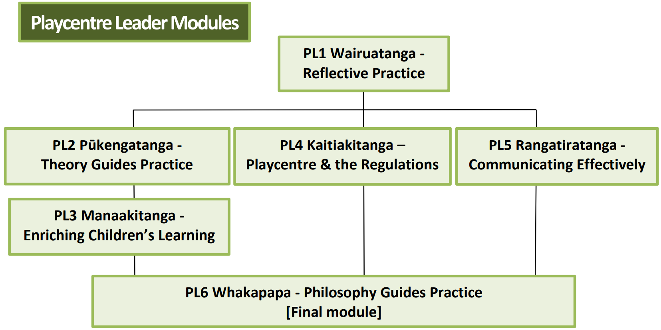

Slide 12
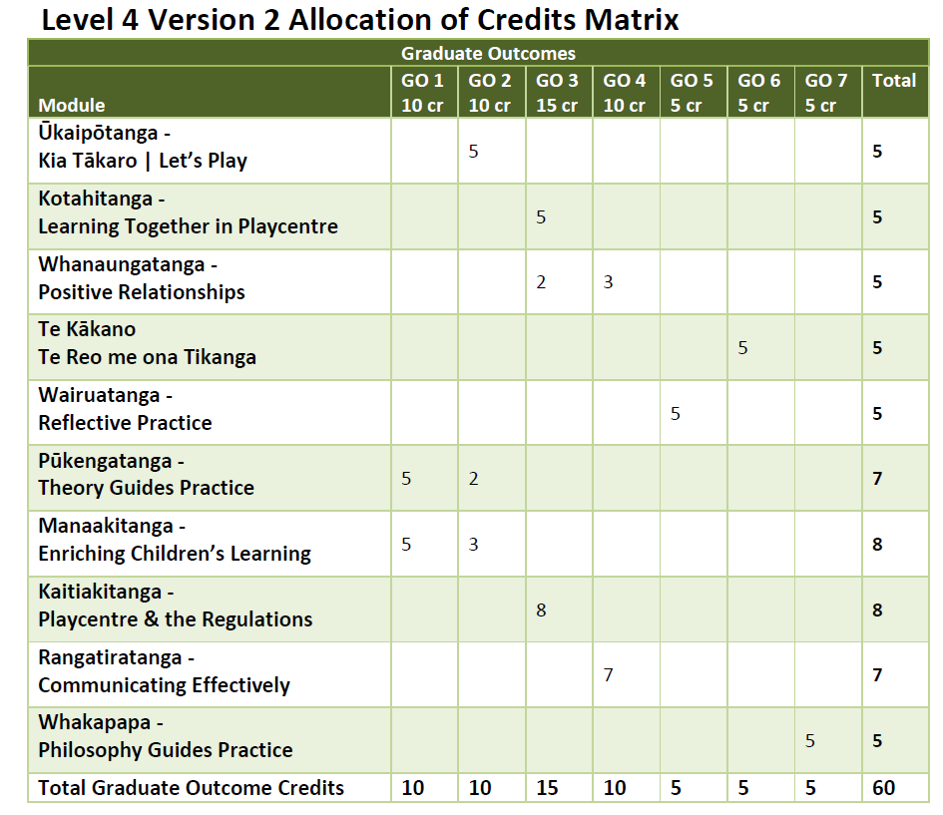
Meets the outcomes of the NZ Certificate in Early Childhood Education and Care (Level 4)
NZQA qual ref: 2850-2

Slide 13
Education Timeline
Most ākonga are multi-tasking parents who are raising tamariki, doing Playcentre and may be working or with other volunteer commitments
Programme designed to be part-time but speed can be increased for those who want to move quicker
Average completion times for part-time study, attending Playcentre 1-2 times per week
  PIA – 1 to 2 terms
  PEA – 1 to 2 terms
  Playcentre Leader modules – 2 to 3 terms

Slide 14
Education Timeline
Ākonga can enrol in two modules at a time
Practicum includes 40 Playcentre sessions ie once per week for a year
Can stop/start at any point, however we encourage ākonga to finish all modules they start
Low completion rates may impact opportunities for future ākonga
Fastest graduate to date – 8 months from start to finish

Slide 15
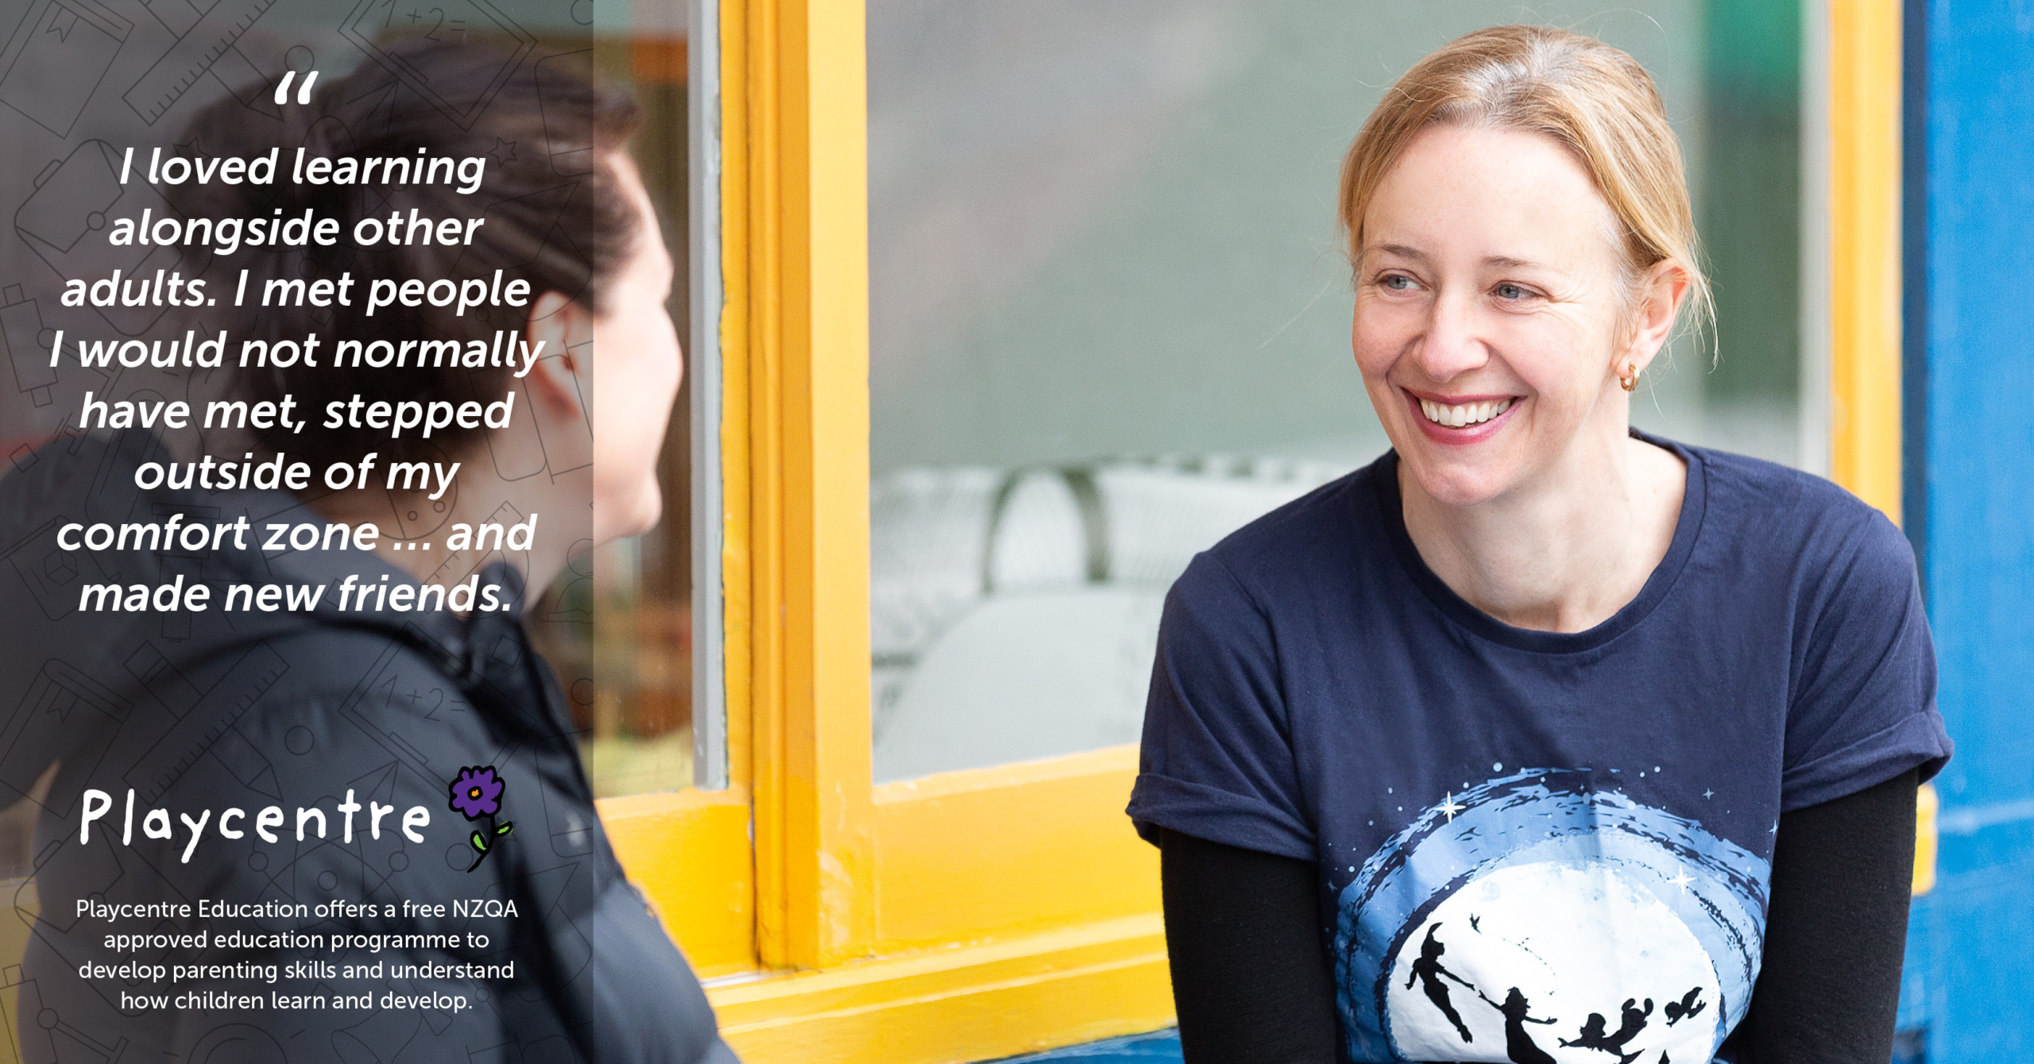

Slide 16
Promoting the Benefits for Whānau & Centres
Understand how children learn and develop
Build strong relationships as skilled kaiako (educators)
Space for participants to share ideas and strategies
Develop skills and confidence to contribute to quality sessions
Support centre licensing (funding)
Strengthen inclusive practice and diversity
FREE qualification (worth $1500-2000) recognised nationally

Slide 17
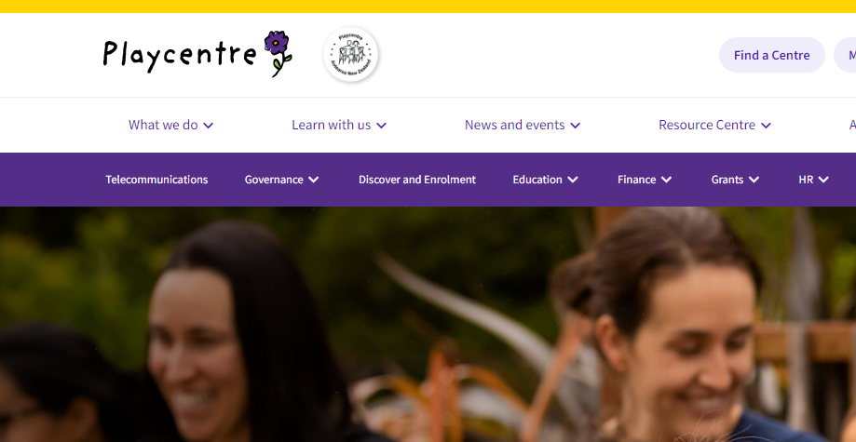
Website – Public Area and Members Area

Slide 18
New Enrolments
All new participants start with Kia Tākaro | Let’s Play
  Module code PE1 from 2023, previously B401
  Face-to-face, webinar or iQualify online options
  Participants are emailed an enrolment pack when they sign up for the first module via online booking
All upcoming module options are listed on the website under Learn with Us → Playcentre Education → Upcoming Workshops and Online Modules https://www.playcentre.org.nz/learnwithus/upcoming-workshops-and-online-modules/

Slide 19

New Enrolments
Enrolment pack includes:
  Student handbook
  Enrolment form
  Recognition of Prior Learning (RPL) form (to apply for
  credit for previous study or work experience)
  Police vetting form
  Safety check form
  As part of the police vet/safety checking process, two forms of ID must also be verified by a Playcentre Aotearoa staff member, proof of NZ/Aus citizenship or residency

Slide 20
Continuing Students
All upcoming module options are listed on the website under Learn with Us → Playcentre Education → Upcoming Workshops and Online Modules https://www.playcentre.org.nz/learnwithus/upcoming-workshops-and-online-modules/
The website groups options into:
  Online – iQualify and webinar – these are offered nationally
  Regional face-to-face workshops
If a student has been inactive for more than two years, they will be asked to complete a re-enrolment form

Slide 21
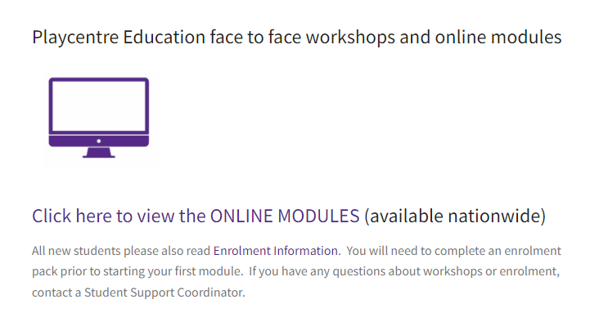
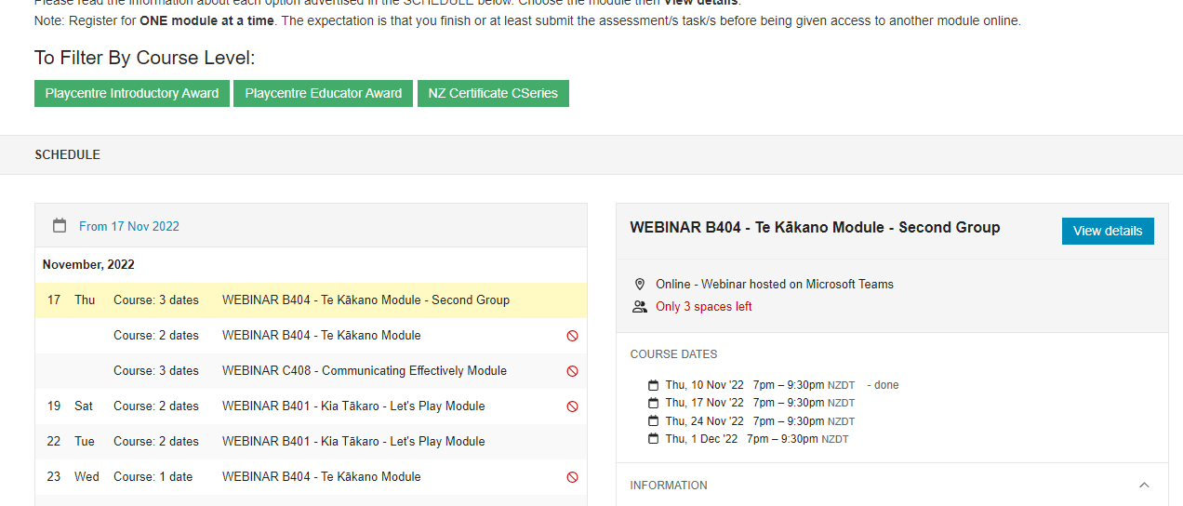
Booking for Online Modules

Slide 22
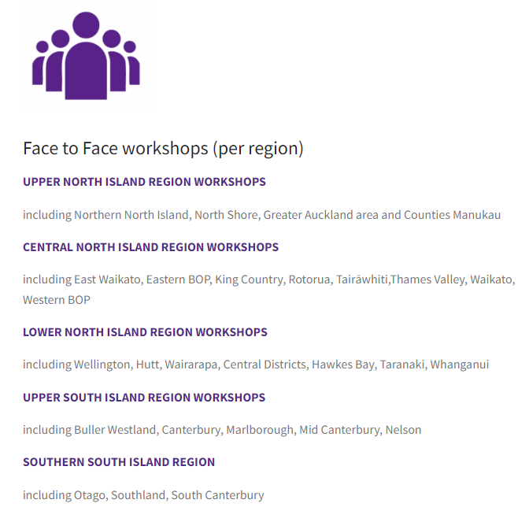
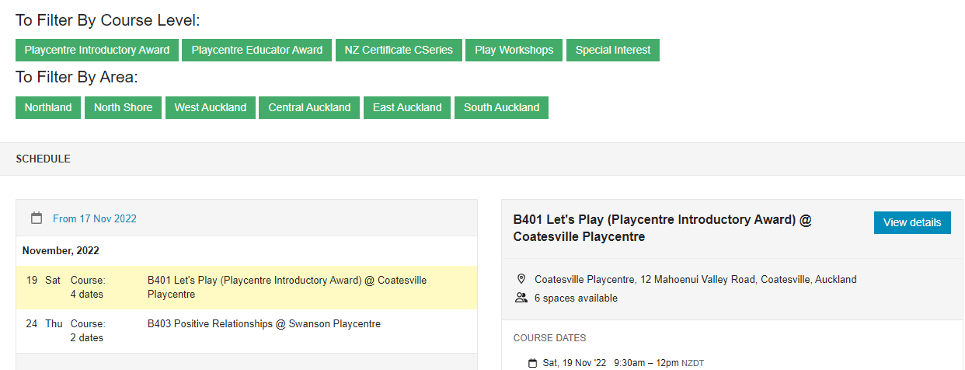
Booking for Face-to-Face Workshops

Slide 23

Receiving and Celebrating Awards
Centres are notified by email when members are
awarded PIA, PEA, PPTBA and L4 certificates
PIA and PEA awards are sent to centres via post or
via Centre Advisors
Level 4 certificates posted directly to ākonga
Celebrate awards at centre hui or a special event
Offer small perks for achieving awards eg a book, play resource, kai

Slide 24
RPL and Other ECE Qualifications
To learn more about recognition of prior learning (RPL), contact an Education Student Support Coordinator prior or at enrolment
People holding an ECE qualification Level 4 or above cannot enrol in the certificate, however can be utilized as Person Responsible (PR) for licensing Playcentre sessions.
  Check the 2022-go4611.pdf (gazette.govt.nz) for accepted qualifications to be PR
International ECE qualifications that have been assessed through NZQA, as being equivalent to NZ ECE qualifications listed on the gazetted list of qualifications, are considered for person responsible.

Slide 25

Primary Teaching Qualifications
Primary teachers can RPL into the L4 certificate
On completion of the Playcentre Primary Teacher Bridging Award, they are recognised as Person Responsible
Bridging award includes:
  PE1 Kia Tākaro – Let’s Play
  PE2 Theory Guides Practice
  PE4 Playcentre and the Regulations
More information on website https://www.playcentre.org.nz/learnwithus/playcentre-education/primary-teachers-in-playcentre/

Slide 26
Transitioning between programme
Prior to 2018, Playcentre offered the Playcentre Diploma in Adult and Early Childhood Education and Care (Level 6)
  Courses 1 – 6
  Courses 2 & 3 can still transition into the new programme
  Course 4, 5, 6 – at level 5-6 and considered a higher level study already – cannot enrol
In 2023, Playcentre Education transitions from v1 to v2 of the NZ Certificate in Early Childhood Education and Care (Level 4)
  All students will be contacted to confirm what this means for them
  No one disadvantaged. Updated content, refreshed look, changes in response to feeback

Slide 27
Requesting Workshops
Collaborate with other centres in your area to find out who needs what
Provide as much info to the Education team as possible
  Modules, days/times, on-session/off-session (off session preferable if possible)
Face-to-workshops available for:
  PE1 Ūkaipōtanga – Kia Tākaro Let’s Play
  PE2 Kotahitanga – Learning Together in Playcentre
  PE3 Whanaungatanga – Positive Relationships
  PE4 Te Kākano – Te Reo me ona Tikanga Māori
  PL5 Rangatiratanga – Communicating Effectively

Slide 28
Hosting Workshops
Make your centre accessible at the day/time pre-arranged with the Education team. If held outside a session time, your centre needs to designate someone to open up/lock and relay any info.
Provide the necessary equipment for the workshop tables, chairs. The facilitator may also require access to relevant books which should be available from your centre’s library (i.e. Te Whāriki, Equipment for Playcentres).
Have refreshments available (milk, tea, coffee, sugar).
If possible, provide adults to supervise any children who are present to ensure their safety during the event. (Capacity to do this discussed in advance with Ed team)

Slide 29
Privacy and Copyright
Education will contact centres 2x per year with a list of enrolled ākonga. Please return this form to indicate who is no longer at centre. Education will follow up with individuals to confirm.
Education is unable to share ākonga progress information with Education Officers or Centre Advisors due to student privacy obligations. The best way to find out someone’s progress is to ask them in a supportive way.
Education pays a Copyright licensing fee for resources provided to students. Materials are provided for student use only.
We discourage centres from keeping copies of old resources at centre due to Copyright obligations and because they change from time-to-time.

Slide 30

Useful Info for Education Officers to Know
Website for booking into modules
Student handbook
Playcentre Education fact sheet
How to support ākonga through PIA and PEA guidelines
Education Fact Sheet
All of these are available on the Playcentre website – remember there is the public area and the members area
Playcentre Education Officers Facebook group (not official)

Slide 31

Adult Library Resources
Required and recommended readings lists to be updated for 2023
Details out soon

Slide 32
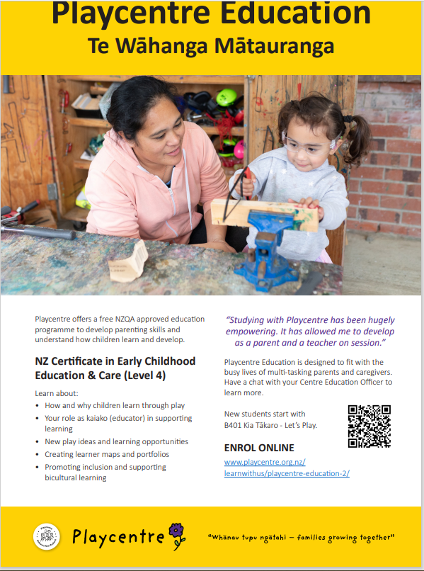
Playcentre Education Posters
A3 and A4 size available on the Playcentre website in the members area
A3 good for walls
A4 great for new family intro packs

Slide 33
Website
Future members – benefits of education for adults
https://www.playcentre.org.nz/future-members/education/
Current members – find a workshop and online
modules, enrolment information and education contact details
Find a Workshop or online module | Playcentre
Centre Resources – Teaching and learning , Te Whariki spotlights
https://www.playcentre.org.nz/centre-resources/te-whariki-spotlight/
Virtual Village – Play Insights, education resources
https://www.playcentre.org.nz/virtual-village/play-insights-education-resources/

Slide 34


