Slide 1
Welcoming / New Families
Office Holder Role Training

Slide 2
Karakia tīmatanga
Tūtawa mai i runga
Tūtawa mai i raro
Tūtawa mai i roto
Tūtawa mai i waho
Kia tau ai
Te mauri tū
Te mauri ora
Ki te katoa
Haumi ē, hui ē, tāiki ē!
Come forth from above, below, within and from
The environment
Vitality and wellbeing for all
Strengthened in unity!
Nā Scotty Morrison

Slide 3
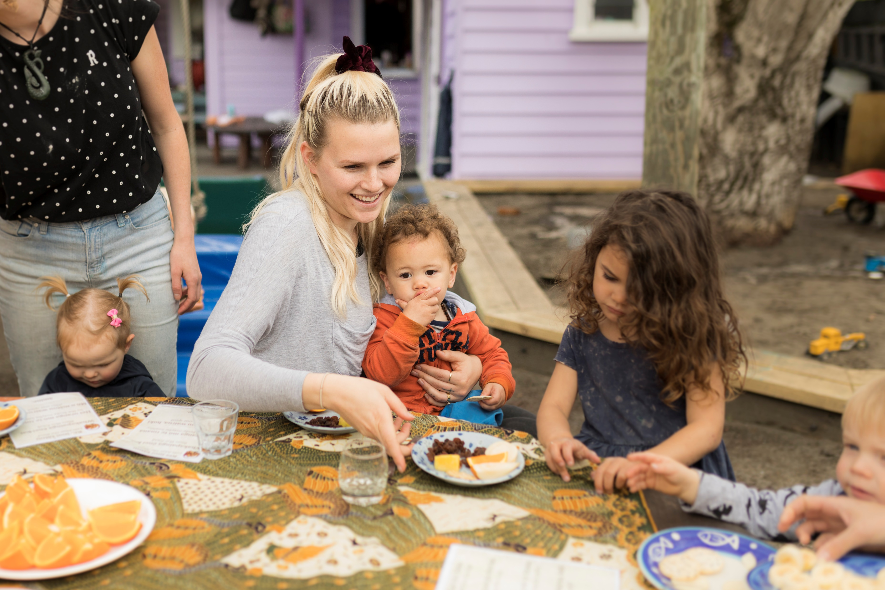
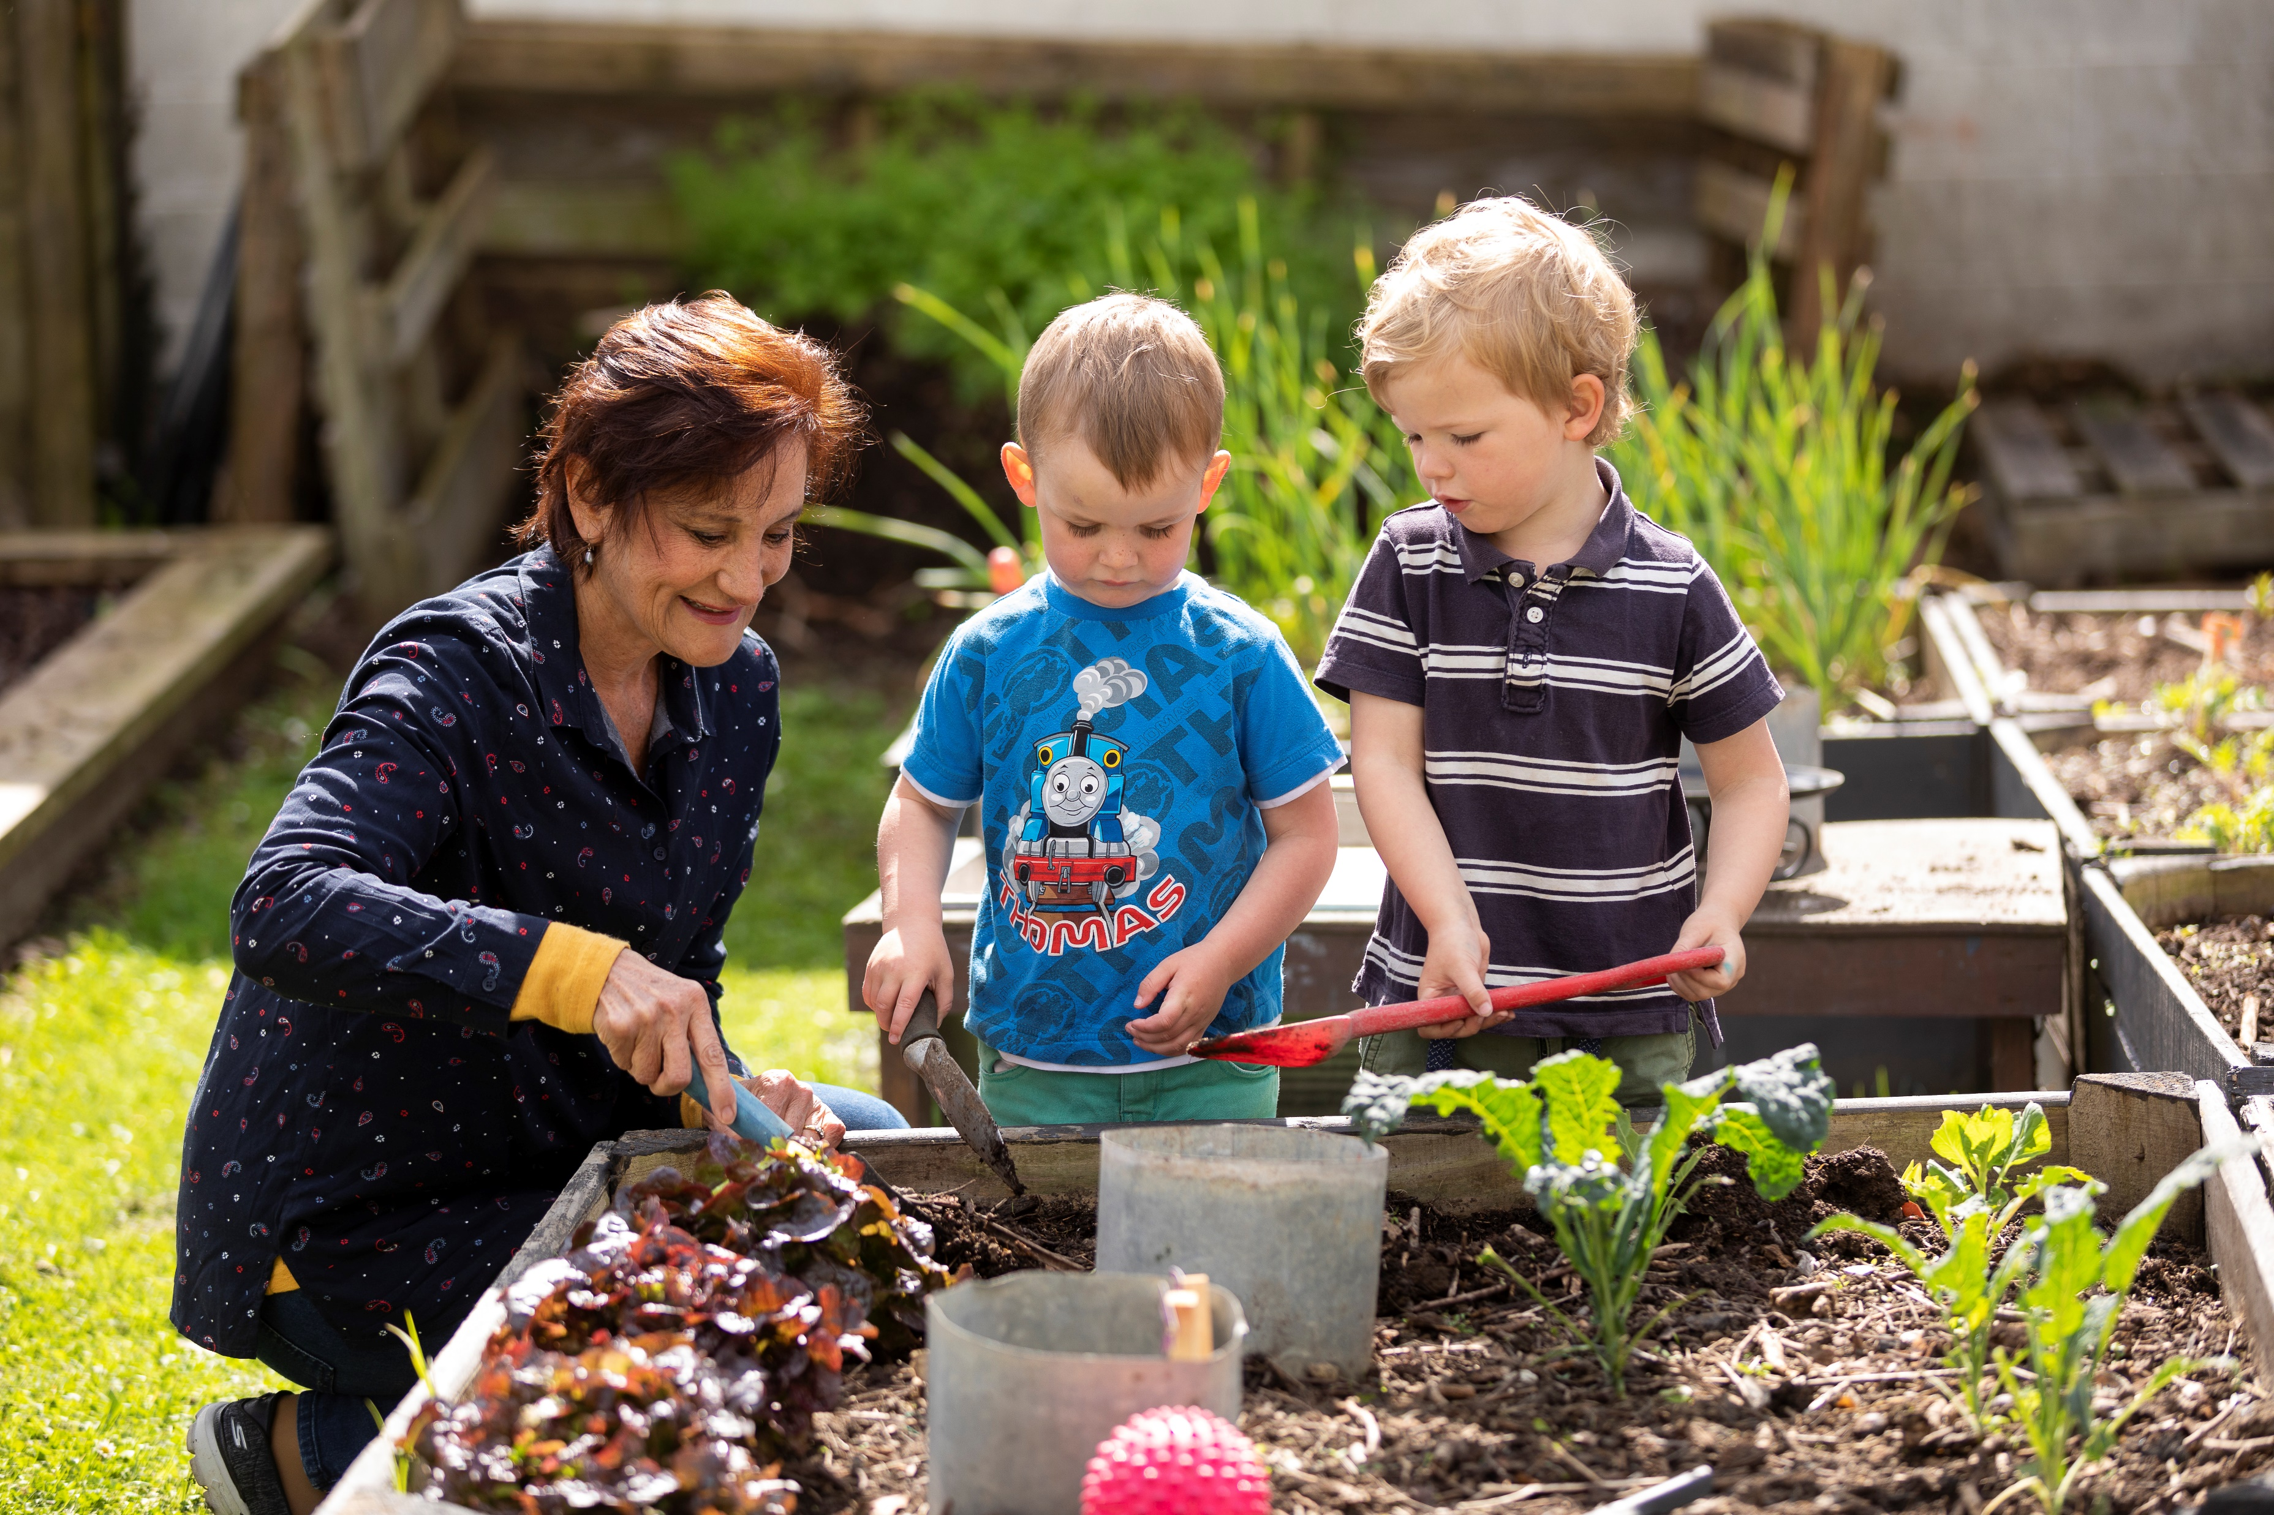
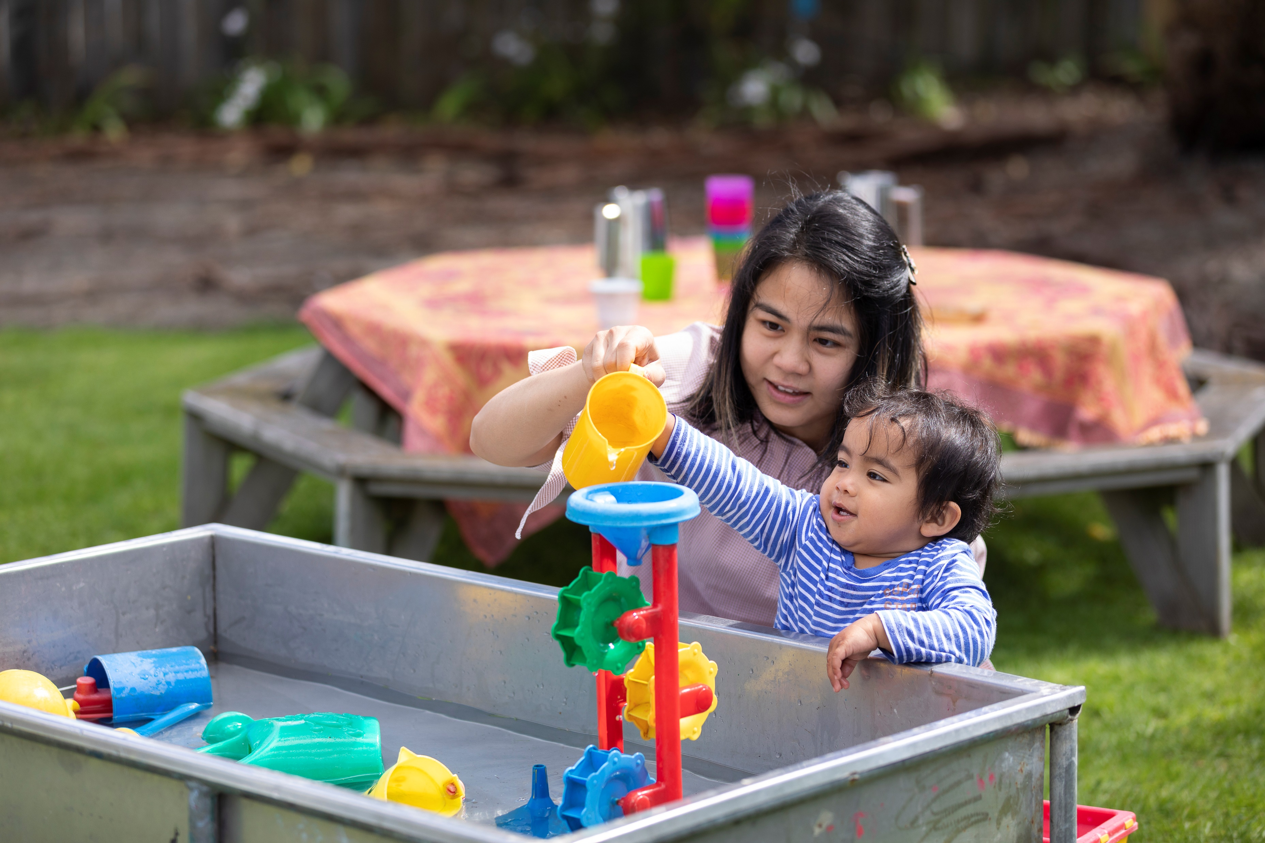
New Families role is very important for the centre
You will often be the first point of contact for someone thinking of joining
There can be a bit of behind-the-scenes work, responding to enquiries, following up etc
You don’t have to do everything, especially since you may not be at every session
Notes:
Having new families joining the centre is crucial for centres ongoing membership
Ideally suited to someone who has been there for a while, or just loves Playcentre
Not everyone who enquires will join
Understanding why someone isn’t joining is also valuable information
The focus is to have everyone who is meant to join Playcentre to enrol

Slide 4
Your Role May Include…..
Managing Visitor Enquiries
Organising Visits
Following-up with Visitors
Supporting Visitors to Enrol
Inducting New Members to your Centre
Notes:
Enquiries – your first main activity may be following up enquiries - check where these come from for your Centre.
These can come from email, Facebook, Twitter, phone, etc. The person at your Centre who opens emails needs to know to send these on to you.
Make sure you do respond to enquiries as quickly as possible
Visits - the best way to experience what Playcentre is all about
When someone is enquiring, the “goal” is to book them in for a visit so they can experience Playcentre for themselves.
They might want to know a little more about Playcentre before they visit. Think about the key points (sometimes called an Elevator Speech) that you will share with someone who asks what Playcentre is all about. For example:
“It's a parent-run early childhood centre that is great fun for the children who all learn through play.
It’s also great for the parents as we get to be involved with the children and learn alongside them”.
Your centre will have its own culture and its own amazing qualities, so to help you create your own key points about your Playcentre, you could run an ice breaker or question current members ”When you first joined, what really appealed?” This blurb would be great to include on your centre page on the website. Ensure the open days and contact details are correct.

Slide 5
Successful Visits
The most important thing you can do as a centre is to be welcoming and friendly.
First visit
Think about this visit as welcoming the whānau into your own home
Second Visit
Support your visitors to really feel at home, and free to explore and ask questions
Third Visit
Talk about what your centre is like, how they may fit in, how to join etc.
Enrolment
Support them through the enrolment process
Notes:
As a centre be welcoming and friendly.
Ideally have a person who is the main point of contact e.g. how to sign in on the Discover tablet, where to put their bag, where the toilets and change tables are. This person doesn’t have to be you but is a key role
Consider name badges for everyone, including current and visiting members
Chalkboard & Facebook post – ‘Welcome Ann and Chloe to Playcentre!’
Remember it can take a lot of courage for someone to enter a new place, be reassuring.
First visit
Think about this visit as welcoming the whānau into your own home
Be prepared for your visitor/s, look out for them, use their names.
Support the family to sign in on the tablet.
Inform the family of the emergency procedures – where is the assembly point, what alarm will they hear and anything particular to the Centre process.
Alert family to current Hazards Register
Accompany the new family, introduce them to others, offer them a cuppa
Focus on play, take an interest in them and their children, what they like to do and ideally lead them to an area of play that the children will be engaged in.
Explain a bit about Playcentre. Keep it simple unless they ask lots of questions.
At the conclusion of the visit have a pamphlet or information ready to hand to the whānau. Or ensure you have an email address to send through this information. Ideally this will include session times, contact details, some brief information about your Centre and Playcentre in general. Invite them along for a second visit, encourage the whanau to visit a different session if they are able to – helps find the best fit.
Discuss the second visit and when this will best suit – perhaps send a text or email saying that you are looking forward to their second visit. Collect this info as not available to the Centre on Discover.
If the person is agreeable, take a photo to go on the ‘Welcome to our Village” Visitor Sheet with photo or, they prefer not to, use the Visitor Sheet without photo (under Documents & Templates on the website). Print this out for them to take home – it contains many FAQs and is a great reminder for their 2nd visit.
After a visit, follow up. Check in and see about arranging a second visit. Let them know it’s ok to be interested and curious about Playcentre and nothing is out of bounds. They can have a nosey at anything in their own time and there's no such thing as a stupid question. Be inviting: “we would love to see you again”.
If you haven’t heard back from someone, it’s a good idea to follow up in 3 days' time. If they drop the ball, they may feel awkward about contacting a centre again.
During third visit –. A Welcome Folder can be useful containing the various procedures a new family need to know – H&S Policy, Child Protection Procedure, Playcentre Philosophy, Complaints Procedure, MoH Choking information and Positive Guidance Procedure. It may also hold Procedures such as Nappy Change, Sleep Procedure etc.
The new family can enroll on Discover. They can also enroll online on Centre’s laptop/computer. If family has come from SPACE/another Playcentre let RFA know and they can transfer the information and create a new enrolment which then needs to be printed and signed. Key to liaise with enrolments officer to ensure any allergies etc are identified. Let the H&S Officer know so any notices etc can be updated.

Slide 6
Once a whānau has joined….
Induction
Ensure that your new whānau gradually understands everything about your centre. You can do this in a variety of ways:
Welcome to Playcentre introduction talk
Designate a buddy
New members officer/Well-being officer
Continue to manaaki the new family
Notes:
Welcome to Playcentre introduction talk – can be scheduled for an evening or on session, can be one person running it or many centre members sharing information, or have Centre Advisor support this. Great to have 3 to 5 new families if feasible.
Look to schedule this up to 4 or 5 weeks after enrolment – allowing time for the new family to settle in, attend a few sessions, develop a curiosity about how things work at the Centre. Let family know at enrolment of this expectation and ideal already have a date scheduled.
Use Introduction to Playcentre Ppt presentation (on Playcentre website) as well as your own centre practices.
Emphasis on: Te Whāriki, Co-operative, Licensed ECE, Education, Philosophy, te ao Māori, Bicultural practice, commitment to Te Tiriti o Waitangi.
Designate a buddy – this is system that is often implemented in Centres as one way to ensure the new whanau are supported as they navigate things Playcentre
Alternatively have someone assigned to ensuring that a Portfolio book is ready on the first day, tamariki added to birthday wall, invite family to add to Whānau wall, prepare a welcome story for first session, add to Storypark, add to Facebook page, chat group, coaster with name and preferred hot drink etc.
Important to continue to manaaki the new family – your job is not complete after first three visits. This does not need to be you but it is key that someone ensures to include new family – such as personal invite on sesson Hui, inclusion in celebrations.
As soon as possible, have people enroll in training. This will vary from person to person and centre to centre, but training is important not only for centre but for members to feel confident in their parenting and what they are doing on session.

Slide 7
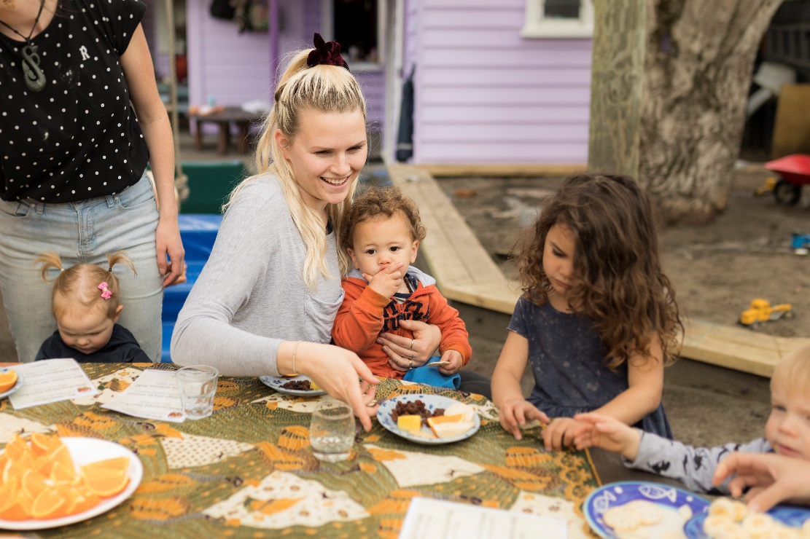
Important Relationships
Regional Funding Administrator
Enrolments Officer
Session Leaders/Coordinators/Duty Teams
Centre President/Coordinator
Centre Advisor

Slide 8
Resources on website and Facebook Group
Welcome to our Village Visitor Sheet with photo
Welcome to our Village Visitor Sheet without photo
Introduction to Playcentre Ppt presentation
There is currently no Facebook Group to support the Welcoming/New Families role – something to consider perhaps?

Slide 9
Karakia Whakamutunga
Koia kei runga
Koia kei raro
Koia kei waho
Koia kei roto
Ko te mauri ako
Ko te mauri ora
Kua tau, kua tau, kua tau e!
That which exists above
That which exists below
That which exists externally
That which exists internally
It is the essence of our learning
And teaching
It is the essence of our physical existence
Let it be at rest for now, let it be, let it be!

