Slide 1
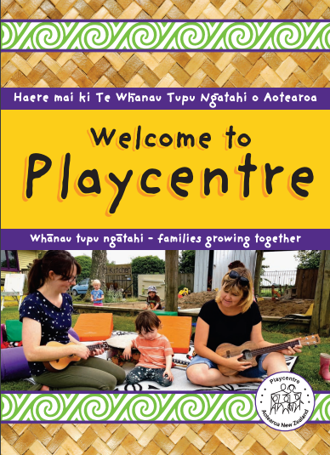
An introduction to Playcentre
These slides are to help leaders at Playcentre to facilitate a discussion for their new Playcentre members. The slides needs to be used alongside the Welcome to Playcentre: Finding your Feet booklet.
You can download a copy of the booklet here.
The booklet can be purchased from the Playcentre shop in Christchurch.
This discussion can be facilitated on session or off session in the evening. Small groups of 3-5 people are ideal. You could work together with neighbouring centres to facilate these discussions.

Slide 2
What’s your story?
Why did you join Playcentre?
Share your story. How did you hear about Playcentre? Why did you decide to join?
The good, the bad, the curious
What have your Playcentre experience been to date? What are you enjoying about Playcentre? What don’t you love? What don’t you yet understand?
Time to share your experience. No judgement.

Slide 3
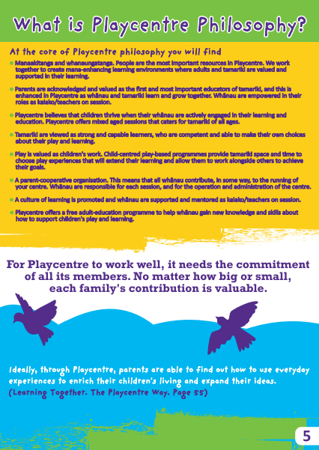
What’s Playcentre philosophy?
What did you learn about how Playcentre works?
Share your understanding of how things work at Playcentre to date? Compare notes with others in the group.
What’s the philosophy about?
Discuss the core ideas and the values behind each of these on page 5 of the Welcome to Playcentre booklet.

Slide 4
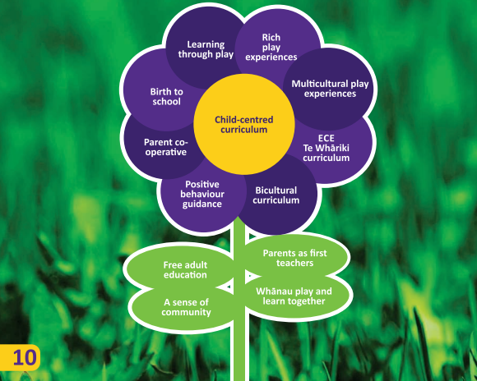
What’s Playcentre curriculum?
What is the Playcentre curriculum about?
Discuss the various aspects of the Playcentre curriculum as defined on page 10 of the Introduction to Playcentre: Finding your Feet booklet:
Learning through play – Play is children’s work. They make sense of their world through play, learn to communicate, practice motor skills, develop problem-solving skills.
Rich play experiences: Create rich learning environment.
Multicultural play experiences: Play experiences to make sense of the wider cultural world.
Te Whāriki: NZ ECE curriculicum.
Bicultural curriculum: Learn to participate in both worlds.
Positive behavior guidance: Social competence behavior is all learning – learning to be patient, regulate, include others and more.
Parent cooperative: Parents as kaiako – parents are first and most important teachers.
Birth to school: Playcentre experiences grow with your child.

Slide 5
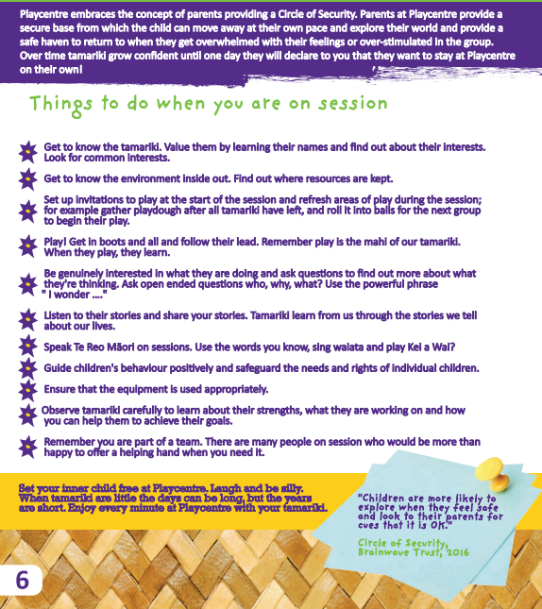
What’s your role on session?
Why did you join Playcentre?
Discuss the ways that you can get involved on session as on page 6 of the Welcome to Playcentre booklet? What have you already done? What might you try next time you are on session?
Let’s get going
Take a guided tour through the centre to familiarise yourself with the set up and equipment. Any questions about this?
In pairs set up an invitation to play to extend on an interest that tamariki on session have been exploring.

Slide 6
How much work is Playcentre?
What is expected from you at Playcentre?
Each Playcentre decides what the expectations are from their Playcentre members. The general wisdom is that each member should ‘give’ what they are comfortable to give at that time in their lives. At the core most parents would require parents to stay and play for at least one session a week. Beyond that most parents at Playcentre would participate in the Playcentre education programme and help to manage the centre. You can decide when the time is right for you to get more involved. Like any other community group, the more you put into Playcentre, the more you will get out of it.
Paying it forward
Paying it forward is about accepting the generosity of others when your children are little and they need more of your support, knowing that your time will come to support other parents when your children are a little older. See the next slide for what your contribution on session might look like.

Slide 7





What will be expected on session?
What will your contribution on session look like?
At first you will baby would want to stay close to you every waking moment at Playcentre. Enjoy the cuddles.
Once they’re mobile, they will want to start exploring. You’ll have your hands full. Other parents can help too!
When they master the art of walking, they will really be off exploring. Now you will have a bit more time to get to know others at Playcentre.
As they grow into an active toddler explore, they will become more and more independent and you will have more time to contribute on session.
Once they’re one of the big kids, Playcentre will be their place and they will play independently with their friends. You will now have the time to support other parents to learn about Playcentre.

Slide 8
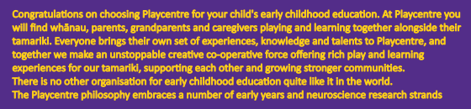
What’s your story?
Playcentre as a cooperative
Welcome to Playcentre: Find your Feet, page 1
What are your talents?
What knowledge, skills and talents do you bring to Playcentre and how can you use that to contribute to the organisation?

