Slide 1

An introduction to Playcentre
These slides can be used alongside the Welcome to Playcentre E-booklet which is available to view on our website. You can also order it free from the Playcentre Shop.
Whanaungatanga
Karakia, waiata, housekeeping, mihimihi/introductions.

Slide 2
What’s your story?
Why did you join Playcentre?
Share your story. How did you hear about Playcentre? Why did you decide to join?
The good, the bad, the curious
What have your Playcentre experiences been to date? What are you enjoying about Playcentre?
What don’t you love? What don’t you yet understand?
Time to share your experience. No judgement.

Slide 3

Playcentre philosophy?
What did you learn about how Playcentre works?
Share your understanding of how things work at Playcentre to date? Compare notes with others in the group.
What’s the philosophy about?
Discuss the core ideas and values behind the Playcentre philosophy.

Slide 4
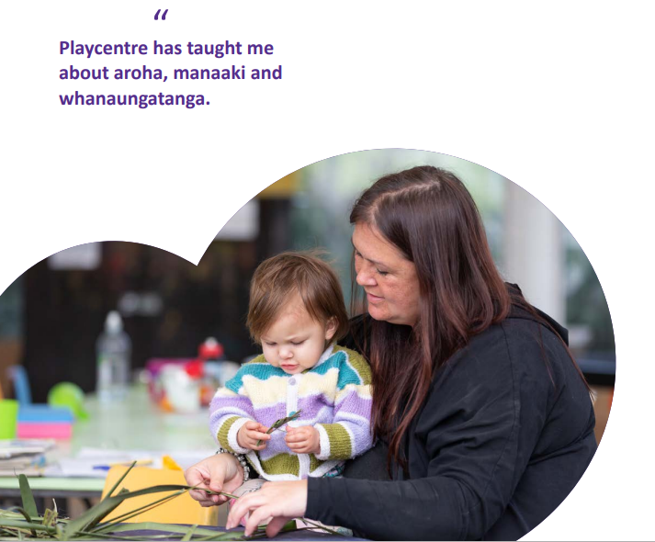
Bicultural commitment?
Our commitment
Playcentre Aotearoa made a commitment to The Treaty of Waitangi in 1989 and to the Te Tiriti o Waitangi in 1994 to ensure the sustainability of Te Ao Māori within the organisation.
What does this mean?
Share your understanding of what this means to Playcentre Aotearoa and what it looks like for your Centre.

Slide 5
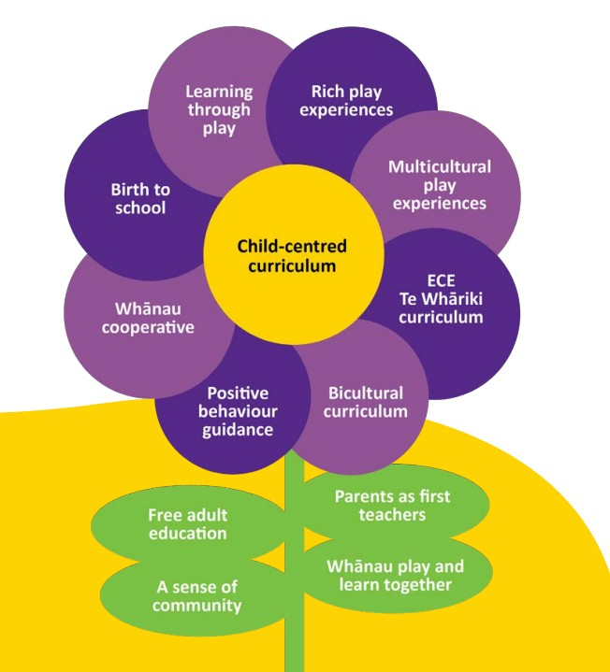
Playcentre curriculum?
What is the Playcentre curriculum about?
Discuss the various aspects of the Playcentre curriculum:
Learning through play – Play is children’s work. They make sense of their world through play, learn to communicate, practice motor skills, develop problem-solving skills.
Rich play experiences: Create rich learning environment.
Multicultural play experiences: Play experiences to make sense of the wider cultural world.
Te Whāriki: NZ ECE curriculum.
Bicultural curriculum: Learn to participate in both worlds.
Positive behavior guidance: Social competence behavior is all learning – learning to be patient, regulate, include others and more.
Whānau cooperative: Parents as kaiako – parents are first and most important teachers.
Birth to school: Playcentre experiences grow with your child.

Slide 6

What’s your role on session?
Getting involved
Discuss the ways that you can get involved on session? What have you already done? What might you try next time you are on session?
Let’s get going
Take a guided tour through the centre to familiarise yourself with the set up and equipment. Any questions about this?
In pairs set up an invitation to play to extend on an interest that tamariki on session have been exploring.

Slide 7
Expectations at Playcentre?
What is expected from you at Playcentre?
The general wisdom is that each member should ‘give’ what they are comfortable to give at that time in their lives. At the core we would expect parents to stay and play for at least one session a week. We encourage parents at Playcentre to participate in the Playcentre education programme and to have an active role in the curriculum and community of their Centre. You can decide when the time is right for you to get more involved. Like any other community group, the more you put into Playcentre, the more you will get out of it.
Paying it forward
Paying it forward is about accepting the generosity of others when your children are little and they need more of your support, knowing that your time will come to support other parents when your children are a little older. See the next slide for what your contribution on session might look like.

Slide 8





What will be expected on session?
What will your contribution on session look like?
At first your baby will want to stay close to you at Playcentre. Enjoy the cuddles!
Once they’re mobile, they will want to start exploring. You’ll have your hands full. Other parents can help too!
When they master the art of walking, they will really be off exploring. Now you will have a bit more time to get to know others at Playcentre.
As they grow into an active toddler and explore, they will become more and more independent and you will have more time to contribute on session.
Once they’re one of the big kids, Playcentre will be their place and they will play independently with their friends. You will now have the time to support other parents to learn about Playcentre.

Slide 9
Parent co-operative
Playcentre as a co-operative
Congratulations on choosing Playcentre for your child's early childhood education. At Playcentre you will find whānau, parents, grandparents and caregivers playing and learning together alongside their tamariki. Everyone brings their own set of experiences, knowledge and talents to Playcentre. Together we make an unstoppable creative co-operative force offering rich play and learning experiences for our tamariki, supporting each other and growing stronger communities. There is no other organisation for early childhood education quite like it in the world.
What are your talents?
What knowledge, skills and talents do you bring to Playcentre and how can you use them to contribute?

Slide 10
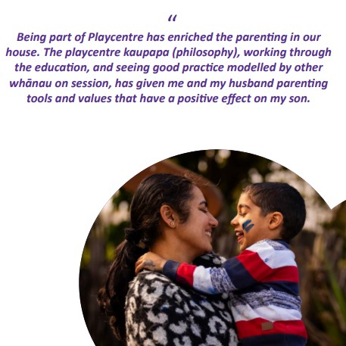
Playcentre Education
What adult education opportunities are available?
For those who would like to take their learning to the next step, Playcentre Education is an NZQA-accredited provider, offering the NZ Certificate in Early Childhood Education and Care (Level 4).
This qualification and the awards within it help parents grow their skills and strategies as parents.
Perhaps start with a play workshop.

Slide 11
Other topics for discussion
Being a licensed early childhood education (ECE) provider
Once your child turns three years old, they are eligible for 20 free hours ECE. You can split this between Playcentre and other ECE services.
Health and Safety – Share Choking Hazards document
Nappy Changing and Disposal Procedure
Sleeping Children Procedure
Child Protection Policy and Flow Chart
Guiding Principles Policy
Code of Conduct
Complaint Resolution Policy and Complaint Resolution Procedure

