Slide 1
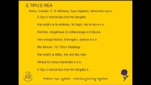
E TIPU E REA (A Mōteatea for Playcentre Aotearoa)
Kaea/Leader: E Te Whānau Tupu Ngātahi, kōrerohia mai e
E tipu e rea ka tipu koe hei tangata
Kia kotahi ai te whānau, te hapū, me te iwi e e e
Kimihia, rangahaua te mātauranga a ō tīpuna
Hei oranga tinana, hinengaro, wairua e e e
Me hōnore i Te Tiriti o Waitangi
Kia kotahi ai tātau, hei ara tika māu
Whaia tō mana motuhake e e e
E tipu e rea ka tipu koe hei tangata e.......

